Slide 1




Three Initiatives, One Goal:
Building an Age-Friendly Care Strategy
Part 6 of the CMS Hospital Measure Webinar Series
Monday, October 19, 2026
3–4 pm EST
Generously supported by:
Moderated by:
Danya Khoujah, MBBS, MEHP
Emergency Physician
AdventHealth
Tampa, Florida

Slide 2

The Initiatives
CMS Age-Friendly Hospital Measure
  Sets the national standard to ensure hospitals are consistently providing quality care for older adults.
IHI’s Age-Friendly 4Ms Framework
  Provides the foundation for age-friendly care that can be applied across the healthcare system.
ACEP’s GEDA Care Processes
  Provides ED-specific standards and tools to operationalize and track care performance.

Slide 3
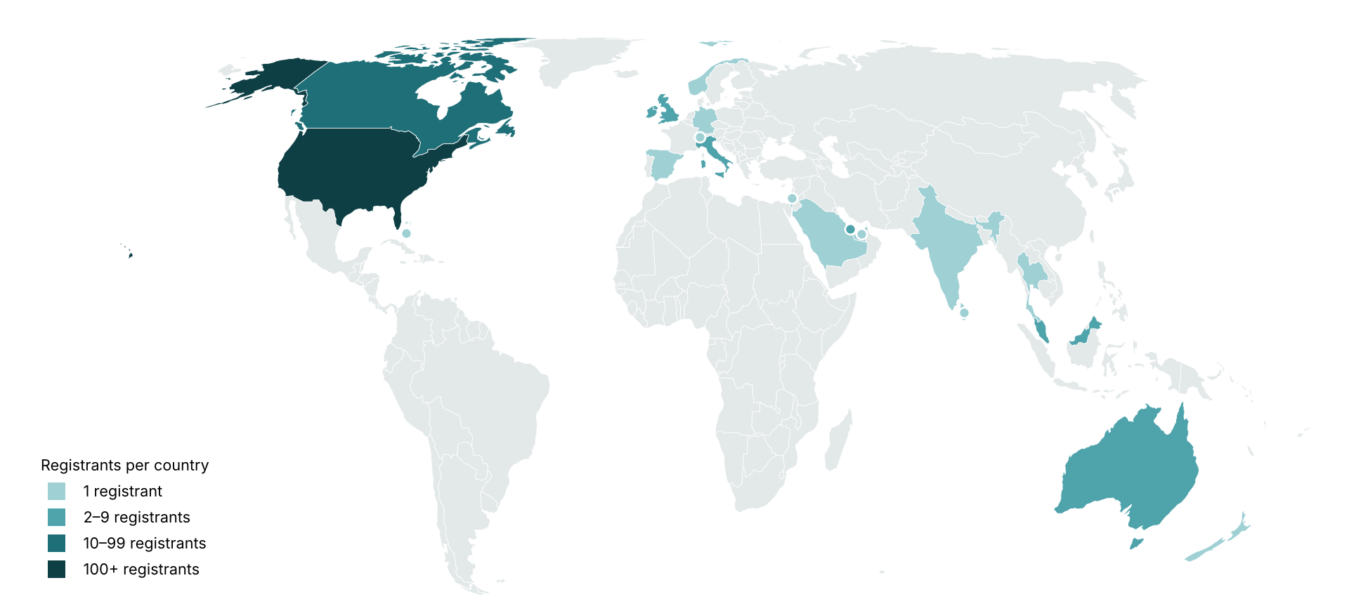
Global attendance joining us today:
United States
Canada
Ireland
Italy
United Kingdom
Australia
Malaysia
Qatar
Bahamas
Germany
India
Israel
New Zealand
Norway
Saudi Arabia
Spain
Sri Lanka
Switzerland
Thailand
United Arab Emirates
280 Registrants across 20 Countries

Slide 4
What is the biggest challenge of aligning your GED initiatives with your organization’s broader strategic and Age-Friendly initiatives (AFHS, CMS AF Measure, GEDA, etc.)?
Resource & capacity constraints
Organizational Leadership
Staffing shortages
Leadership support
ED crowding and boarding
Competing priorities
Workforce engagement & education
Performance Monitoring
Staff buy-in
EHR integration
Cultural change
Data infrastructure for reporting, dashboards, etc
Workflow integration
Implementation sustainability
Screening burden
Local needs
Assessment consolidation
Scaling initiatives

Slide 5

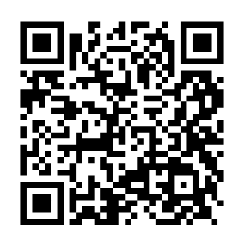
GEDC Free Membership
Free CME Courses & Education
Clinical Tools & Best Practices
Support for GEDA Accreditation
Track your Team’s Progress
Learn about ED Leadership Engagement
Gedcollaborative.com
Transforming Emergency Care for Older Adults
Resources
Implementation Toolkits
Online Learning Courses
Live & On-Demand Webinars
Podcasts
GED Blogs & Journal of Geriatric Emergency Medicine
Join the GEDC

Slide 6
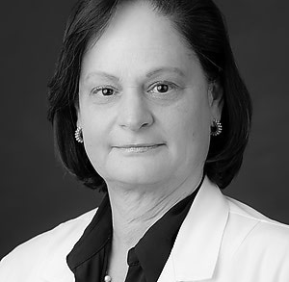
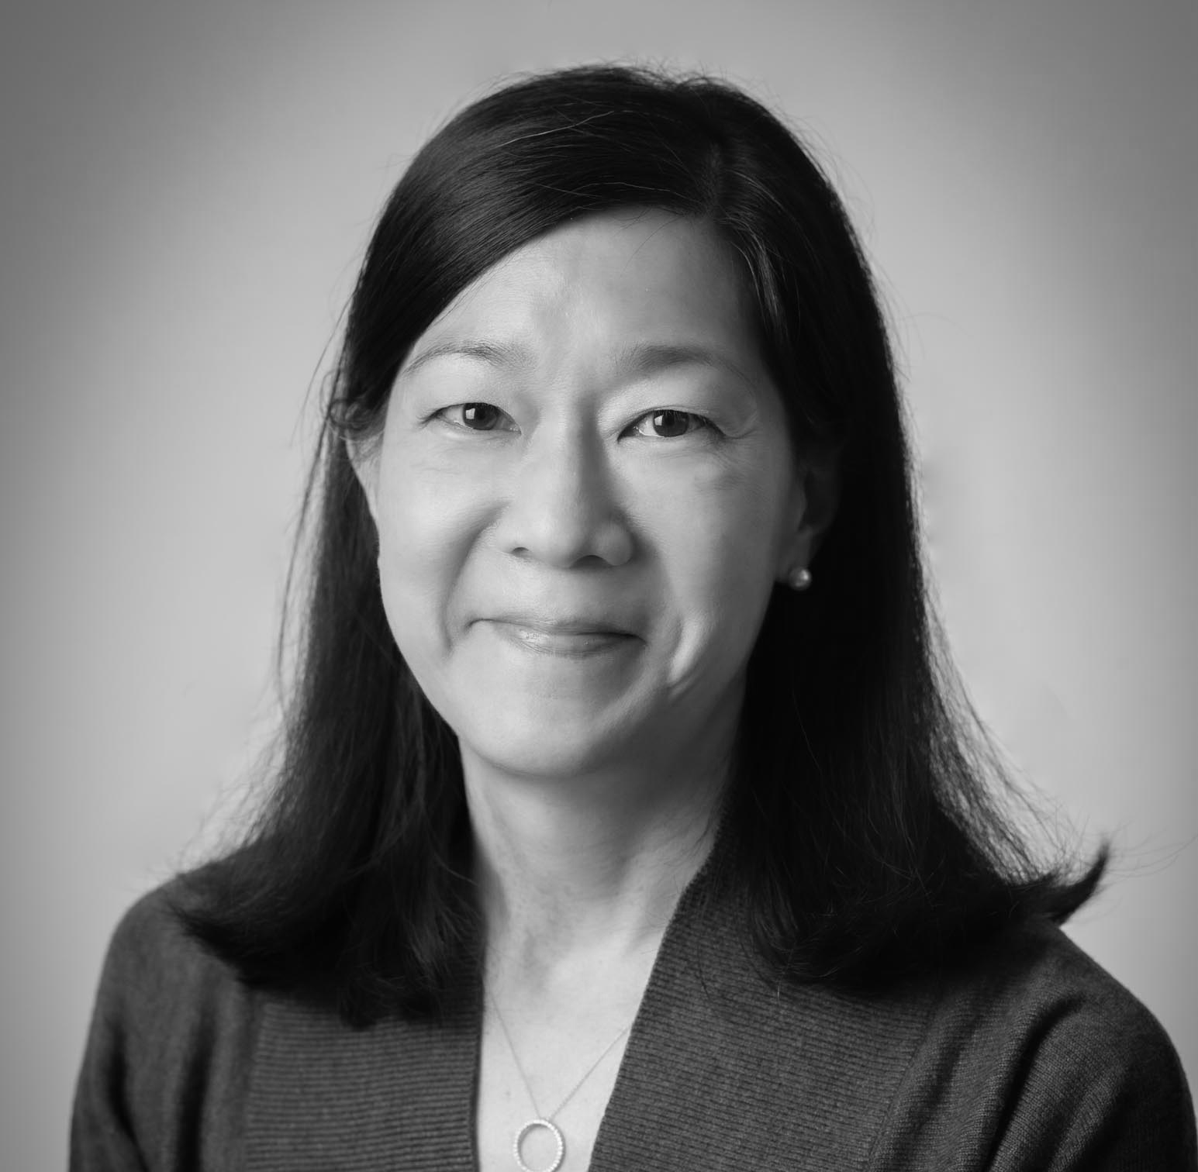
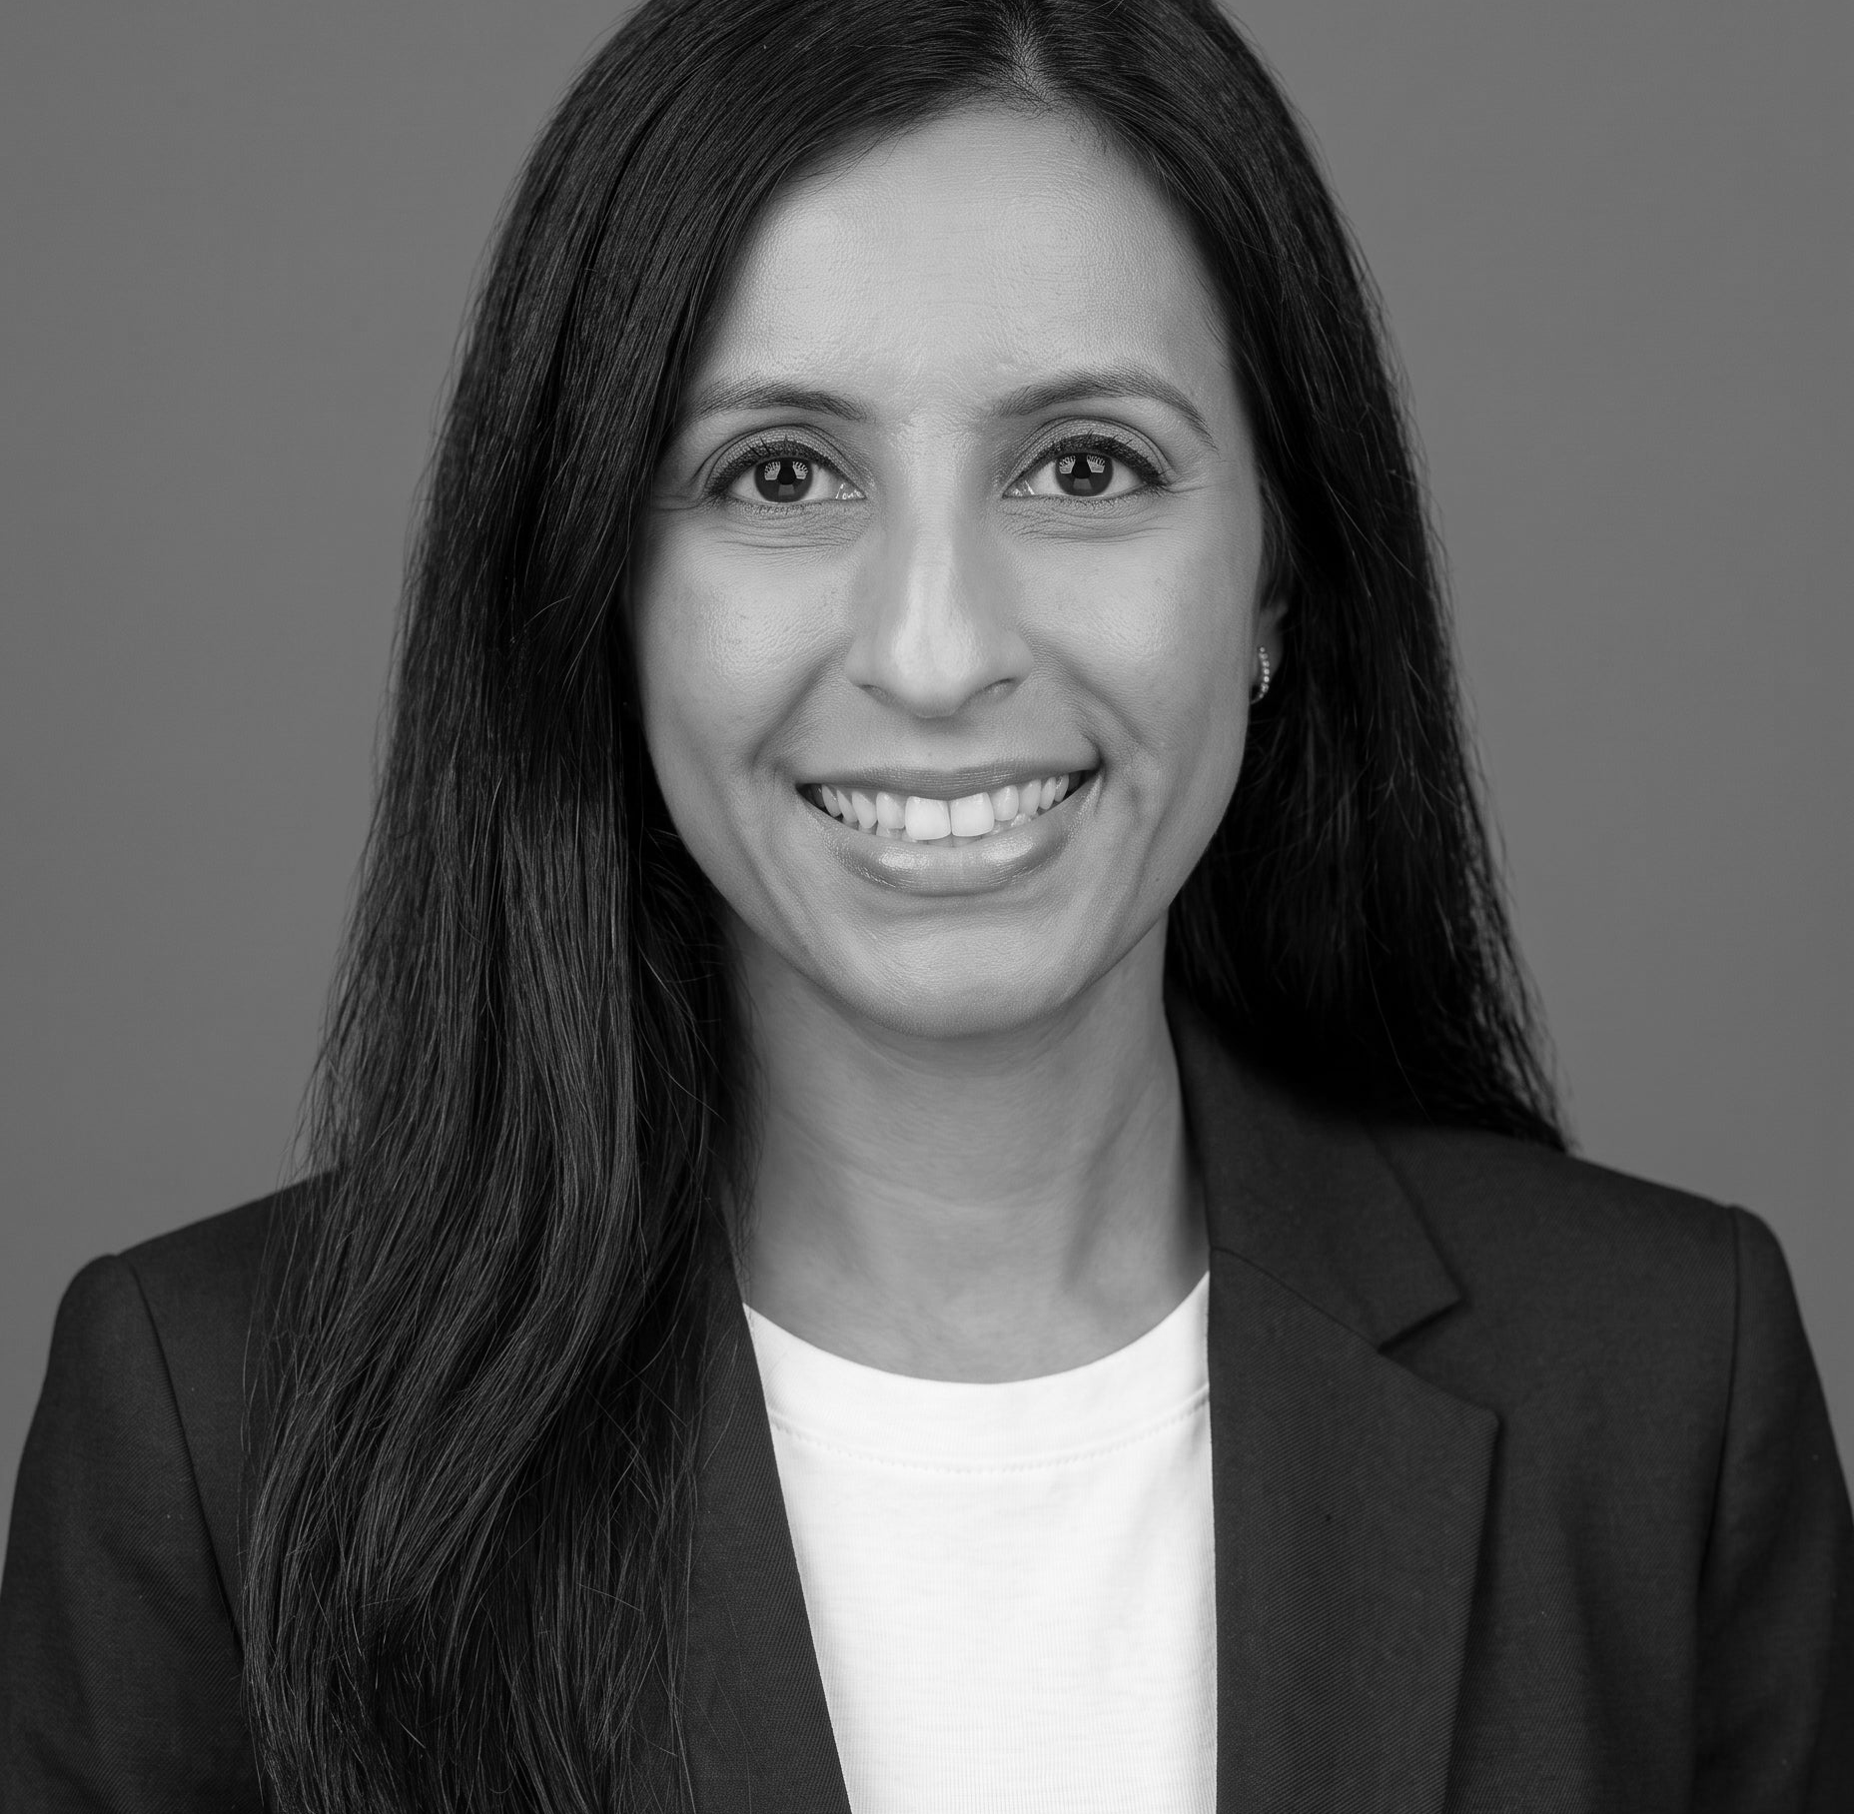
Meet Your Expert Panel
What questions do you have for our panelists?
Michele Bellantoni, MD
Associate Director, Post-Acute and Long-Term Care
Johns Hopkins Bayview Medical Center
Medical Director
Johns Hopkins Bayview Specialty Hospital Programs
Ula Hwang, MD, MPH, FACEP
Medical Director for Geriatric Emergency Medicine
Professor, Departments of Emergency Medicine and Population Health
NYU Langone Health;
Core Investigator, GRECC (Geriatrics Research, Education and Clinical Center)
James J. Peters Bronx VAMC
Payal Sud, MD, FACEP
Associate Chair, Emergency Medicine – North Shore University Hospital
Chief of Geriatric Emergency Medicine – Northwell Health
Medical Toxicologist – Northwell Health
Associate Professor of Emergency Medicine – Donald and Barbara Zucker School of Medicine at Hofstra/Northwell

Slide 7
Webinar Poll
How familiar are you with GEDA, IHI Age-Friendly, and the CMS Age-Friendly Measure?

Slide 8
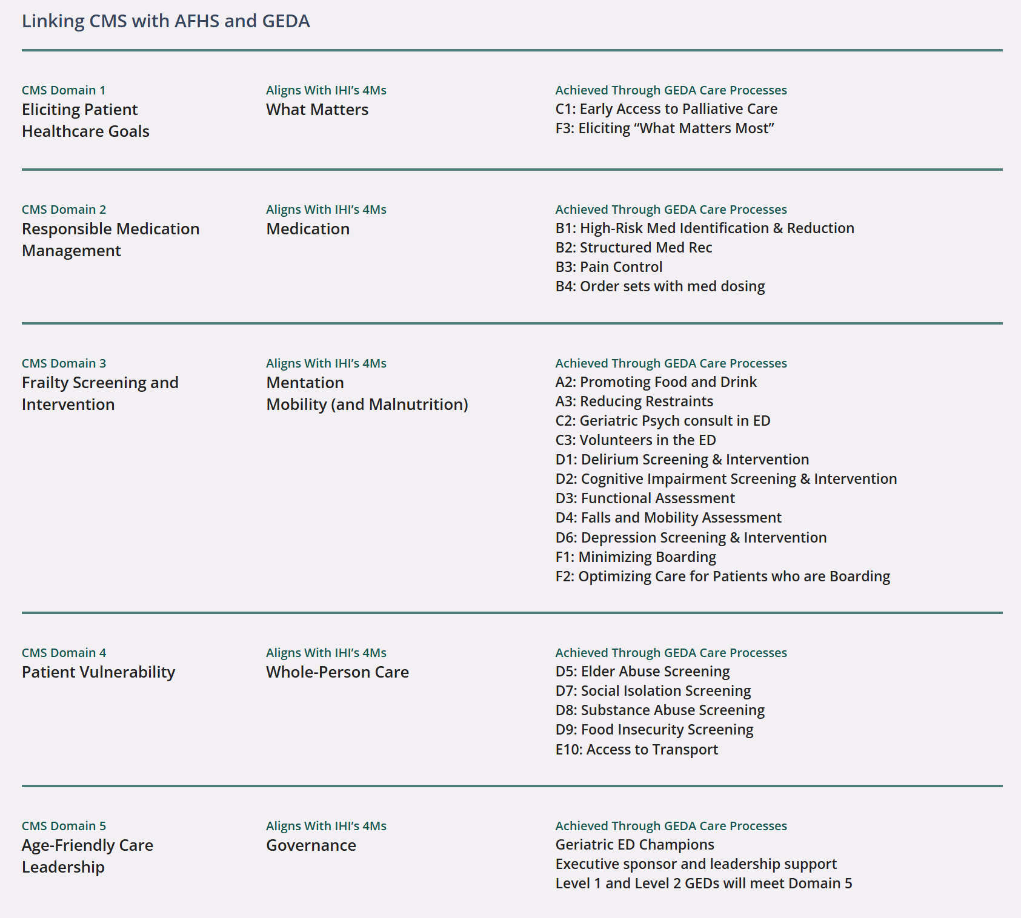
Making the Connections
CMS Domains | AFHS 4Ms | GEDA
GEDA helps us implement
The 4Ms help us organize clinical care
The CMS helps make age friendly care a health system priority

Slide 9
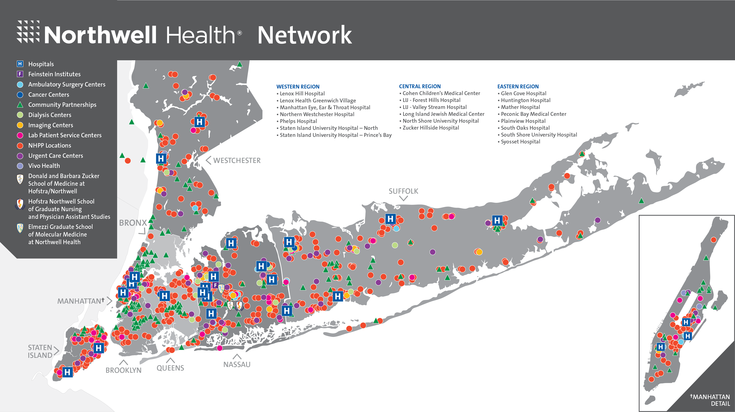
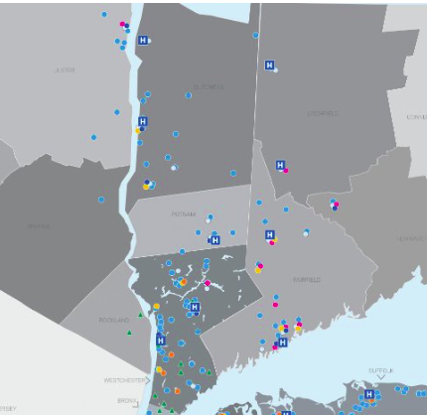
And Nuvance!
2
Level 3 GEDAs
2
1
14
17
Level 1 GEDAs
Level 2 GEDAs
Level 3 GEDAs*
Northwell
GEDAs**
*Two Level 3 EDs have applied for Level 2
**The 17 EDs represented here are inclusive of Northwell EDs that see adult patients
Notes:
Sarah

Slide 10
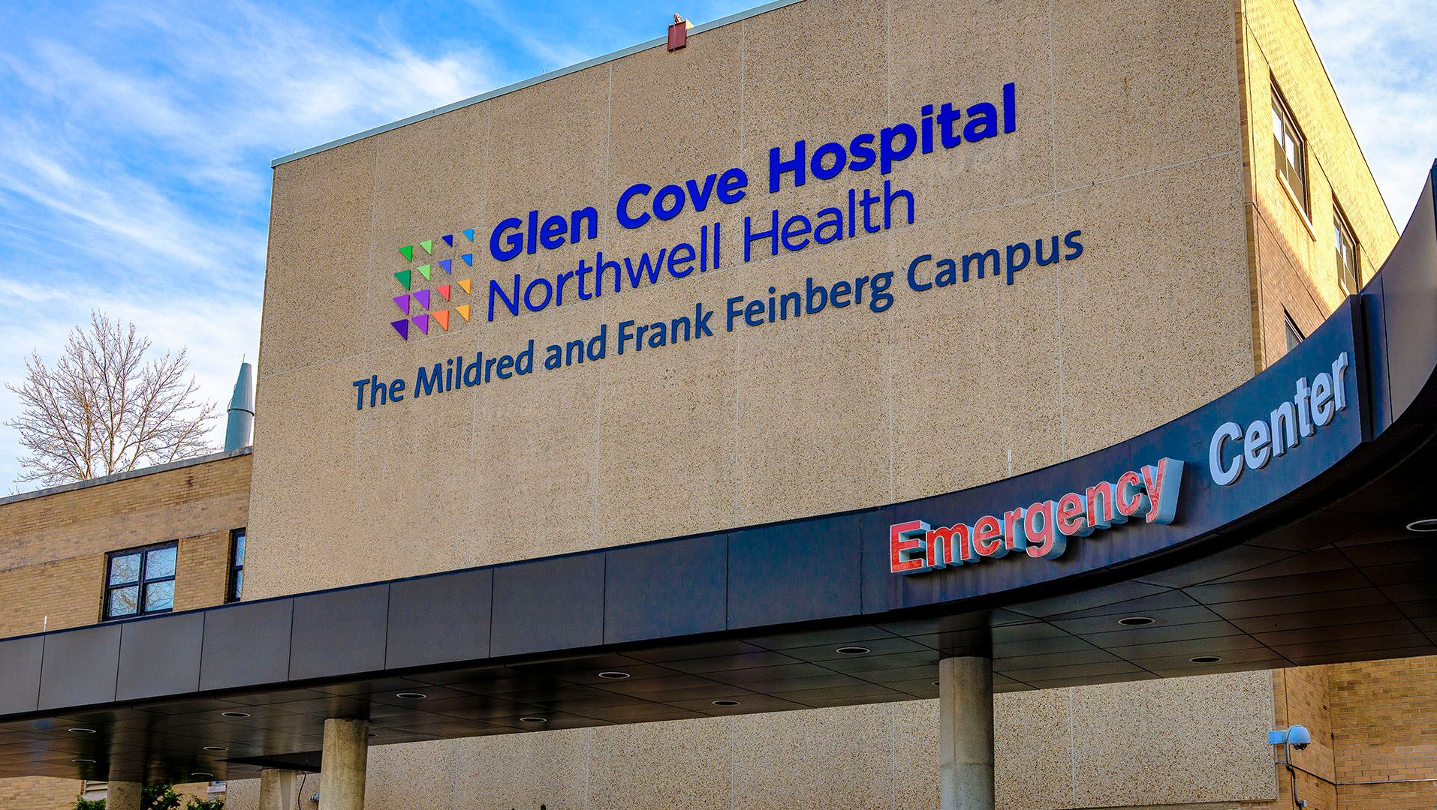

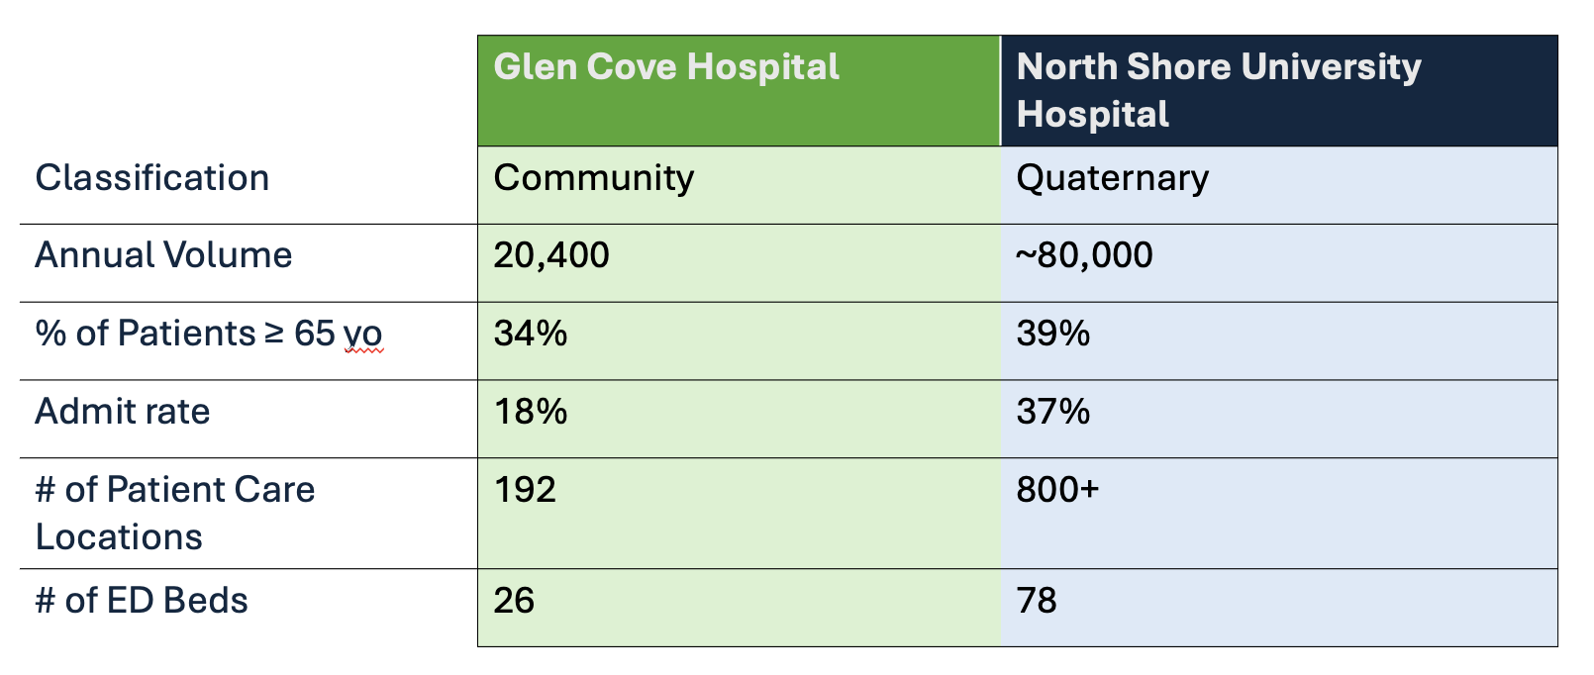



Slide 11
Implementation: Multi-Pronged Approach
Business Plan Group
Education Group
Research Group
ED/Hospice Partnership
ED/Palliative Partnership
Notes:
PAYAL

Slide 12
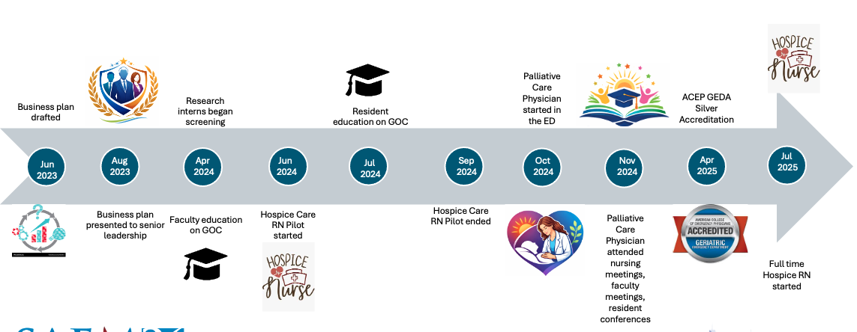
Implementation Timeline
Notes:
PAYAL

Slide 13

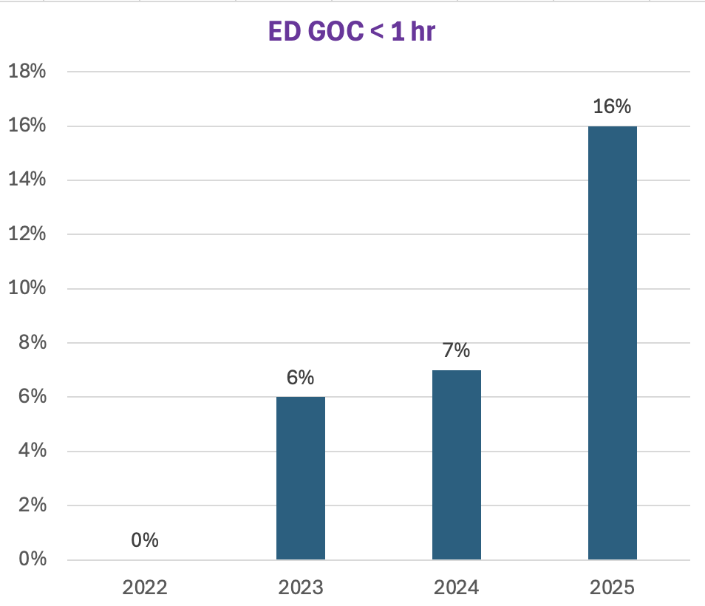
The Golden Hour

Slide 14
Ed-embedded Palliative Care
 | Control (Nov 22-Apr 23) (Cohort 1) | Education (Nov 23-Apr 24) (Cohort 2) | ED-Palliative (Nov 24-Apr 25) (Cohort 3)
LOS (days) | 8.67 | 7.72 | 6.87
 | Patients with GOC (Nov 24-Apr 25) | Patients with GOC + ED-Pall consult (Nov 24-Apr 25)
LOS (days) | 6.45 | 5.81
*patients from a propensity score matched subset of Cohort 3

Slide 15
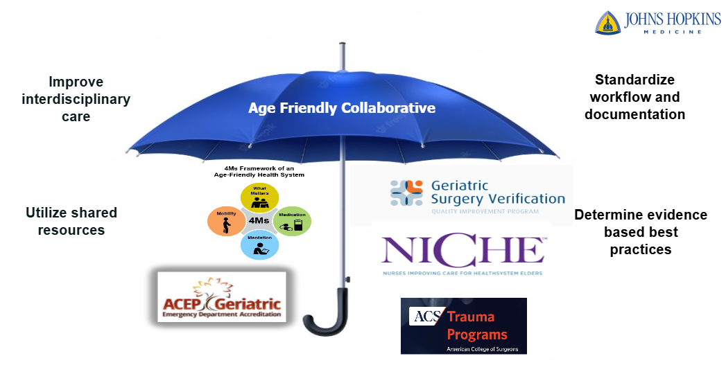

Slide 16
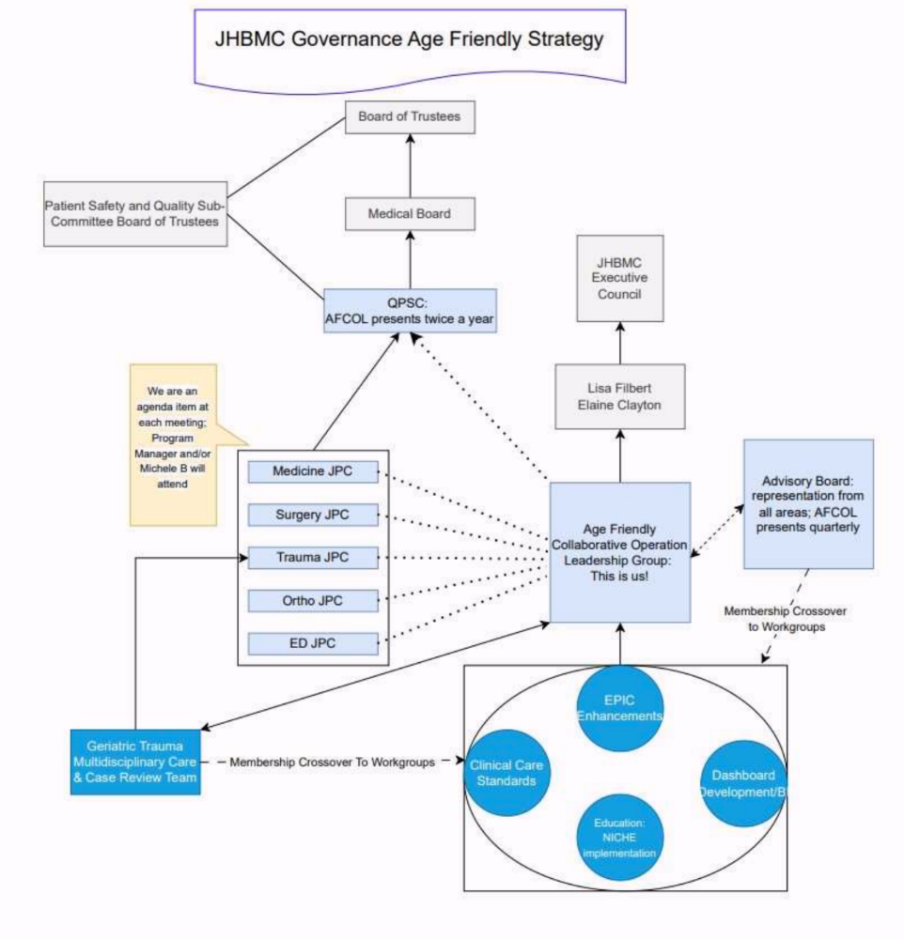

Slide 17

AGE FRIENDLY CARE
MILESTONES & RECOGNITION • 2015–2027
✦
✓
↗
PROGRAM ORIGINS
VERIFICATION & EVIDENCE
CURRENT & NEXT MILESTONES
2015
2017
2018
2022
• Initial Geriatric Multidisciplinary Conference call
• Geriatric Surgery Verification Alpha Pilot; helped develop verification standards
• NICHE Leadership Training completed at JHBMC
• IHI Age Friendly Level I Verified; Age Friendly Collaborative created
• August: NICHE member recognition and bedside nursing enrollment began
• GEDA Level III Verified
• Enrolled in the ACS Geriatric Pilot
• Hosted Geriatric Surgery Symposium at JHBMC
• Published initial positive impact of Age Friendly work
• Published cost-savings impact of Age Friendly work
2025
2026
2027
• February: JHM Age Friendly / NICHE Regional Conference
• NICHE Senior Friendly level
• Compliance with CMS Age Friendly IP Reporting Measures
• Continued expansion of the 4Ms across all phases of care to include ambulatory
• GEDA Level II re-verification
• April: GSV Age Friendly Verified
• CMS announced Age Friendly reporting requirements
• IHI Age Friendly Level II Verified
● COLLABORATION
◆ VERIFICATION
✦ EVIDENCE & IMPACT

Slide 18
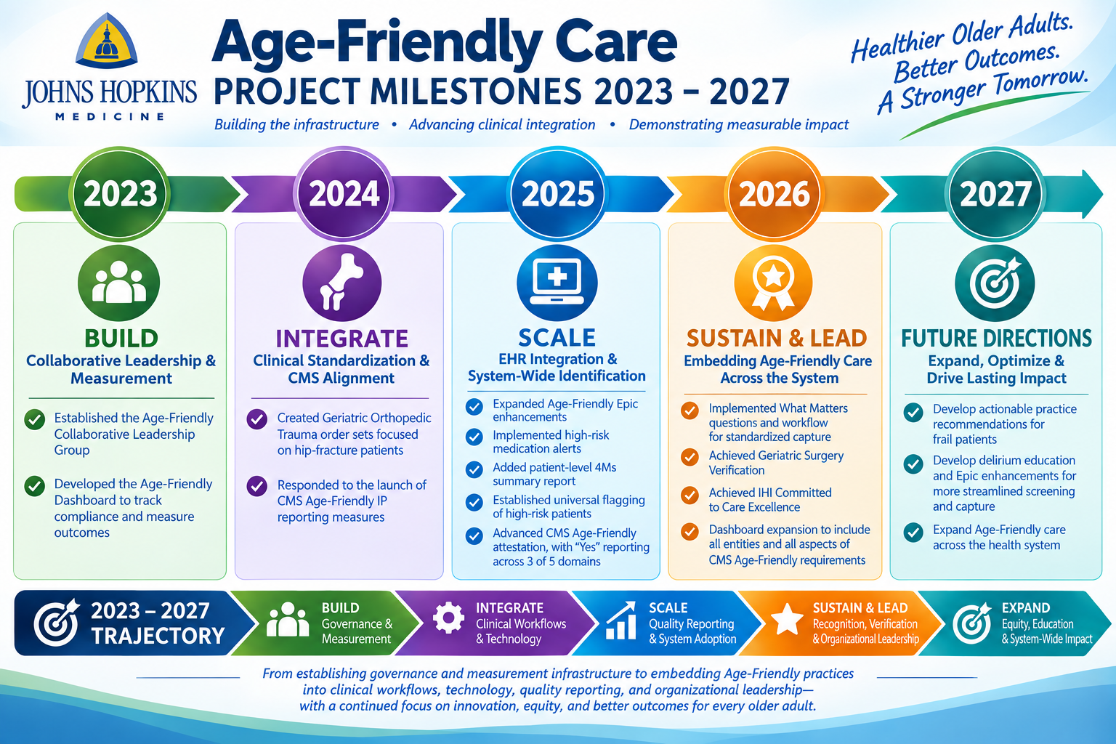
A3: Age Friendly Dashboard

Slide 19
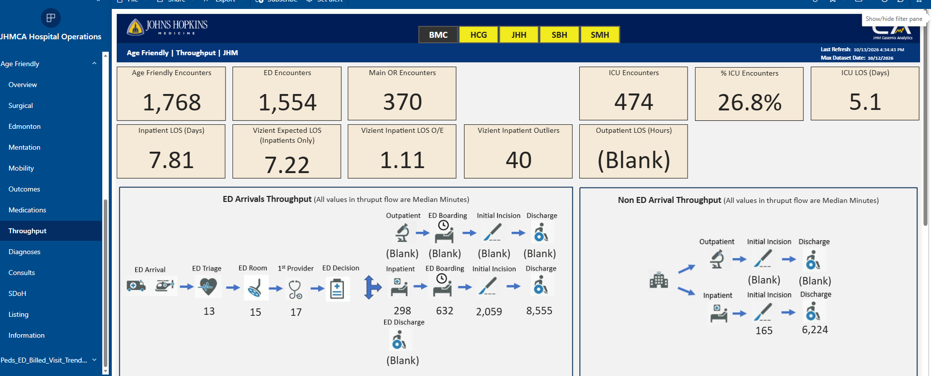

Slide 20
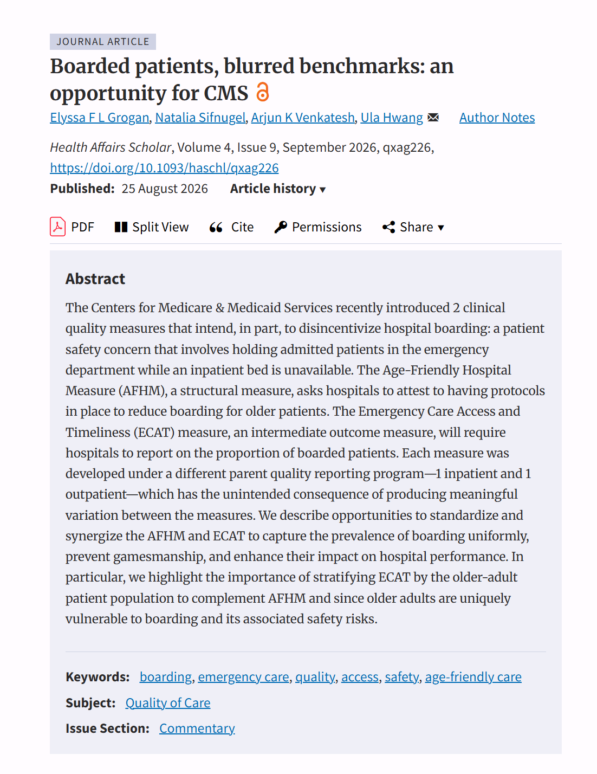
Key takeaways
Boarding is a persistent problem: Patients admitted from the ED routinely face boarding, harming both quality of care and access.
CMS has two measures that partly address it: The Age-Friendly Hospital Measure and the Emergency Care Access and Timeliness Measure.
CMS should better align them: Tie both to performance-based payment, standardize the definition of boarding and its harm threshold, and require reporting stratified for older adults.
CMS should stratify measures by older age: The prolonged stays and boarding times disproportionately impact older adults more than younger patient.

Slide 21
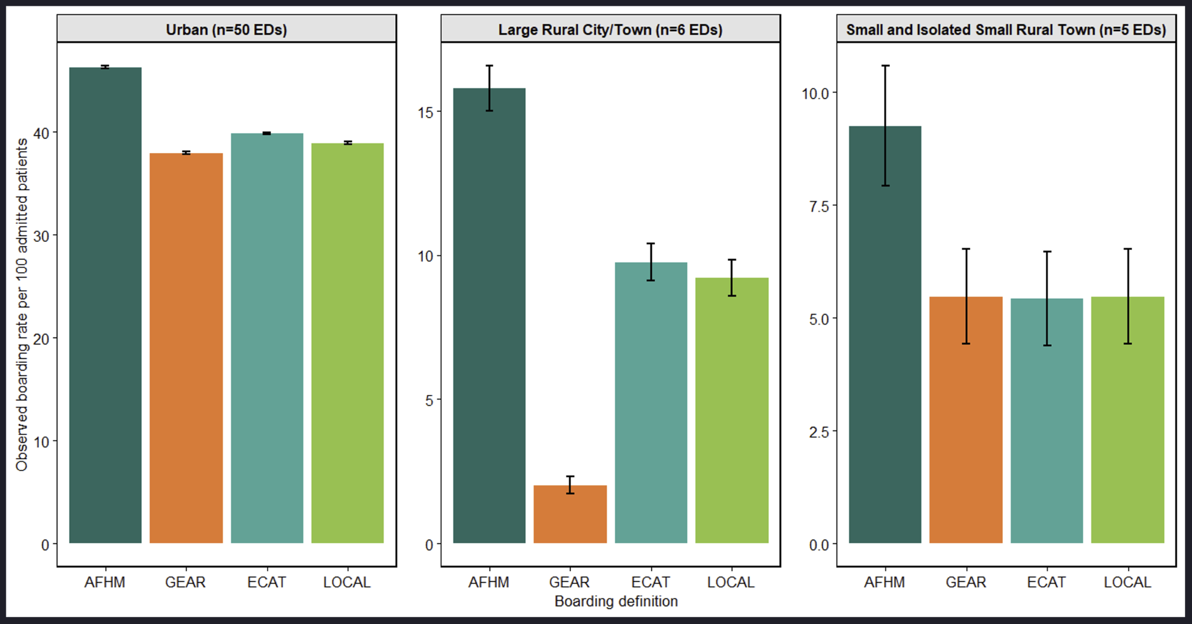
PRELIMINARY DATA

Slide 22
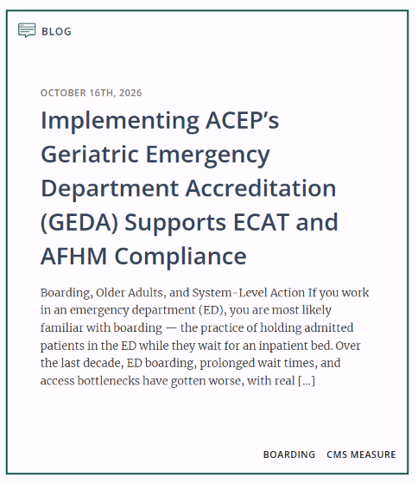
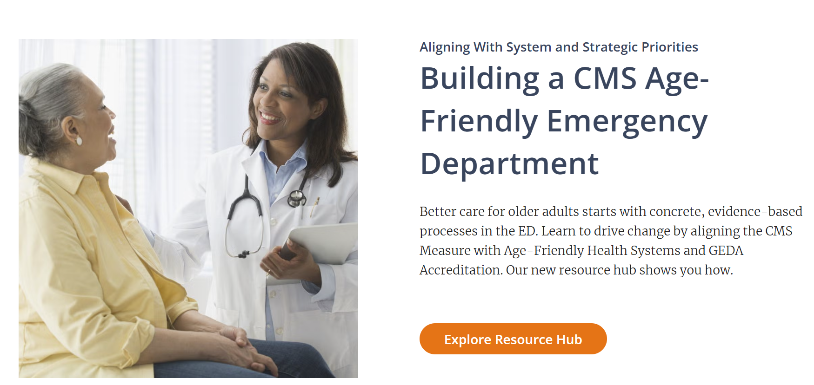
New Resource: ECAT
New Resource: Aligning Priorities

Slide 23

Q & A
Ask your questions
in the chat!
We will try to get to everyone

Slide 24
Generously supported by

