Slide 1
Best Practice Accelerator
Community
for the BRAIN Initiative
September 30, 2026 | 12-1pm ET
Improving care for older adults with dementia and delirium in emergency and inpatient settings.
Geriatric Emergency Department Collaborative | West Health | Alzheimer's Association

Slide 2
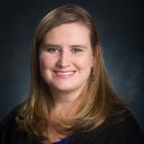
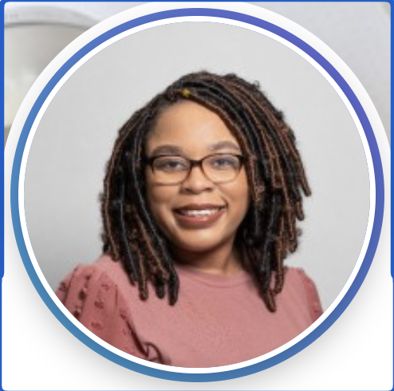
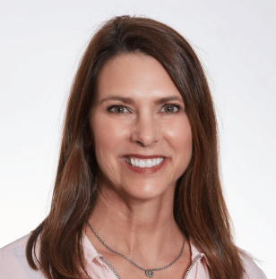
Agenda
Best Practice Accelerator Community | September 30, 2026 | 12-1pm ET
Run of show
Featured speakers from UAB
1
Introduction
Christina Shenvi
Emily Simmons
MSN, RN, CNL, CPAFH
Director of Program Development
Welcome
2
Education & QI Strategies
Emily Simmons, UAB
Presentation
Jada Finley
DNP, RN, AGCNS-BC
Program Development Manager
3
Facilitated Discussion
Moderated by Christina Shenvi
Discussion
4
Delirium Prevention & Screening
Jada Finley and Terri Middlebrooks, UAB
Presentation
Terri Middlebrooks
MSHQS, RN
Program Development Manager
5
Facilitated Discussion and Wrap-Up
Moderated by Christina Shenvi
Discussion

Slide 3
The BRAIN Initiative
The tools exist. The bright spots exist. Most hospitals just don't have a clear path to implementation.
Identify
Hospitals already achieving strong outcomes in dementia and delirium care.
Synthesize
The evidence, models, and practices that drive real, measurable results.
Package
Practical, plug-and-play tools that lower the activation barrier for change.
Scale: 50 hospitals in Year 1 | 100 in Year 2 | 200 in Year 3
Today, you will hear directly from one of those bright spots.

Slide 4
UAB Present

Slide 5

From Education to Practice: Our Approach to Delirium Prevention and Screening
UAB Hospital
Emily Simmons, MSN, RN, CNL, CPAFH
Jada Finley DNP, RN, AGCNS-BC
Terri Middlebrooks, MSHQS, RN
Notes:
BEFORE USING THIS TEMPLATE:
Before using this template, follow the steps below to be sure images do not automatically compress upon saving:
Go to FILE > OPTIONS > ADVANCED and check the box that says "Do Not Compress Images in File"
TO CHANGE THE FOOTER ACROSS ALL SLIDES AT ONCE: You can change the name of your department, unit, division, etc. in the footer.
Choose a slide that shows the default footer (usually any slide except the title slide)
Click on INSERT in the top menu then click on HEADER & FOOTER
Replace the default footer text with your new text
Click “Apply to All”

Slide 6
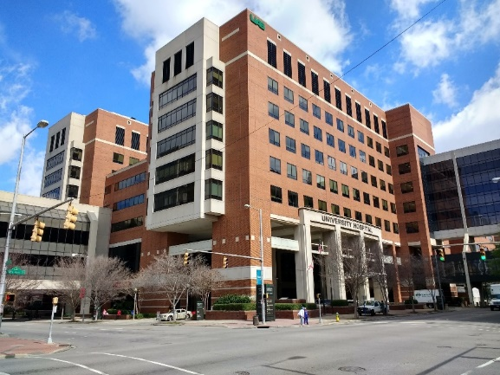

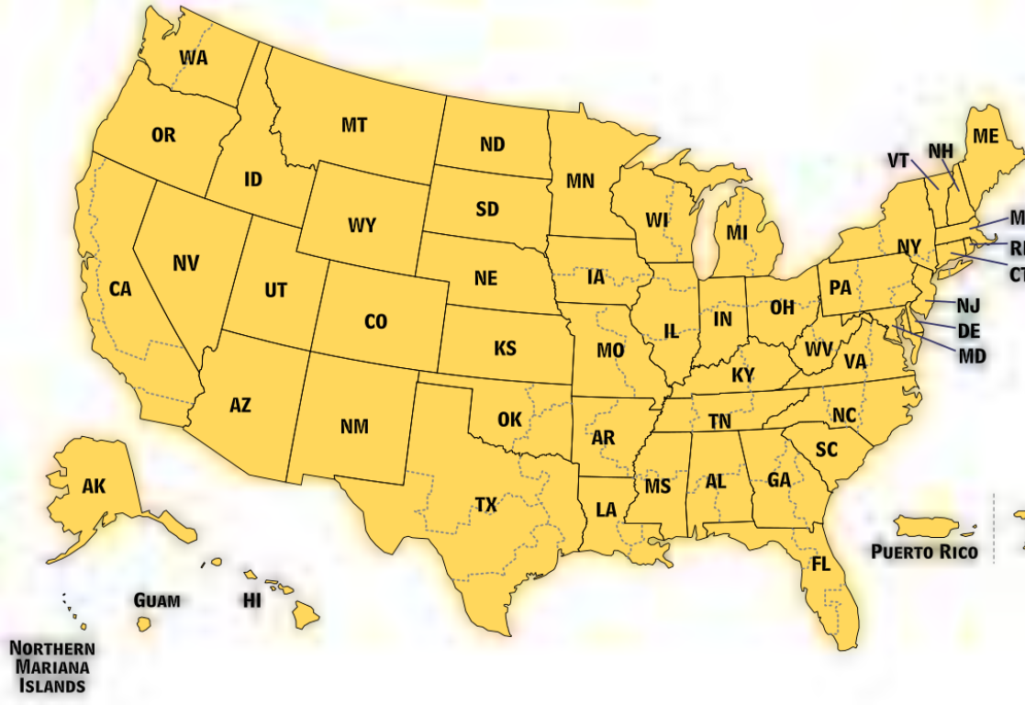




UAB Hospital
1,224+ beds
Medical staff: 1,650+ | Nursing Staff: 4,200+ | Technical & Support Staff: 1,200+
ACE Unit since 2008
  Joint Commission Recognized Best Practice
Magnet designated since 2002 (6-time designation)
  UAB’s Geriatric Scholar Program Recognized by Magnet as an Exemplar Program
NICHE Hospital since 2008 and Exemplar Status since 2014
Age-Friendly Health System Committed to Care Excellence since 2019
Geriatric ED Level 1 Accreditation at UAB-Highlands since 2021
Birmingham, AL

Slide 7
Delirium Education and QI Strategies

Slide 8
Delirium Education Content
Why
  All education starts with why delirium assessment, prevention, and management is important
How
  Location of the assessment is important
  Increased compliance with completing NuDESC when moved to standard charting workflow
What
  Education includes screening, prevention strategies, when to notify physician and healthcare team, and management strategies
When
  Delirium assessments are part of standard documentation for all adult patients
Why
How
What
When

Slide 9
Mentation Education Strategies
Orientation
Included in nursing staff orientation
1 hour presentation on Age-Friendly 4Ms
Geriatric Scholar Program
1- or 2-year program
Age-Friendly 4Ms Education
Age-Friendly Workshop
3-hour workshop
Age-Friendly 4Ms Content
Unit Level Education
3 modules in 15-minute sessions
Focused on one of 4Ms; example: Delirium
Scholars educate peers

Slide 10
Geriatric Scholar Program

Slide 11
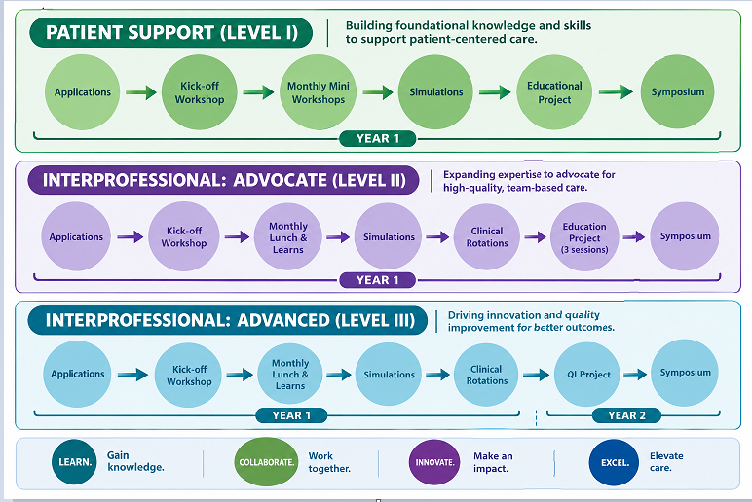

Geriatric Scholar Program
The Geriatric Scholar Program’s purpose is to bring together staff who are passionate about improving care for older adults and equip them with the knowledge, skills, and confidence to become change agents within their sphere of influence.

Slide 12
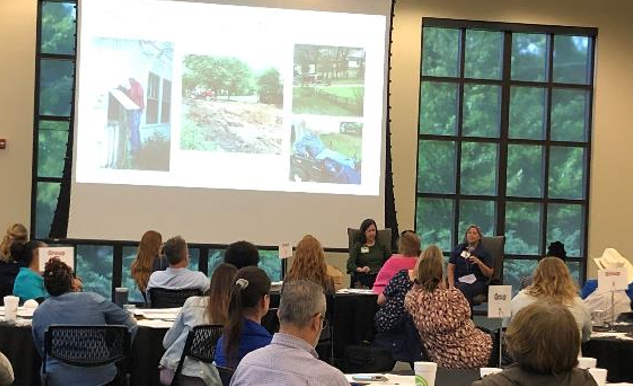
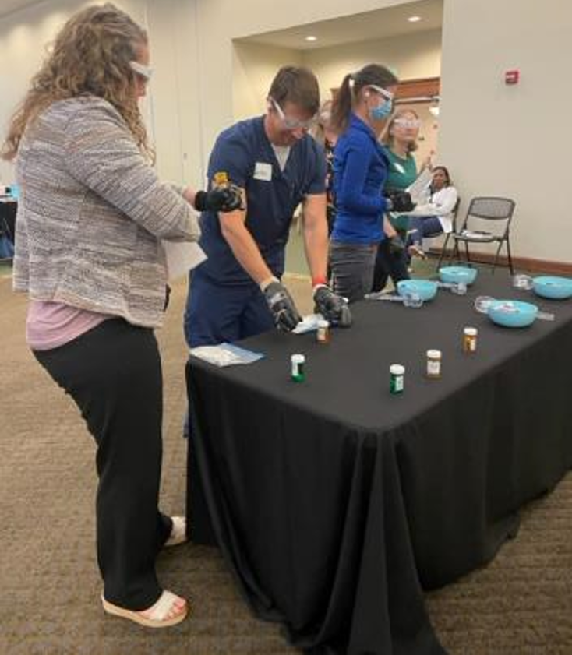
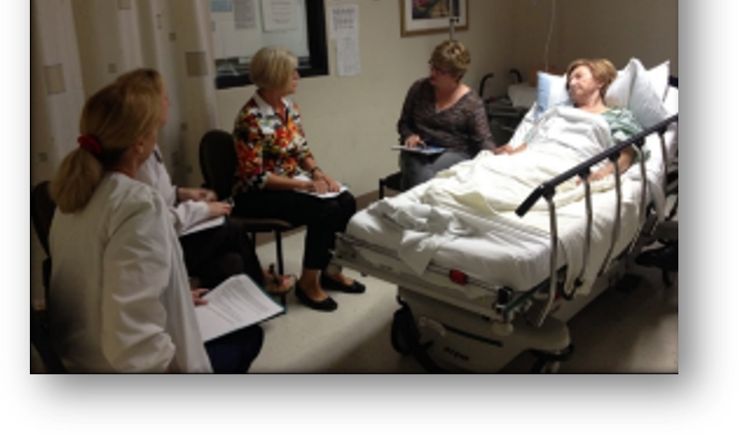
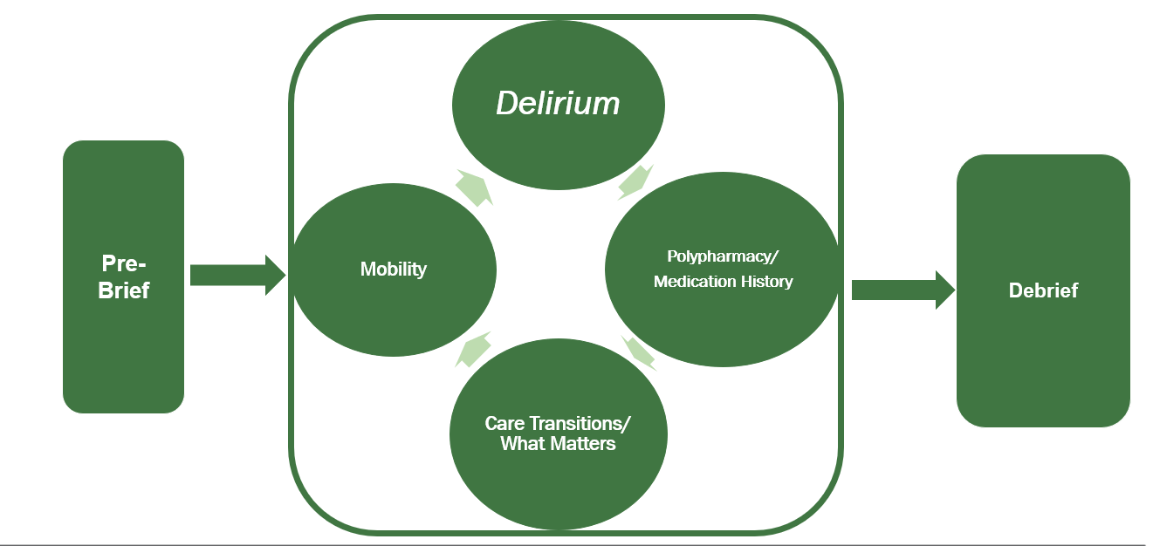
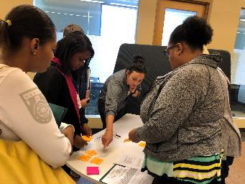
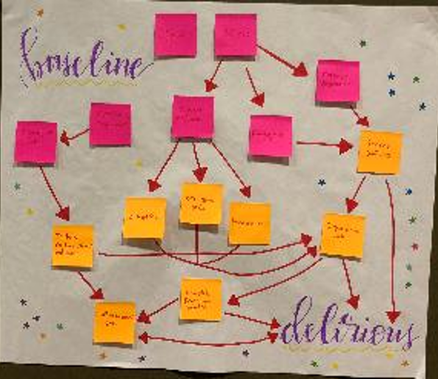
Geriatric Scholar Program Delirium Curriculum
Patient & Family Stories
Simulations
Sensory Activity
Delirium Case Studies & Concept Mapping

Slide 13
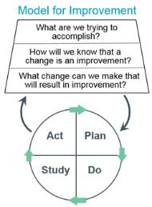
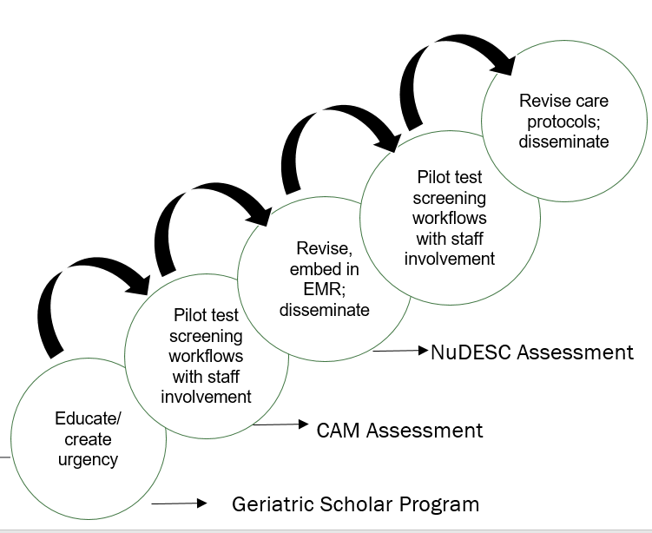
Geriatric Scholar Program: Quality Improvement Projects
Year 2: Quality Improvement-
Owning & Driving Change
Age-Friendly Standardized Screens in EHR:
IHI Improvement Model:
Plan-Do-Study-Act
On Admission | Each Shift | Every 3 Days
John Hopkins Mobility baseline | John Hopkins Mobility goals and score | Katz ADLs reassessment
Katz ADLs: baseline & current | Delirium screening: NuDESC or CAM-ICU
Cognitive screening: Six-Item Screener | Delirium Prevention
Notes:
Break a Big Goal into several smaller goals
Frequent Small Changes
Celebrate success at each step!!
DARE TO THINK SMALL!!

Slide 14
Age-Friendly Bootcamps

Slide 15
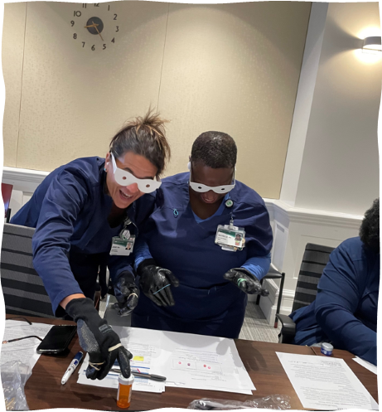
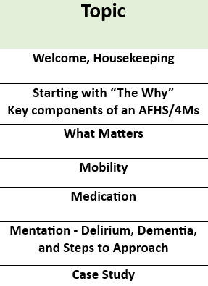
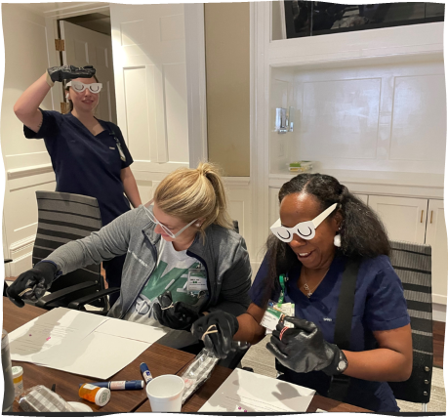
UAB’s Age-Friendly Journey:
Age-Friendly Bootcamp
Structure
Designed Age-Friendly training session that includes the 4Ms Framework of Age-Friendly Healthcare
3.5 hour sessions
Targeted Staff
  All Disciplines (Inpatient & Outpatient)
Marketing
  Internal webpage, email, word of mouth, leadership meetings

Slide 16
Unit-Level Delirium Education Strategies

Slide 17
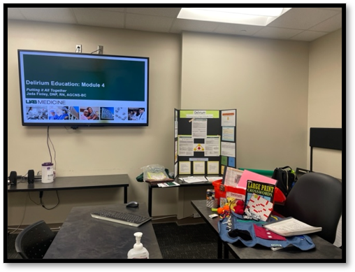
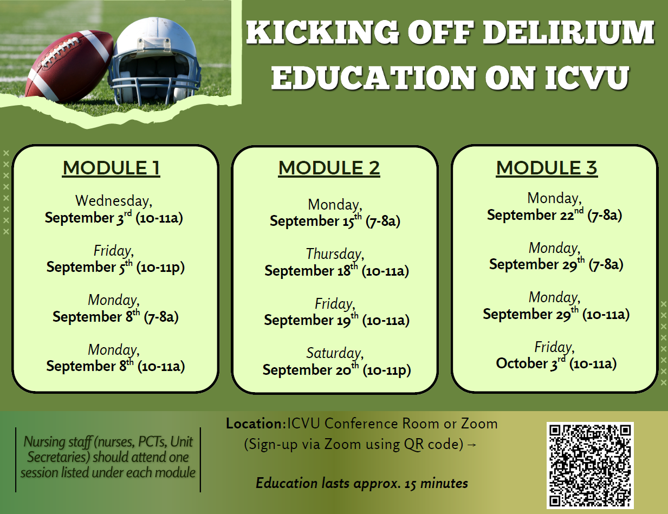
Unit-Level Delirium Education: Model
Structure
3 Training Modules
1 module delivered over 2 weeks
Session Breakdown
Total of 60 minutes
(15-20 min increments)
1 module covered
(repeated 2-3 times)
Key Aspects
Location: Unit Conference Room
Unit leadership presence required
Staff attend when convenient during the 60- min session
Notes:
Graphic: https://www.freepik.com/vectors/conference-room

Slide 18
Unit-Level Delirium Education: Curriculum
General Structure (15 mins):
Presentation: 7 minutes
Activity: 5 minutes
Debrief: 3 minutes
Module 1 | Module 2 | Module 3
Age-Related Changes and Delirium Basics (interactive / didactic) | Screenings, Communication, and Delirium Prevention/Management Strategies (interactive / skills-based) | Putting it All Together (interactive / case-based)
Focused on: Age-related changes affecting communication (hearing, vision) Common causes of confusion in older adults (dementia, delirium, acute illness, environment) Understanding delirium and its risk factors Importance of delirium prevention Activity + Debrief: Vision blurring and hearing loss | Focused on: Delirium & cognitive impairment screenings Distinguishing between delirium from dementia Delirium prevention, management & communication strategies Tools: ACE Tracker (Risk Factors) Activity + Debrief: Videos (depicting communication challenges) | Focused on: Activity: Case study STOP DELIRIUM Protocol Engaging the family Collaborating with the interprofessional team Reflections Complete retrospective survey (~15 questions)

Slide 19
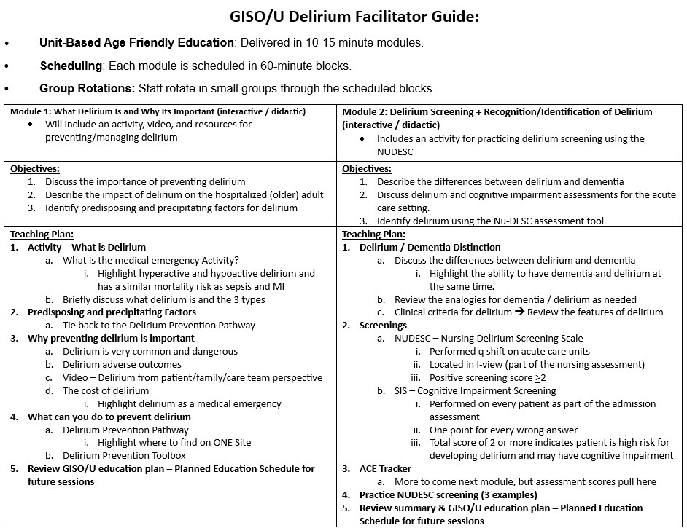
Unit-Level Delirium Education: Facilitator Guide
Components:
Module #
Teaching Plan
Objectives
Notes:
The training was designed to be a train-to-trainer module, allowing staff to share the information with others.

Slide 20
Unit-Level Delirium Education: Key Points
Key Takeaways
Unit-Based Learning Enhances Access
Leadership Presence is Crucial
Rounding & Coaching Reinforces Practice
Supports Age-Friendly Health System Goals
Challenges & Considerations
Requires coordination and buy-in from leadership
Scheduling flexibility is key to accommodate varying shift patterns
Ongoing reinforcement may be needed to sustain gains

Slide 21
Discussion topics: Education and QI
Scholars
Geriatric Scholar Program: trains staff to lead change on their units through patient and family stories, case studies, sensory activities, and simulation. Scholars run QI projects such as standardized Age-Friendly screens in the EHR.
Bootcamps
Age-Friendly Bootcamps: 3.5-hour sessions on the 4Ms Framework, open to all disciplines in inpatient and outpatient settings, promoted through the intranet, email, word of mouth, and leadership meetings.
Unit Level
Unit-level delirium education: three 15-minute modules taught on the unit (7-minute presentation, 5-minute activity, 3-minute debrief), moving from delirium basics to screening and prevention to a case built on the STOP DELIRIUM protocol.

Slide 22
Discussion points
Keys to successful change
Start all education with why delirium prevention matters
Build change agents through the Geriatric Scholar Program
Keep unit-level teaching short and interactive
Reach all disciplines with Age-Friendly Bootcamps
Discussion Questions
How do you train nurses and other staff on delirium now?
What would it take to protect staff time for education like this?
Who on your units could serve as change agents?
What barriers have you faced, and what tools would help?
Questions for the UAB team?

Slide 23
UAB Present

Slide 24
Screening Protocols

Slide 25
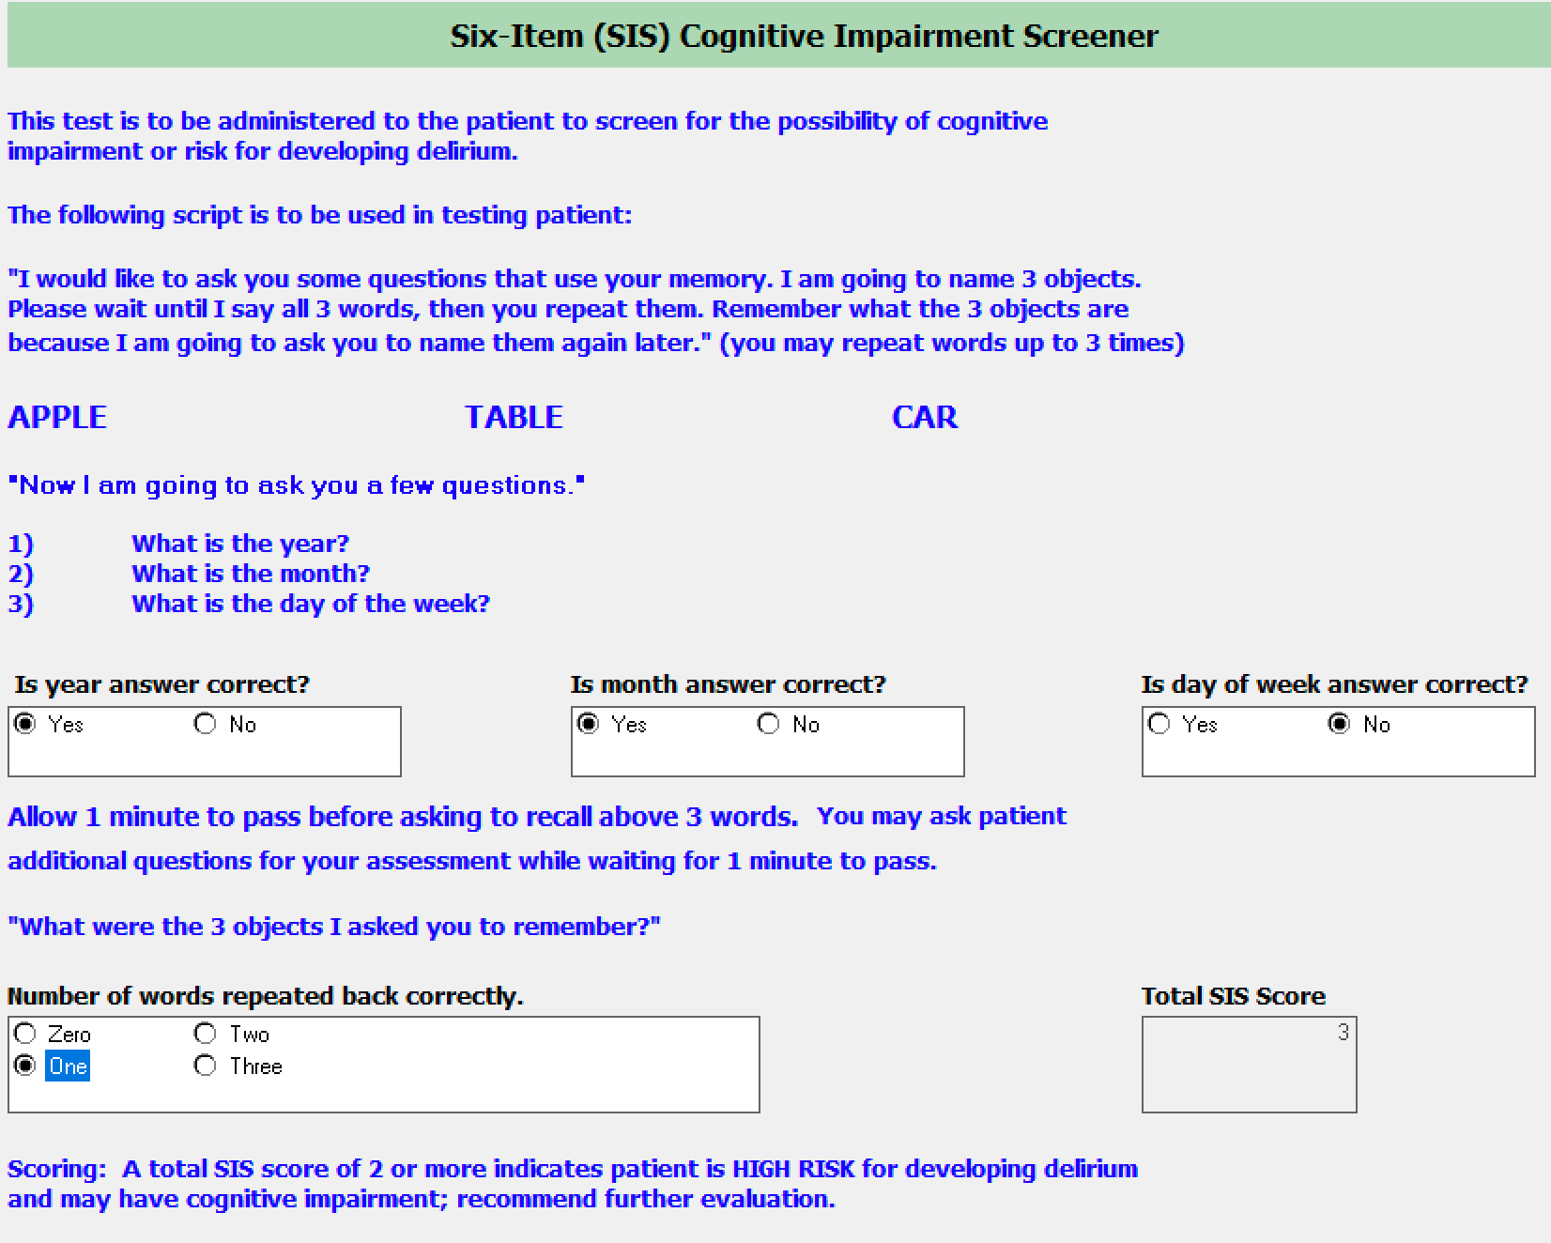
Six Item Screen (SIS) for Cognitive Impairment
*Completed as a part of nursing’s admission assessment
Six Item Screen:
Ask person to listen to and remember 3 words
  Apple, Table, Car
Ask patient to tell you:
  Year
  Month
  Day of the week
After 1 minute, ask patient to recall the 3 words
Scoring and Interpretation:
1 point for each mistake
Score ≥ 2 is abnormal
Does NOT tell you if patient has dementia, delirium, or something else (ex: med causing confusion)
Does indicate cognitive impairment from something and HIGH RISK for new/ongoing delirium and other adverse outcomes

Slide 26
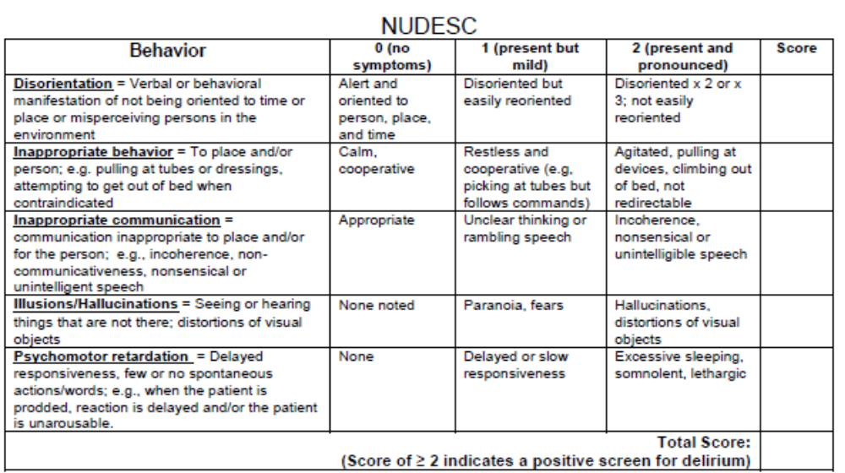
Delirium Screen: Acute Care
Nu-DESC Assessment (Nursing Delirium Screening Scale)
Five domains
Used on Acute Care Units
Results = 0-1 points if normal; ≥ 2 points is positive screen
*Completed once per shift

Slide 27
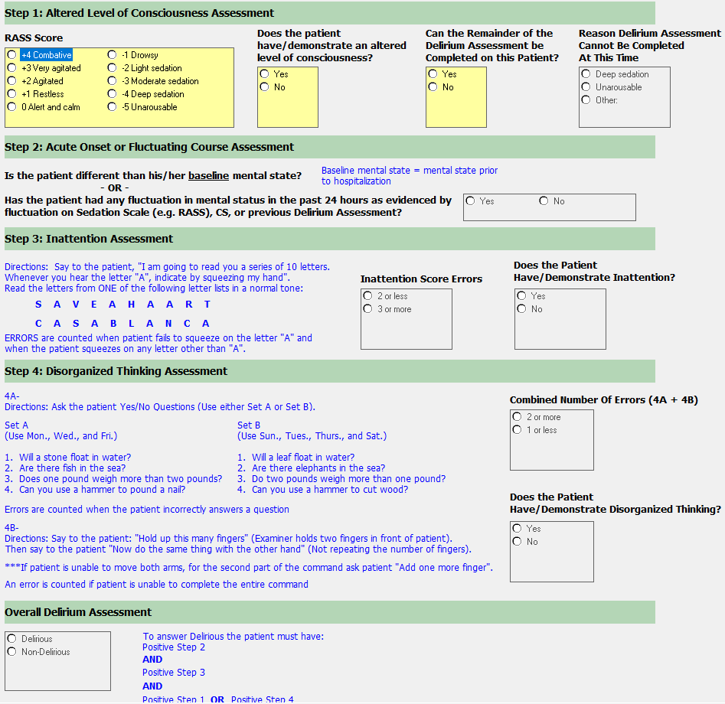
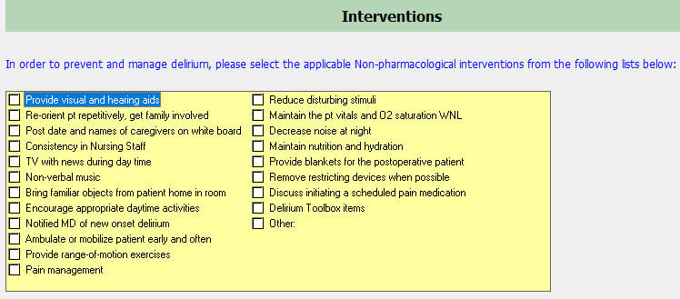
Delirium Screen: Critical Care
CAM-ICU
Used on Critical Care Units
Results = Delirious or Non-Delirious
*Completed once per shift

Slide 28
Identifying Patients at Risk for Delirium

Slide 29

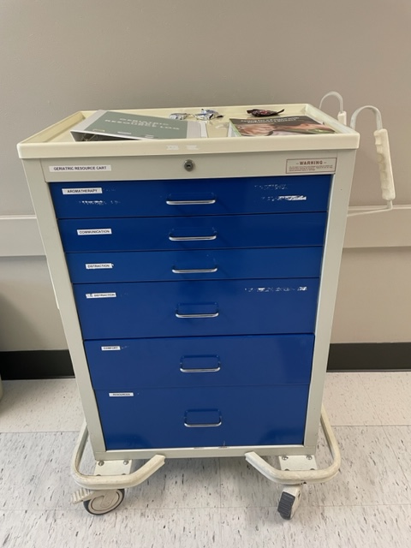
Staff are Educated on Implementation Steps
Assess for Delirium
  NuDESC or CAM-ICU
  Collateral information
    Baseline cognition
    Is this a change?
Identify those at risk
  Know baseline cognitive status (Mentation)
    SIS
  Know functional and mobility status for baseline vs current level (Mobility)
    KATZ
    John Hopkins Mobility Scale
  Assess for pain
  Think about medications (Medication)
Discuss risk/presence with the Interprofessional Team
  Transition of Care rounds
  Bedside shift report / Hand off
Intervene to prevent or reverse Delirium
  STOP DELIRIUM Pathway
  Delirium Prevention Toolbox
Notes:
So how do we do this? We think about the 4Ms framework and we use the tools we have to assess and intervene
Identify those at risk for delirium

Slide 30
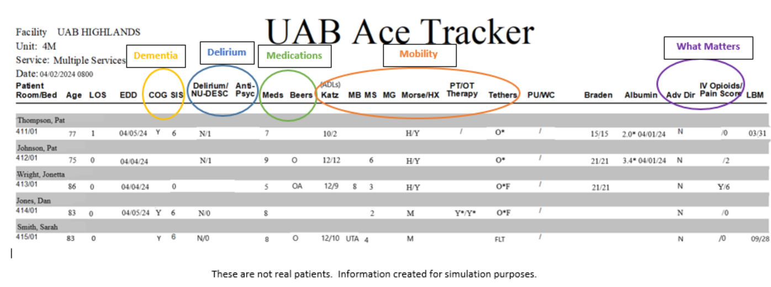
Identifying Patients at Risk: ACE Tracker
Developed by Aurora Healthcare
Malone, M., Volbrecht, M., Stephenson, J., Burke, L, Pagel, P., Goodwin, J. (2010). Acute care for elders tracker and e-geriatrician: Methods to disseminate ACE concepts to hospitals with no geriatricians on staff. Journal of American Geriatrics Society, 58, 161-167

Slide 31
Delirium Prevention Strategies

Slide 32
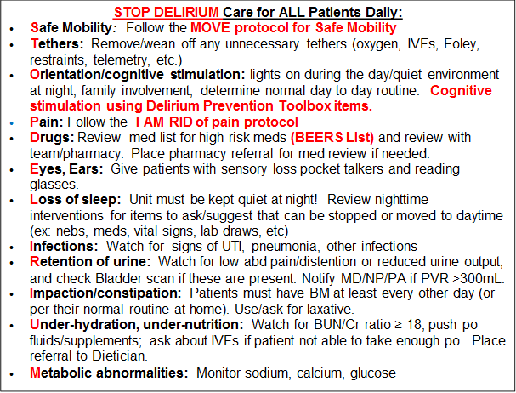
Prevention Strategies: UAB STOP Delirium Pathway
M – Mobilize at least 3 times a day
O – Optimize pain control
V – Verify and communicate mobility status among healthcare team
E – Educate patient and family
I – Interprofessional team: MDs, RNs, chaplains, music therapy, PT, OT, arts in medicine, pet therapy
A – Assess for possible causes (constipation, urinary retention, joint stiffness)
M – Mobility: encourage frequently
R – Reposition at least q2 hours
I – Ice/Heat packs
D – Distraction/emotional support: visitors, volunteers, Arts In Medicine, Pet Therapy, Music Therapy, Delirium Toolbox
Notes:
Use the Stop Delirium Pathway tool. It is available for you. It can be found in Lippincott or on the DIPT one Page and I am going to give you a QR code so that you can scan it and have this delirium prevention pathway on your phone. This pathway was created to remind us what to look for and what to do to prevent delirium.
Safe Mobility
Tethers
Orientation/Cognitive stimulation
Pain follow the I am rid pathway
Drugs Know the meds on the BEERs list. Make pharmacy referrals. Think in your mind,” is this patient getting a med that could cause them to become delirious.
Eyes and ears. Can they hear you and see you. Get them what they need.
Lose of sleep. Let them sleep…Help them sleep Make suggestions that can help with this.
Infections watch for signs of infections.
Retention of urine. Do bladder scans. Think about how this could be happening. Just because they are wet or are voiding some…. Patient may not be emptying their bladder
Impaction/Constipation They need to poop at least ever other day. If they are getting pain meds, they need bowel meds. It’s a given.
Under hydration under nutrition. Watch for this. Push PO fluids. Place dietician referral if needed.
Metabolic abnormalities. Are they out of whack. Check on them.

Slide 33
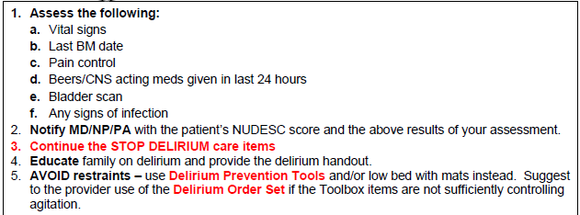
If the NUDESC Score is ≥ 2, then….
Notes:
If your patient has a NuDESC score of 2 or greater. Notify the MD or the NP with what you already know. Be informed when you notify them that the patient is delirious. Let them know if the patient has pain, has no BM, stopped mobilizing, or can’t empty the bladder.
When you are informed and knowledgeable about what is going on with your patient and whether this is a change from baseline, you help to educate those who may not be so informed.
Explain what delirium is to the families also.
Again, the same interventions that help prevent also help to treat delirium. Don’t just throw meds at them. Think about what the cause may be. If unsure, you can always consult Geriatrics to help identify delirium

Slide 34
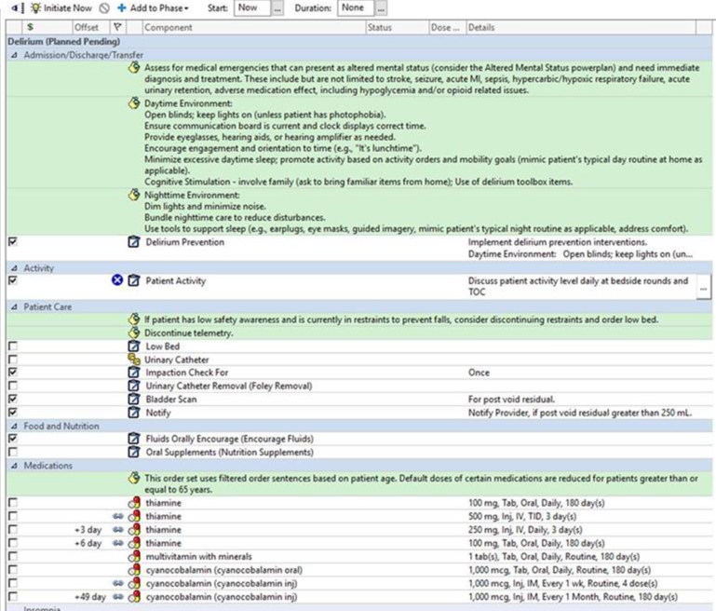
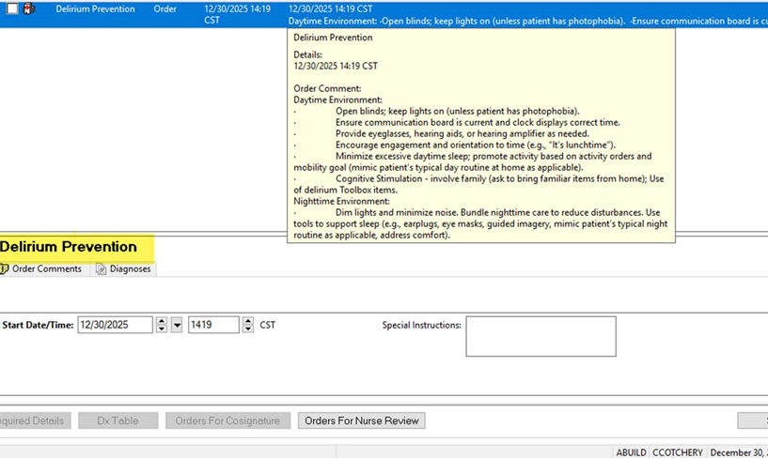
Delirium Prevention Order and PowerPlan
Delirium PowerPlan in Cerner
New option for Delirium Prevention Order recently added to Cerner.

Slide 35
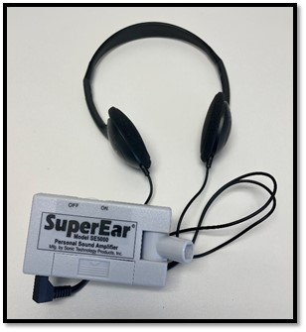
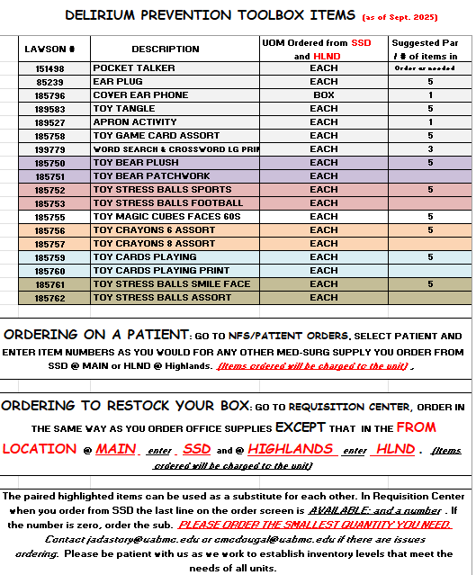
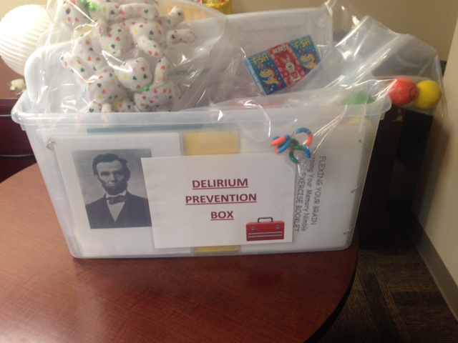
Delirium Resources / Interventions
Delirium Prevention Toolbox
Items for cognitive stimulation
  Magic Cubes
  Activity Books (crossword, word find)
  Crayons
  Coloring Sheets
  Brain Exercise Booklet
  Card Games
Items for distraction (to help with pain management, pulling at lines, boredom, etc.)
  All of the above plus:
  Teddy Bears
  Sports Balls
  Stress Balls
  Tangles
Ear Plugs
Hearing amplifiers
Resources
  Delirium education
  Beer's medications list
  Delirium handout for family
*Delirium prevention toolboxes available on all units

Slide 36
Hospital Elder Life Program (HELP)

Slide 37
Hospital Elder Life Program (HELP)
Specially trained volunteers use the 4Ms framework of Age-Friendly Health Care to add value to the hospital experience for older and vulnerable patients.
HELP Volunteer Protocols:
Orientation – meaningful conversations to keep the patient oriented to time & place
Cognitive Stimulation - Reminiscence, Card Games, Puzzles, Music
SPOONS – Feeding assistance protocol
Range of Motion or Walking Buddy Protocol
Volunteer Quote:
“I was inspired by the HELP Program and wanted to get a more hands on approach to patient care. Because of this, I am getting a position as a PCT but I will continue to volunteer”
Patient Quote:
“The volunteer’s visit is better than any medicine that I have received.”
Staff Quote:
“Having the volunteers help me to do my job as a nurse better. The patient does not need me as much

Slide 38
Discussion topics: Prevention and Screening
Screening
Standardized screening: nurses complete the Six-Item Screener on admission, then NuDESC (acute care) or CAM-ICU (critical care) every shift. The ACE Tracker flags delirium risk factors for the team.
Prevention
STOP DELIRIUM Pathway: a NuDESC score of 2 or more triggers bundled interventions, backed by a Delirium Prevention Order and PowerPlan in Cerner and prevention toolboxes on every unit.
HELP
Hospital Elder Life Program: trained volunteers use the 4Ms to provide orientation, cognitive stimulation, feeding assistance (SPOONS), and walking or range-of-motion support.

Slide 39
Discussion points
Keys to successful change
Pair a cognitive baseline (SIS) with a delirium screen every shift
Match the tool to the unit: NuDESC in acute care, CAM-ICU in critical care
Tie a positive screen (NuDESC ≥ 2) to a defined response: STOP DELIRIUM
Build prevention into EHR orders and PowerPlans
Stock every unit with a delirium prevention toolbox
Extend bedside support with HELP volunteers
Discussion Questions
Which screening tools do you use, and how often?
What happens at your hospital after a positive delirium screen?
Could order sets in your EHR support delirium prevention?
What would it take to start a volunteer program like HELP?
What barriers have you faced, and what tools would help?
Questions for the UAB team?

Slide 40
Next Steps/Call to Action
Consider how your institution could implement something similar to one of the things UAB has accomplished.
What metrics would demonstrate value?
What strengths can you leverage?
What team members would you need?
What support would it take?
This is the second BPAC – watch for future similar events.
Sign up for BRAIN program updates through the link (in chat and QR code)
Stay tuned: GEDC will be creating an impact kit to help facilitate knowledge translation and practical implementation of initiatives to improve care for patients at risk for delirium.

Slide 41
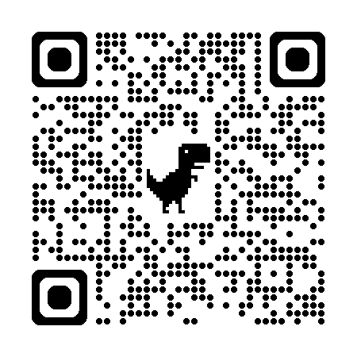
Get Updates on the BRAIN Project

Slide 42


st Practice Accelerator
THANK YOU

