Slide 1



Resource-Limited Settings
and the Geriatric ED
Monday, August 10, 2026
3–4 pm EST
Generously supported by:
Moderated by:
Danya Khoujah, MBBS, MEHP
Emergency Physician
AdventHealth
Tampa, Florida

Slide 2
Rural and Resource Limited Settings
Background on why we cover resource-limited sites:
  Resource limitations impact every healthcare setting—not just small or rural hospitals.
  The challenges may vary by environment, but the need for age-friendly care is universal.
  Resource-limited settings offer innovative approaches that can inform care everywhere.
  Successful age-friendly care is built on adapting resources to meet patient needs.
  Resource-limited sites are not simply smaller versions of larger hospitals, they are unique care environments with valuable lessons to share.

Slide 3
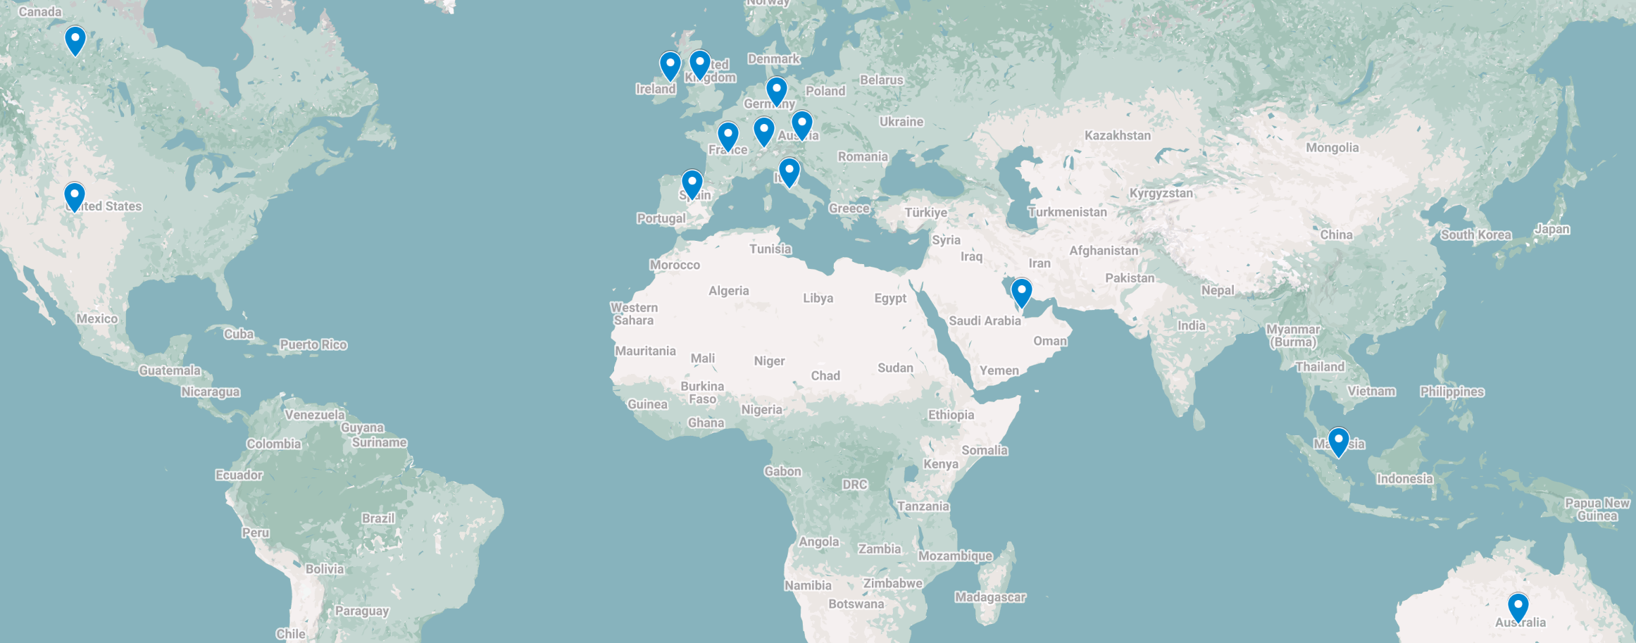
Global attendance joining us today:
United Arab Emirates
Austria
Australia
Canada
Switzerland
Germany
Spain
France
Great Britain
Ireland
Italy
New Zealand
Qatar
Singapore
United States
260 Registrants across 15 Countries

Slide 4
What is a resource-conscious clinical strategy that you can foresee benefiting your geriatric ED patients?
Community-based interventions
Phone calls
Home visits
Facilitating transitions
Care coordination
Screening for early detection
Transportation
Frailty / delirium / falls / polypharmacy
Allied health services
Telehealth
PT, SW, Pharmacy..
Virtual GEM nurse
Memory clinic

Slide 5

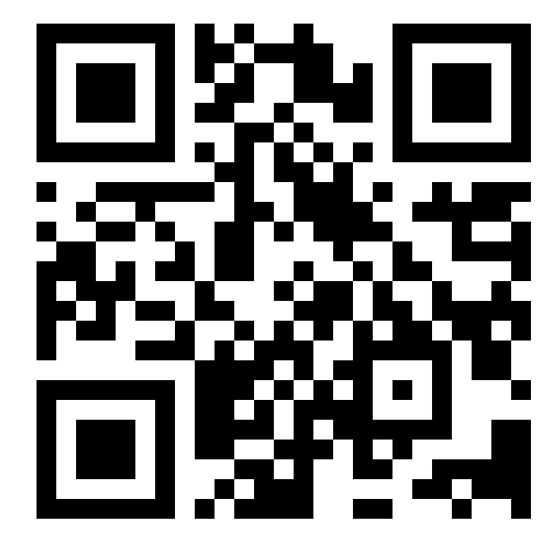
GEDC Free Membership
Free CME Courses & Education
Clinical Tools & Best Practices
Support for GEDA Accreditation
Track your Team’s Progress
Learn about ED Leadership Engagement
Gedcollaborative.com
Transforming Emergency Care for Older Adults
Resources
Implementation Toolkits
Online Learning Courses
Live & On-Demand Webinars
Podcasts
GED Blogs & Journal of Geriatric Emergency Medicine
Join the GEDC

Slide 6

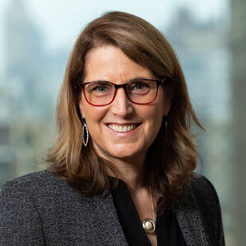
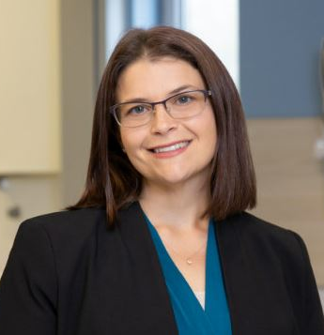
Meet Your Expert Panel
What questions do you have for our panelists?
Panelists
Special Guest
Brock Slabach, MPH
Chief Operations Officer
National Rural Health Association
Nancy Wexler, DBH, MPH
Senior Program Officer
The John A. Hartford Foundation
Kristie Foster, MSN, RN, GERO-BC
Director of Nursing Operations
Mount Ascutney Hospital and Health Center
Geriatric Emergency Department Collaborative Consultant
American College of Emergency Physicians Independent Contractor

Slide 7
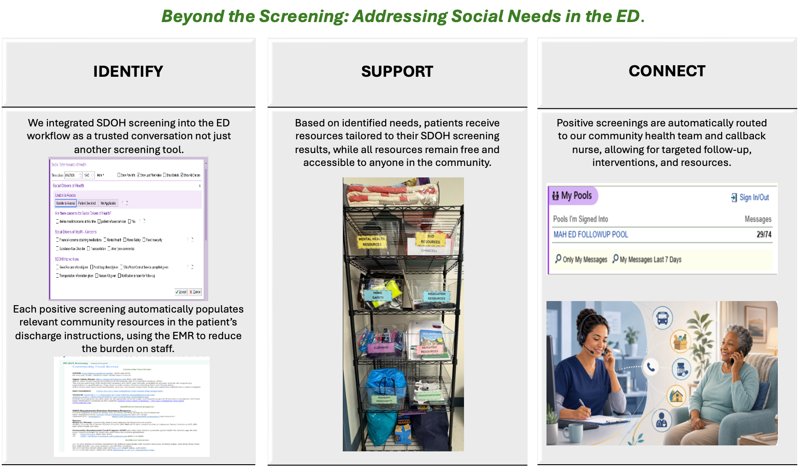

Slide 8
Participate in the GEDC Rural Innovators Cohort
Rebuilding the Rural Accreditation
What Your Hospital Receives
Accreditation criteria were written in academic medical centers and < 5% of GEDA sites are critical access hospitals
By coaching rural hospitals to accreditation, we want to refine the requirements
Our goal is to “right-size” the model
Recruiting 3+ hospitals for 2027 participation
A discounted accreditation application fee
Dedicated coaching and mentorship from Kristie Foster
What We Ask From You
Feedback on participation and desired accreditation level
A 1-hour leadership interview
Willingness to contribute to a case study
Notes:
Drop email in the chat?

Slide 9
Brock Slabach Takeaways
Rural hospitals are not just smaller versions of big city hospitals.
Reimbursement needs to incentivize care coordination.
Tele-geriatric support - bringing specialists to the bedside
Community health workers

Slide 10
Kristie Foster Takeaways
Community taking care of community
Staff engagement is key
Care coordination with LTCFs

Slide 11

Q & A
Ask your questions
in the chat!
We will try to get to everyone

Slide 12
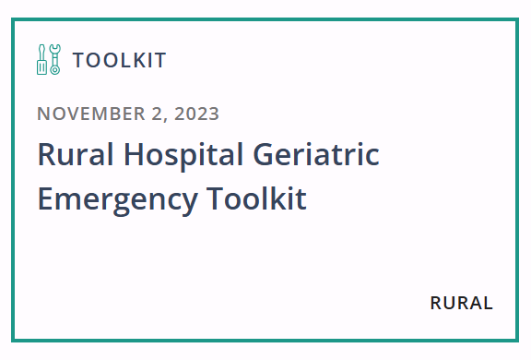
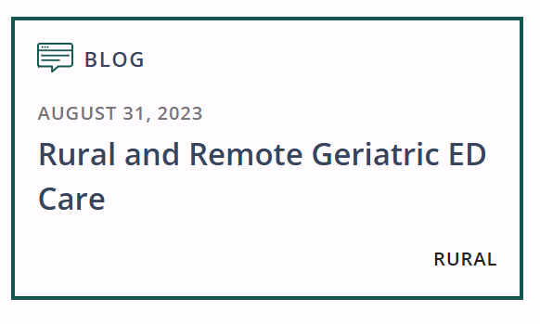
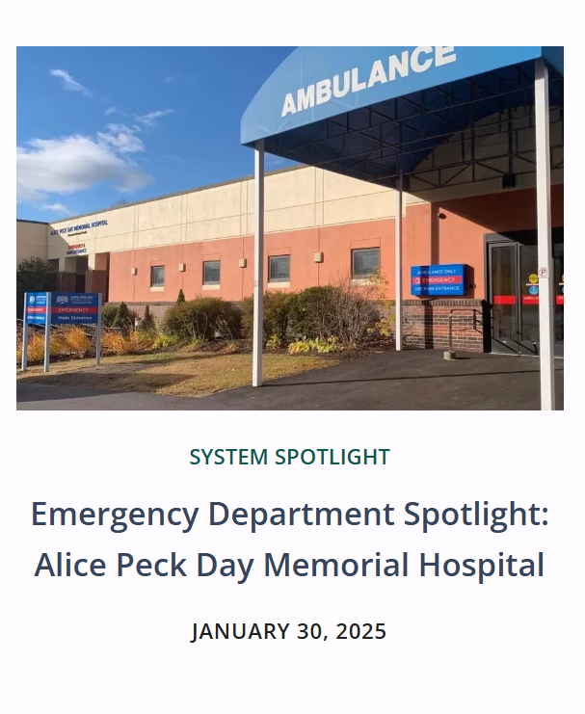
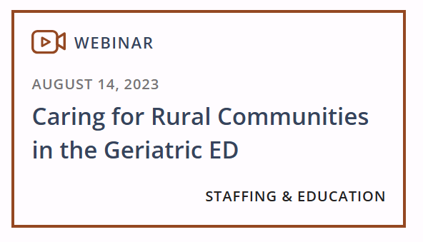
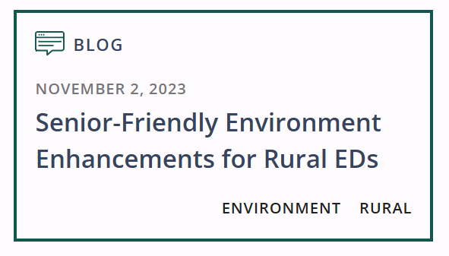
Rural Resources

Slide 13

OUR NEXT GEDC
EXPERT PANEL WEBINAR
Three Initiatives, One Goal: Building an Age-Friendly Care Strategy
Part 7 of the CMS Series
October 19, 2026
3-4pm EST
Register Now
https://gedcollaborative.com/resource/cms-measure/three-initiatives-one-goal-building-an-age-friendly-care-strategy/
Notes:
Title on TEAMS from Don

Slide 14
Generously supported by

Slide 15
GEDC Free Membership
Free CME Courses & Education
Clinical Tools & Best Practices
Support for GEDA Accreditation
Track your Team’s Progress
Learn about ED Leadership Engagement
Gedcollaborative.com
Transforming Emergency Care for Older Adults
Resources
Implementation Toolkits
Online Learning Courses
Live & On-Demand Webinars
Podcasts
GED Blogs & Journal of Geriatric Emergency Medicine
Join the GEDC

