Slide 1



Frailty Screening and Intervention and the CMS Hospital Measure
Part 4 of the CMS Hospital Measure Webinar Series
Monday, February 23, 2026
3–4 pm EST
Generously supported by:
Moderated by:
Danya Khoujah, MBBS, MEHP
Emergency Physician
AdventHealth, Tampa, Florida

Slide 2
Five Domains to Prioritize Older Adults’ Healthcare Needs
Domain 1: Eliciting Patient Healthcare Goals
Domain 2: Responsible Medication Management
Domain 3: Frailty Screening and Intervention
Domain 4: Social Vulnerability
Domain 5: Age-Friendly Care Leadership
2

Slide 3
FY25 CMS Age-Friendly Hospitals Measure
 | Title | Measure
Domain 3 | Frailty Screening and Intervention (Mobility, Mentation, and Malnutrition): | Malnutrition risk screening Delirium risk screening and Mobility plans Fall risk screening, Decubitus ulcers, and 30 day readmissions for patients 65+ Reduce ED delirium by transferring older patients out of the ED within 8 hours of arrival or within 3 hours of admission.

Slide 4
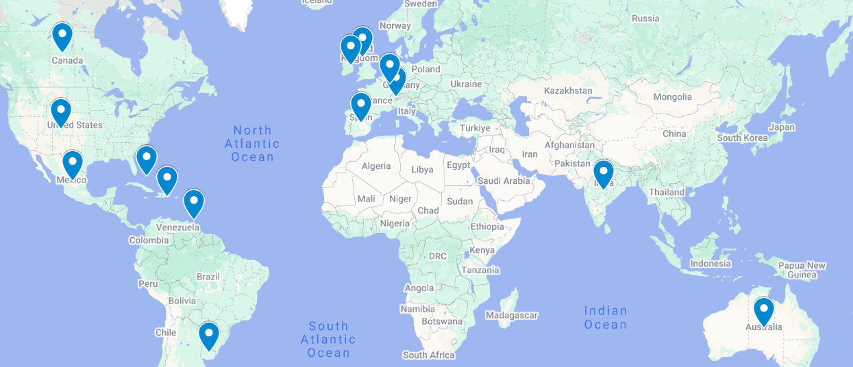
Global attendance joining us today:
United Arab Emirates
Australia
Bahamas
Brazil
Canada
Switzerland
Dominican Republic
Spain
United Kingdom
Ireland
Italy
India
Luxembourg
Mexico
Trinidad & Tobago
United States
Uruguay
480 Registrants across 17 Countries

Slide 5
What is your biggest interest related to frailty screening or intervention in your ED?
BEST tool to use
Tools in the Electronic Record
What does the score predict?
What do we do after a positive screen?
Dedicated or designated staff to do it
How to involve interdisciplinary staff
How does the ED help meet the CMS frailty requirement?
Impact on hospital and community care
Sustainability strategies
How to incorporate into ED workflow
Impact on patient flow
How others gather EHR data to report the measure
Components of a frailty assessment
What interventions are linked to best practice?
Rationale for importance in ED

Slide 6
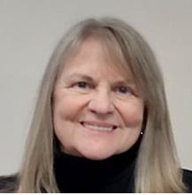
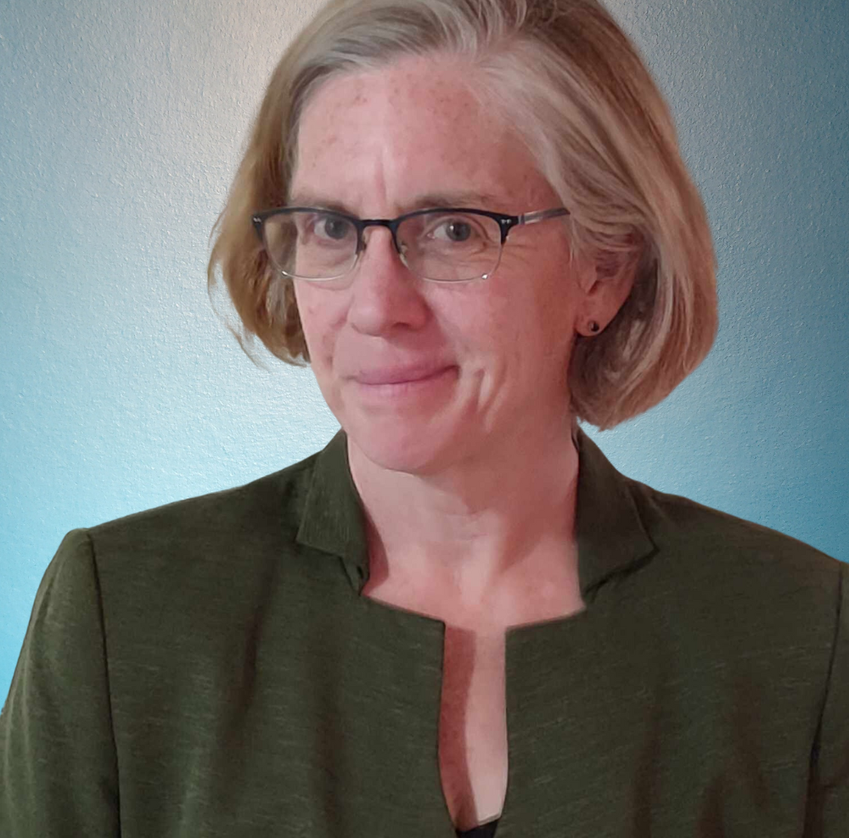

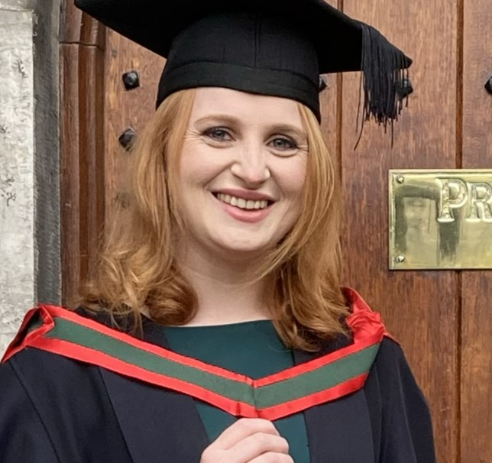
Meet Your Expert Panel
What questions do you have for our panelists?
Karen Allen, RN, BsN, GEM
Geriatric Emergency Medicine Nurse Navigator
Dartmouth-Hitchcock Health
Lisa Adams Wolf, PhD, RN, CEN, FAEN, FAAN
Lead Nurse Scientist
Emergency Nurses Association
Kara Mc Loughlin, MSc
Research Fellow/PhD Candidate - CREAT-ED - Development of Core Outcome Set for Older Adults in the Emergency Department
University of Limerick
Elizabeth Goldberg, MD, ScM
Associate Vice Chair for Research
Emergency Medicine
University of Colorado Anschutz

Slide 7

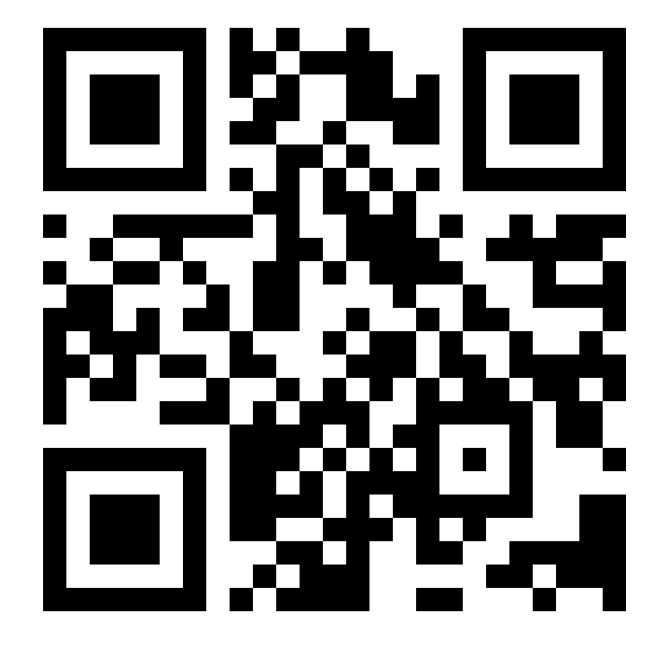
GEDC Free Membership
Free CME Courses & Education
Clinical Tools & Best Practices
Support for GEDA Accreditation
Track your Team’s Progress
Learn about ED Leadership Engagement
Gedcollaborative.com
Transforming Emergency Care for Older Adults
Resources
Implementation Toolkits
Online Learning Courses
Live & On-Demand Webinars
Podcasts
GED Blogs & Journal of Geriatric Emergency Medicine
Join the GEDC

Slide 8
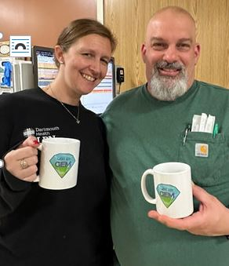
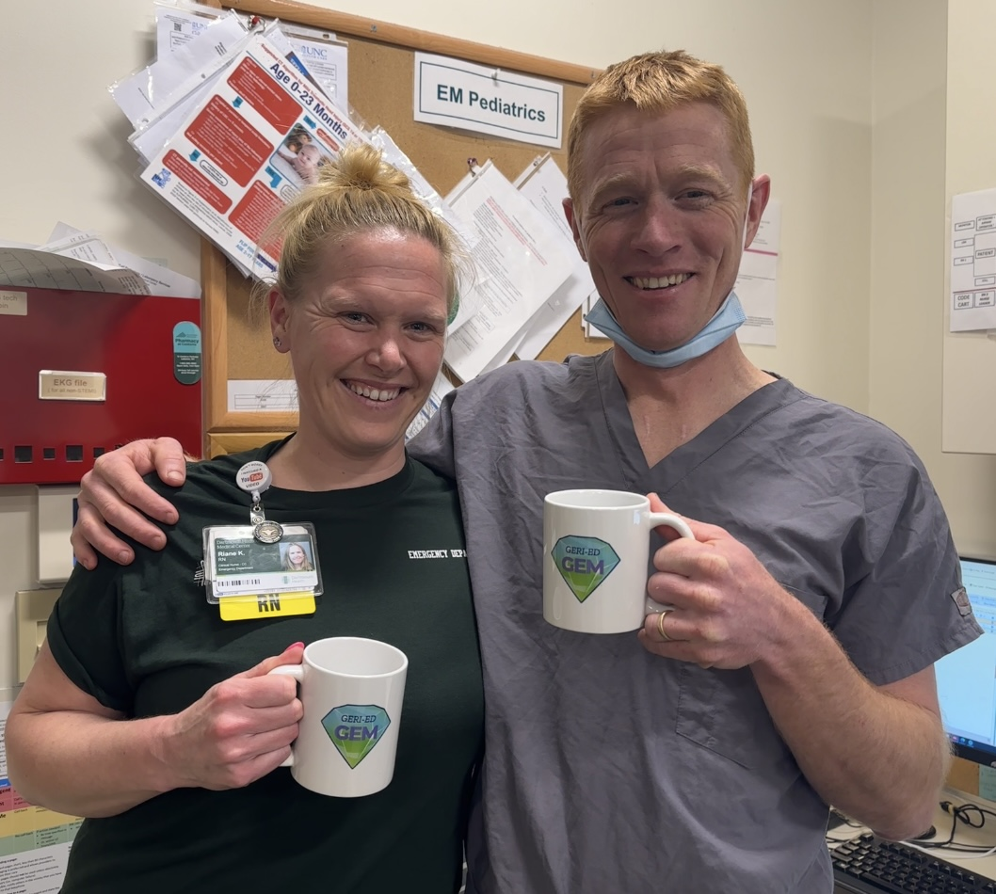
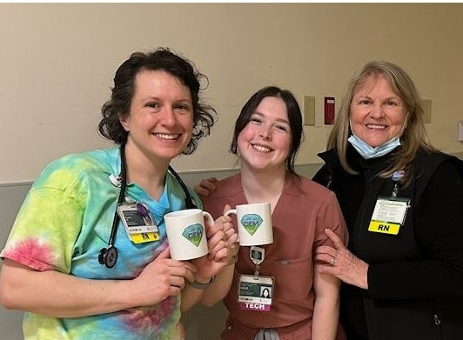
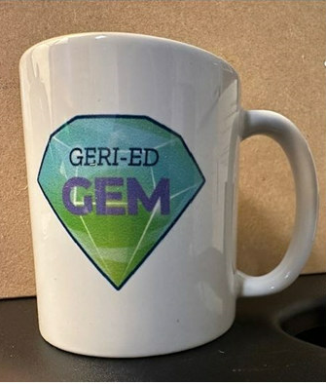
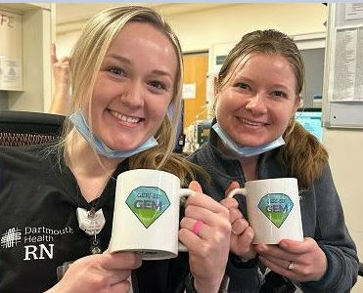
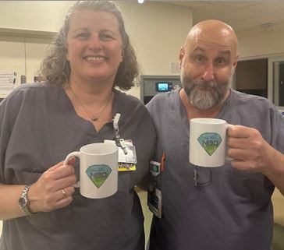
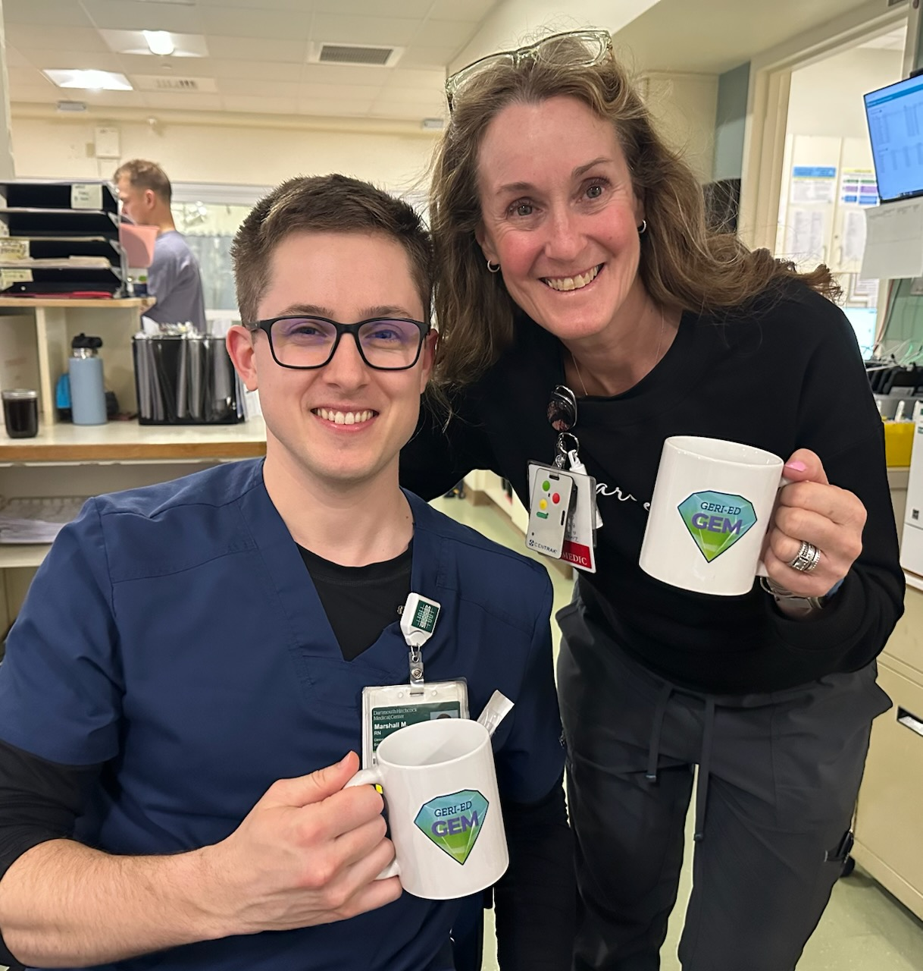

Slide 9
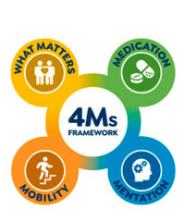
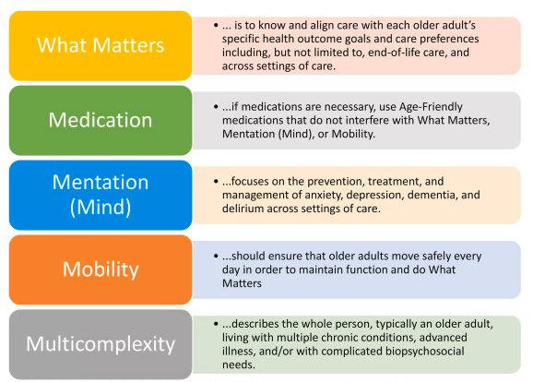
The 4 Ms - What Matters Most Framework and
Why Geriatric Screenings Assessments are
Important
PRINT INSTRUCTIONS:
Wall Poster for Staff
Page 1 – Break Room

Slide 10
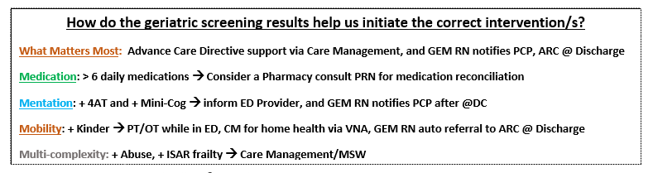
PRINT INSTRUCTIONS:
Wall Poster for Staff
Page 2 – Break Room
The 4 Ms - What Matters Most Framework
and
Why Geriatric Screenings Assessments are
Important

Slide 11

Q & A
Ask your questions
in the chat!
We will try to get to everyone

Slide 12
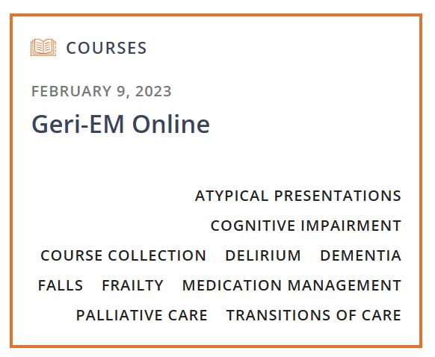
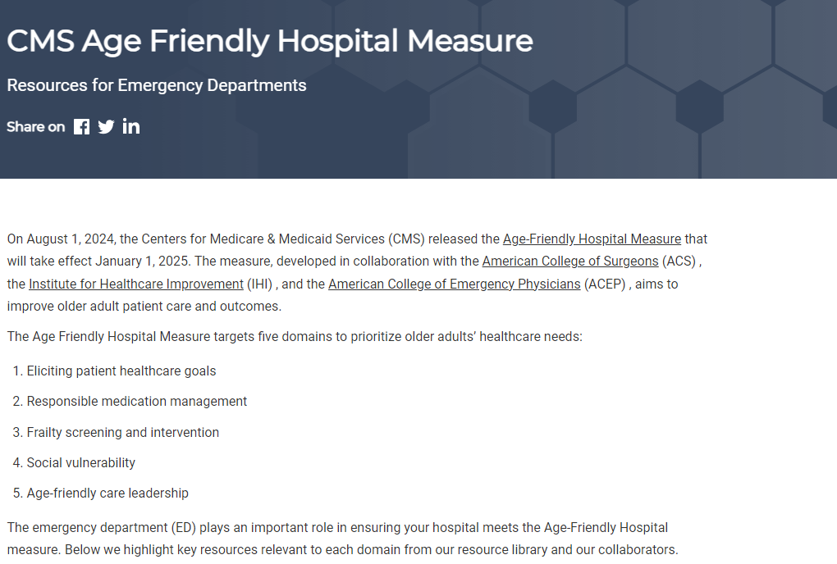
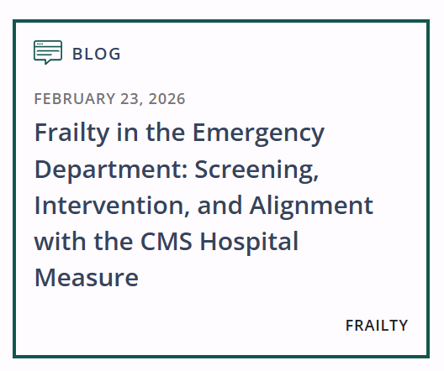
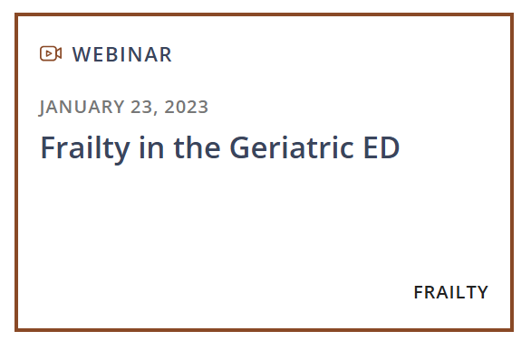
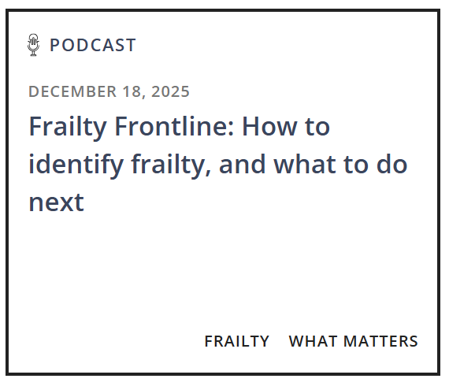
More Resources: CMS & Frailty
Resource by Panelists

Slide 13

OUR NEXT GEDC
EXPERT PANEL WEBINAR
Boarding and the Geriatric ED
Register Now
May 11, 2026
3pm EST
https://gedcollaborative.com/resource/frailty/frailty-screening-and-intervention-and-the-cms-hospital-measure/
Notes:
Title on TEAMS from Don

Slide 14
Generously supported by

Slide 15
GEDC Free Membership
Free CME Courses & Education
Clinical Tools & Best Practices
Support for GEDA Accreditation
Track your Team’s Progress
Consulting Services
Learn about ED Leadership Engagement
Gedcollaborative.com
Transforming Emergency Care for Older Adults
Resources
Implementation Toolkits
Online Learning Courses
Live & On-Demand Webinars
Podcasts
GED Blogs & Journal of Geriatric Emergency Medicine
Join the GEDC

Slide 16


GEDC Consulting Services
IMPROVE GERIATRIC CARE AND OUTCOMES
The GEDC Team will work with your site and health system leaders to create a consulting engagement package that will help your ED or health system reach its goals.
AGE-FRIENDLY GUIDELINES SUPPORT
The GEDC offers specialized Consulting Services to help your site or system meet its unique needs.
  Achieving GED accreditation or leveling up to achieve Level 1 or 2 status
  Excelling on the CMS Age-friendly Guidelines
  Your hospital or system’s needs, challenges, or goals for geriatric care
https://gedcollaborative.com/consulting-and-services/
Notes:
First step: gedc membership (next slide)

Slide 17

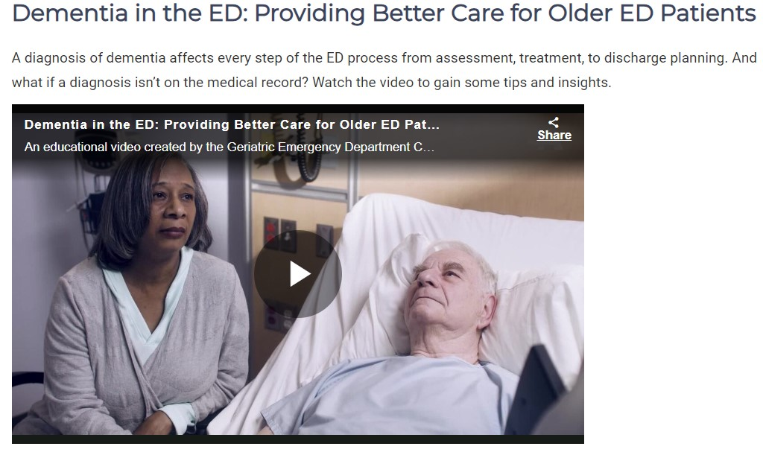
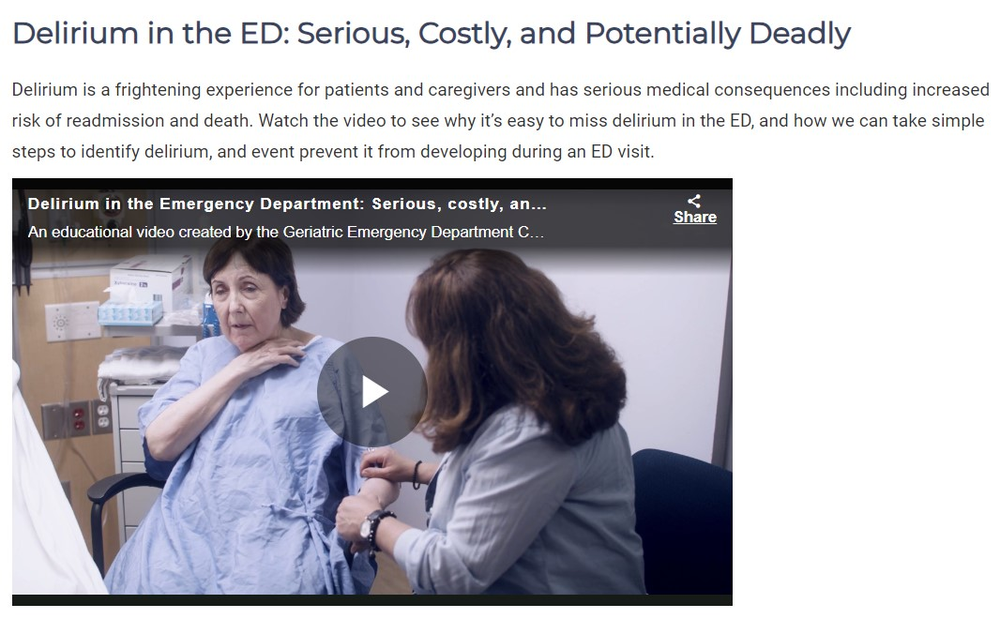
Brain Health in the ED
Educational Videos by AARP
https://gedcollaborative.com/resource/brain-health-in-the-ed-videos/

Slide 18
Takeaway points: Karen Allen
Insert
Insert
Insert

Slide 19
Takeaway points: Liz Goldberg
Insert
Insert
Insert

Slide 20
Takeaway points: Lisa Wolf
Insert
Insert
Insert

Slide 21
Takeaway points: Kara Mc Loughlin
Insert
Insert
Insert

