Slide 1




What Matters: Eliciting Patient Healthcare Goals and the CMS Hospital Measure
Part 3 of the CMS Hospital Measure Webinar Series
Monday, October 27, 2025
3–4 pm EST
Generously supported by:
Moderated by:
Don Melady, MD, MSc(Ed)
Professor, University of Toronto
Emergency Physician
Mount Sinai Hospital, Toronto, Canada
Danya Khoujah, MBBS, MEHP
Emergency Physician
AdventHealth, Tampa, Florida

Slide 2
Five Domains to Prioritize Older Adults’ Healthcare Needs
Domain 1: Eliciting Patient Healthcare Goals
Domain 2: Responsible Medication Management
Domain 3: Frailty Screening and Intervention
Domain 4: Social Vulnerability
Domain 5: Age-Friendly Care Leadership
2

Slide 3
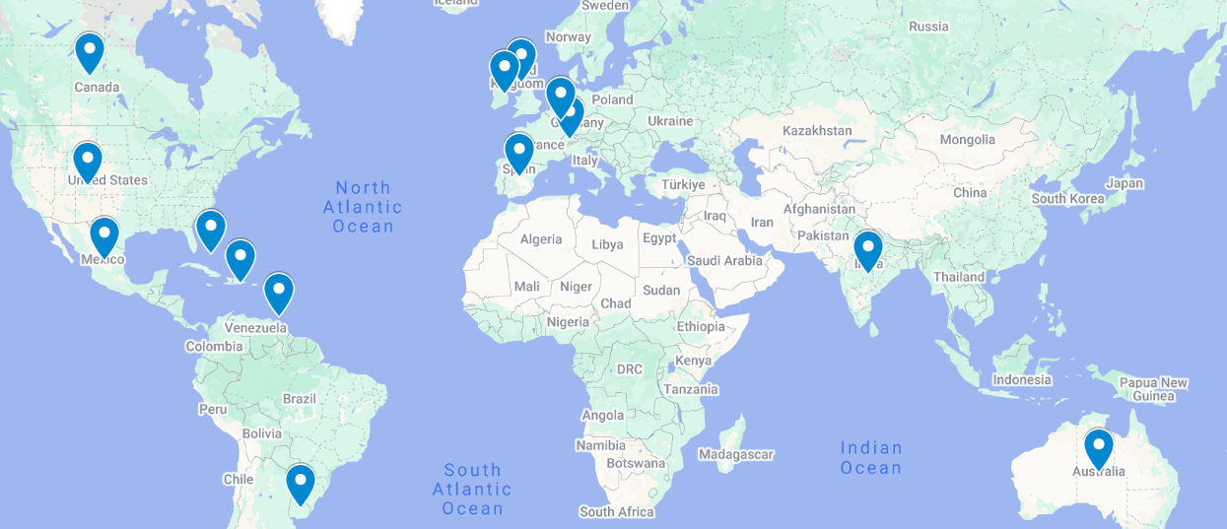
Global attendance joining us today:
United Arab Emirates
Australia
Bahamas
Canada
Switzerland
Dominican Republic
Spain
United Kingdom
Ireland
India
Luxembourg
Mexico
Trinidad & Tobago
United States
Uruguay
400 Registrants across 15 Countries

Slide 4

Aside from more time, what would make it easier to establish health care goals in the ED?
A shared sense that this is important
Tools in the Electronic Record
Improved access to information systems
Common sense!
Dedicated or designated staff to do it
Access to palliative care consultation in the ED
Some guidance about talking points or scripts or prompts; a conversation guide
Connection with primary care in the community
Establishing the “proper forum”
Ensuring family and caregivers are present
Better connection with the community/outpatient setting
Leveraging the EHR for reminders and shortcuts
Integrating more staff into the process, i.e. interdisciplinary team
Having a chart about the most important issues
Engaging a wider range of team members, not just doctors

Slide 5

Membership
Join the ranks of hospitals that are providing the best possible care to older adults in the ED, while helping to define best practices.
Member Benefits:
Unlock ED Resources
Access Tailored Content
Track your Team’s Progress
Get Individualized Support
Engage in Consulting Engagements
Make Global Connections
Learn about ED Leadership Engagement
gedcollaborative.com
Mission & Vision
A world where all emergency departments provide the highest quality of care for older patients.
We transform and evaluate interdisciplinary best practice in geriatric emergency medicine, and then build and distribute practical, evidence-based clinical curriculum and quality improvement tools that support sustainable, quality care for older adults.
Join the GEDC
https://gedcollaborative.com/membership/

Slide 6
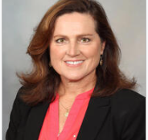
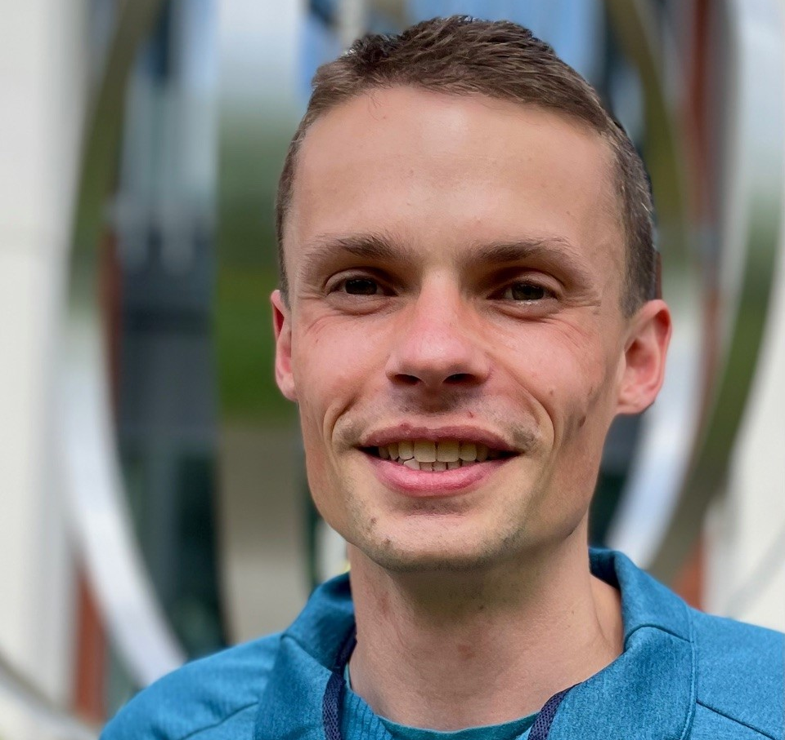

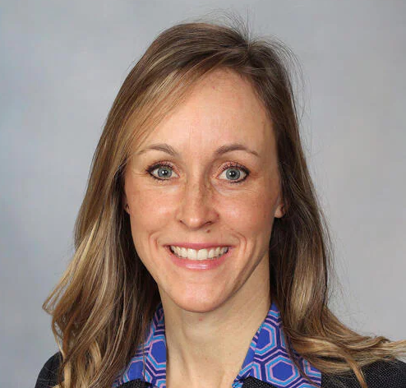
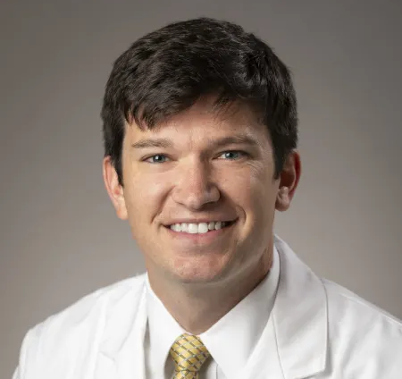
Meet Your Expert Panel
What questions do you have for our panelists?
Susan Bower, MSN, RN Geriatric Emergency Department Nurse Coordinator
Assistant Professor of Nursing
Mayo Clinic, Minnesota
James van Oppen, FRCEM, MRCP, PhD
Clinical Lecturer in Emergency Medicine
University of Sheffield & Sheffield Teaching Hospitals
Sheffield, England, United Kingdom
Anita Chary, MD, PhD Assistant Professor, Baylor College of Medicine Center for Innovations in Quality, Effectiveness and Safety Michael E. DeBakey VA Medical Center
Texas
Jessica Stanich, MD Geriatric Emergency Medical Director
Department of Emergency Medicine
Assistant Professor of Emergency Medicine and Geriatric Medicine
Mayo Clinic, Minnesota
Cameron Gettel, MD, MHS
Assistant Professor
Department of Emergency Medicine
Yale University School of Medicine
Connecticut

Slide 7
FY25 CMS Age-Friendly Hospitals Measure
 | Title | Measure
Domain 1 | Eliciting Patient Healthcare Goals: | Our hospital has protocols in place to ensure patient goals related to healthcare (i.e., health goals, treatment goals, living wills, identification of health care proxies, advance care planning) are obtained/reviewed and documented in the medical record. These goals are updated before major procedures and upon significant changes in clinical status.

Slide 8
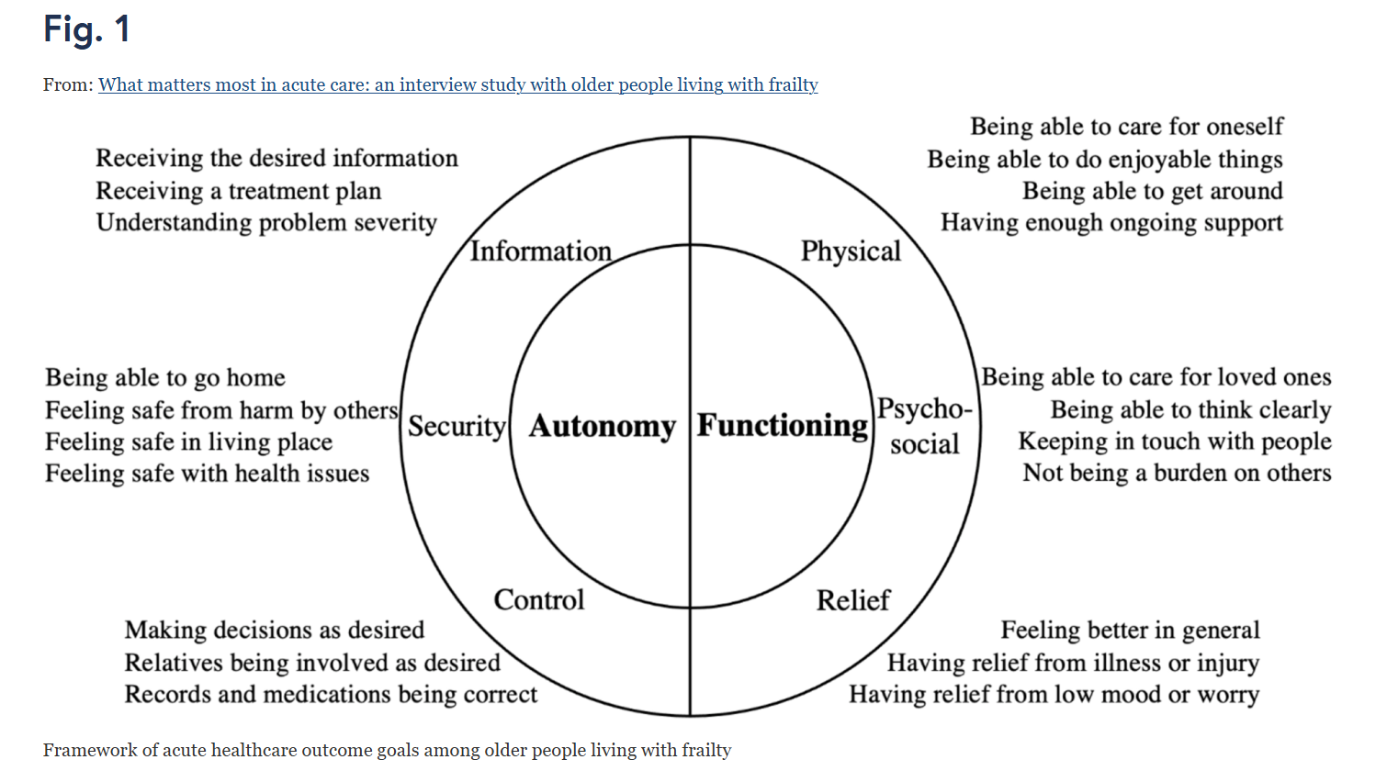
TV on always
Goes by “Skip”
?
https://bmcgeriatr.biomedcentral.com/articles/10.1186/s12877-022-02798-x/figures/1

Slide 9
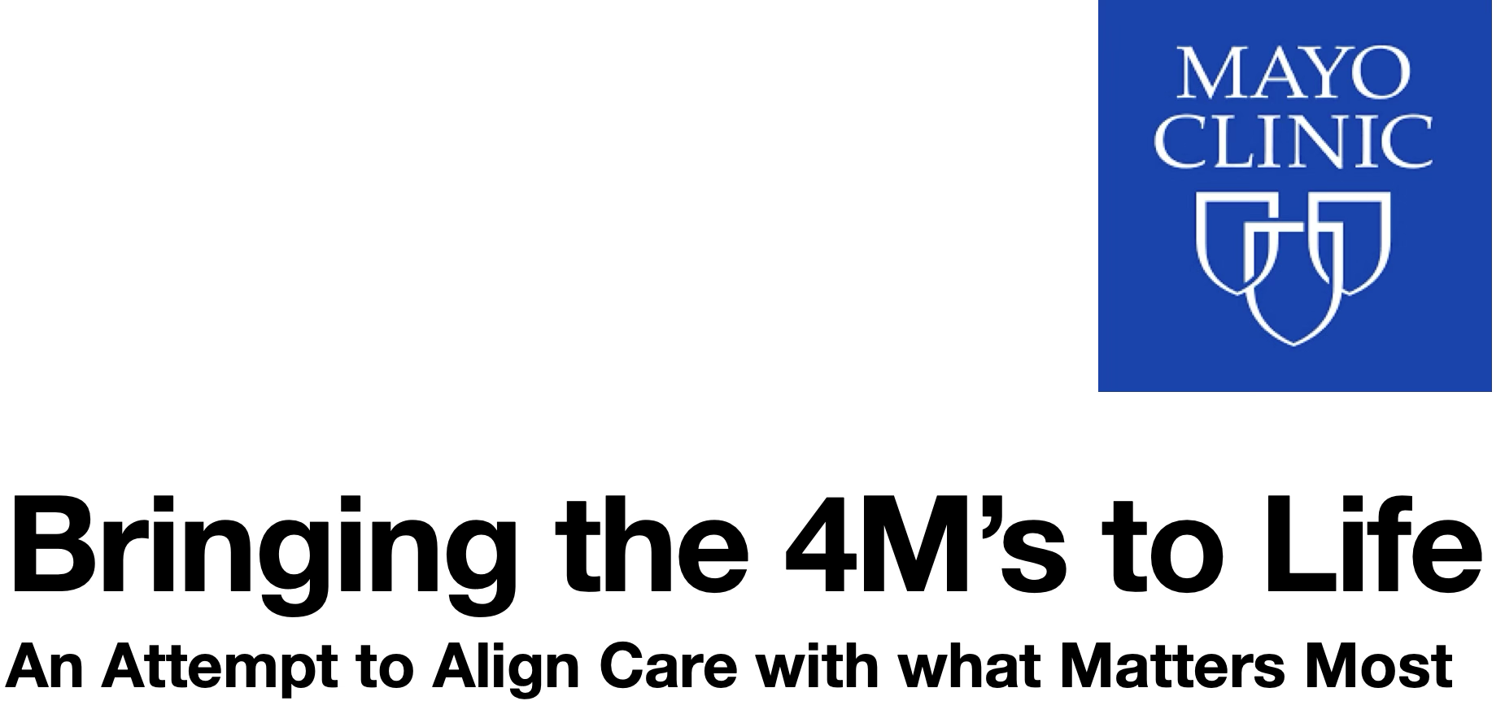
Jessica Stanich M.D. & Susan Bower R.N.

Slide 10
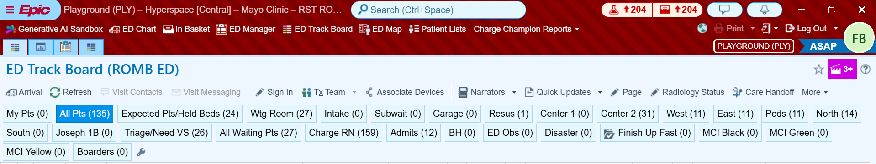
Geriatrics

Slide 11
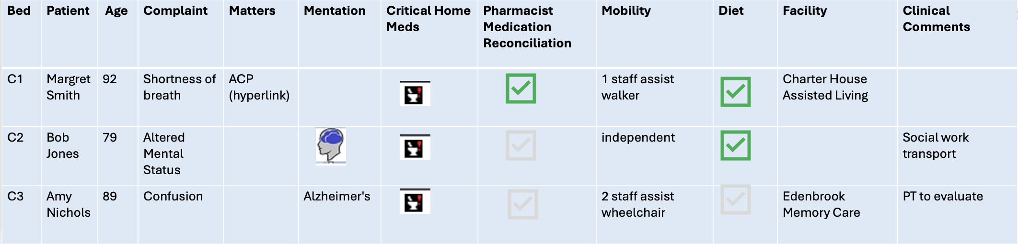
Geriatrics

Slide 12
Takeaway points: Jessica Stanich & Susan Bower
The Geriatric Tab helps organize details specific to older adults.
Provides a visual aid drawing attention to core geriatric priorities.
Automatic inclusion of the tab promotes consistent use and buy-in across the care team.

Slide 13
Takeaway points: Anita Chary
Patients may not think of care "goals" but rather worries, concerns, and/or expectations of what will happen from the visit.
Situations where healthcare goals in the ED are most useful:
Serious illness (e.g., resuscitation decisions
Disposition decisions (admit, discharge, care transitions)
Non-traditional approach to the clinical presentation
Information about caregiving context and functional status makes a patient's healthcare goals more actionable for clinicians.

Slide 14
Takeaway points: Cameron Gettel
Simple “What Matters” questions uncover older adults’ true priorities - often beyond the chief complaint - and can be asked in under 3 minutes.
Integrating these conversations into ED care improves alignment with patient goals, prompting earlier engagement of supports and more proactive care.
Documenting “What Matters” can fulfill CMS’s new Age-Friendly Hospital Measure domain on eliciting patient healthcare goals, positioning EDs for success.

Slide 15
Takeaway points: James van Oppen
• Person-centered emergency care for older adults with frailty requires understanding and prioritizing individual values and goals, rather than relying solely on standardized protocols.
• ‘What matters most’ frameworks might help clinicians to structure consultations around patient-defined outcomes - such as situational security and maintaining independence.
• Patient-Reported Outcome Measures (PROMs) could provide a practical way to measure and improve person-centered care by capturing how well services fulfill individual-level priorities

Slide 16
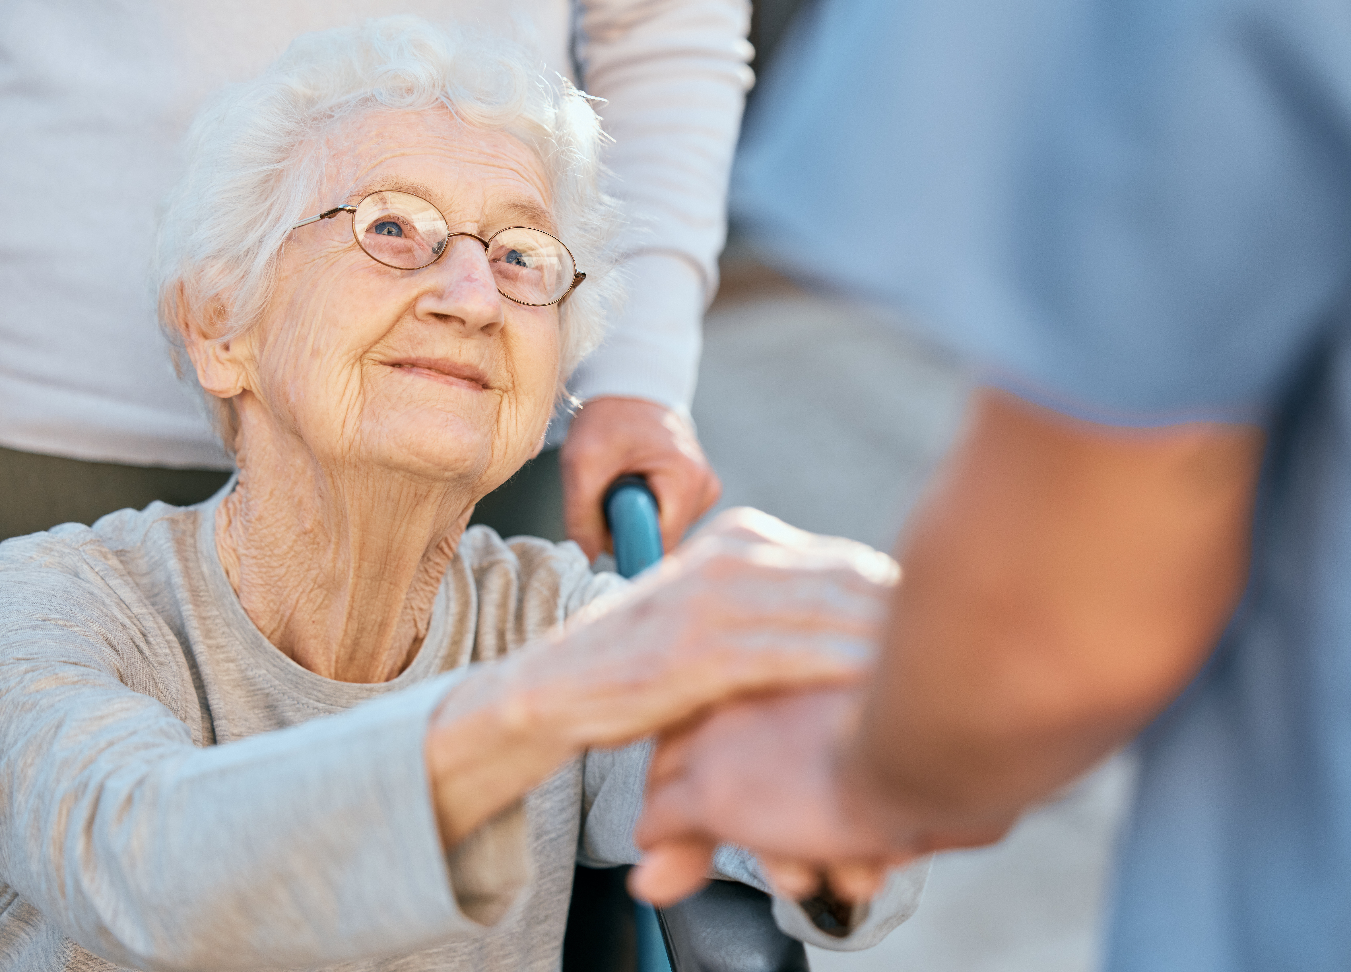
Q & A
Ask your questions
in the chat!
We will try to get to everyone

Slide 17
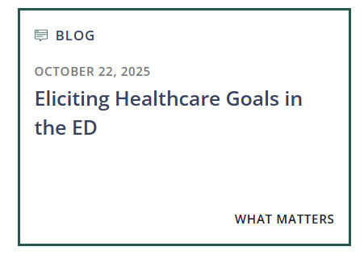
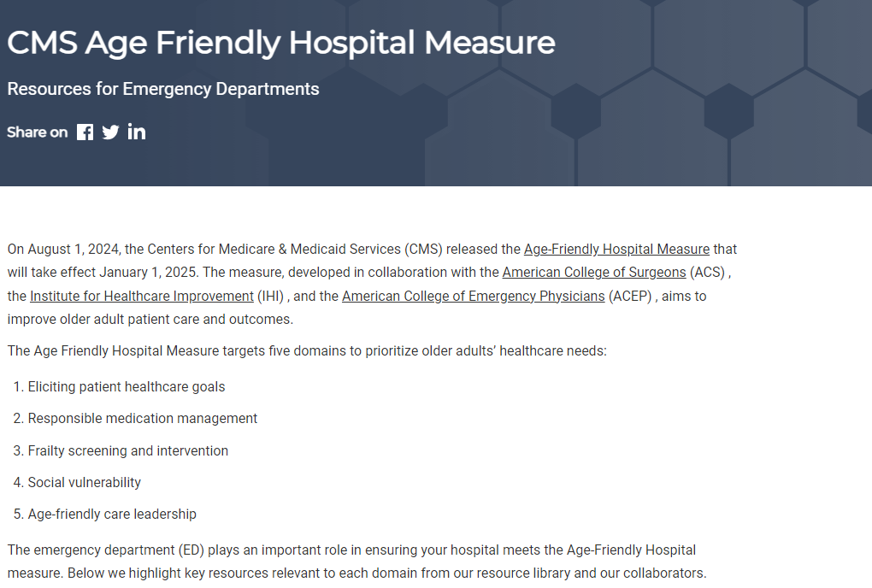
More Resources: CMS & Eliciting Patient Healthcare Goals
CMS Resource: All 5 Domains
https://gedcollaborative.com/article/cms-hospital-measure-resources-for-eds/

Slide 18


GEDC Consulting Services
IMPROVE GERIATRIC CARE AND OUTCOMES
The GEDC Team will work with your site and health system leaders to create a consulting engagement package that will help your ED or health system reach its goals.
AGE-FRIENDLY GUIDELINES SUPPORT
The GEDC offers specialized Consulting Services to help your site or system meet its unique needs.
Achieving GED accreditation or leveling up to achieve Level 1 or 2 status
Excelling on the CMS Age-friendly Guidelines
Your hospital or system’s needs, challenges, or goals for geriatric care
https://gedcollaborative.com/consulting-and-services/
Notes:
First step: gedc membership (next slide)

Slide 19

OUR NEXT GEDC
EXPERT PANEL WEBINAR
Frailty Screening and Intervention and the CMS Hospital Measure
Part 4 of the CMS Hospital Measure Webinar Series
Register Now
February 23, 2026
3pm EST
https://gedcollaborative.com/resource/frailty/frailty-screening-and-intervention-and-the-cms-hospital-measure/
Notes:
Title on TEAMS from Don

Slide 20

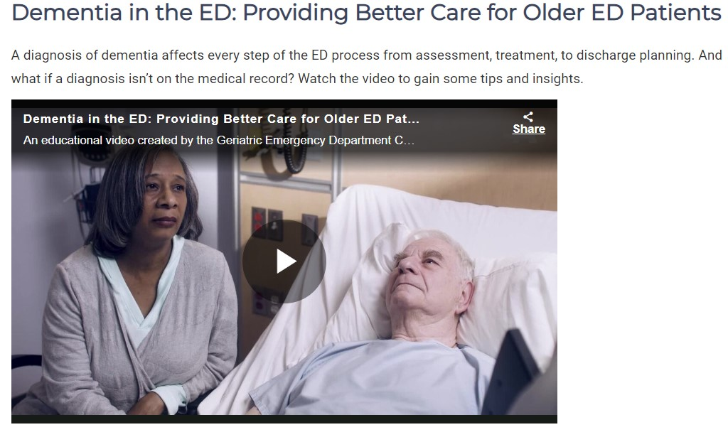
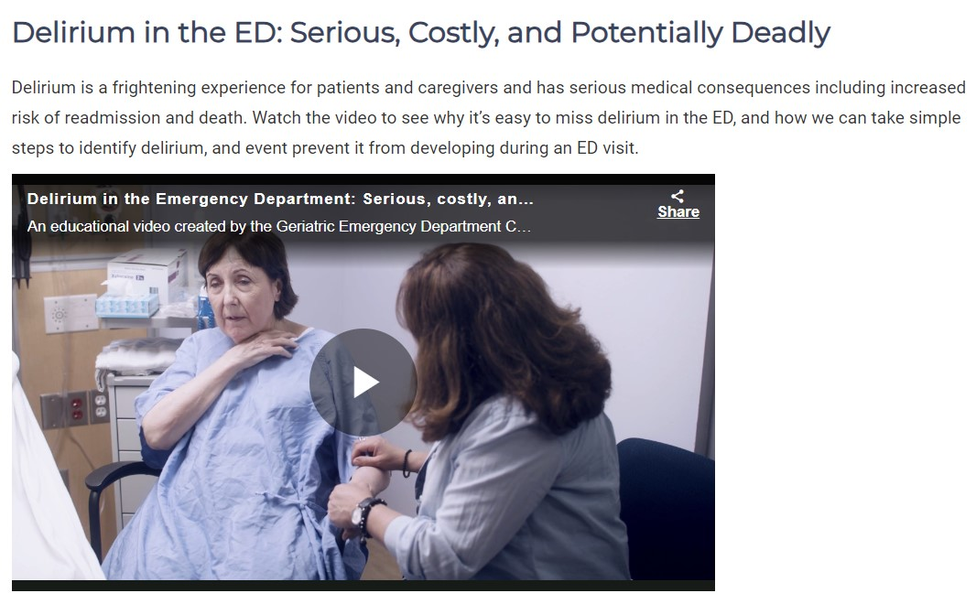
Brain Health in the ED Educational Videos by AARP
https://gedcollaborative.com/resource/brain-health-in-the-ed-videos/

Slide 21

Join
the
GEDC
gedcollaborative.com
@theGEDC
We bring best practice into action.

Slide 22
Generously supported by

