Slide 1



Medication Management and the CMS Hospital Measure
Part 2 of the CMS Hospital Measure Webinar Series
Expert Panel Webinar
Monday, July 14, 2025
3–4 pm EST
Generously supported by:
Moderated by:
Don Melady, MD, MSc(Ed)
Professor, University of Toronto
Emergency Physician
Mount Sinai Hospital, Toronto, Canada
GEDC Faculty

Slide 2
Five Domains to Prioritize Older Adults’ Healthcare Needs
Domain 1: Eliciting Patient Healthcare Goals
Domain 2: Responsible Medication Management
Domain 3: Frailty Screening and Intervention
Domain 4: Social Vulnerability
Domain 5: Age-Friendly Care Leadership
2

Slide 3
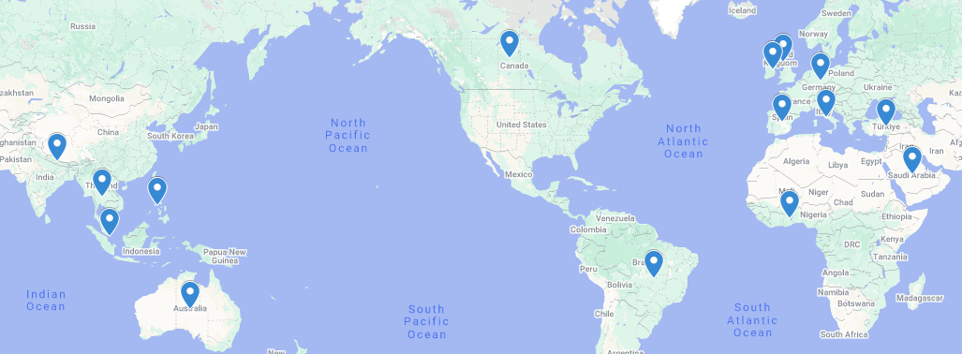
Global attendance joining us today:
United States
Brazil
Canada
Germany
Spain
UK
Ghana
Ireland
Australia
Italy
Nepal
Philippines
Saudi Arabia
Singapore
Thailand
Turkey
340 Registrants across 18 Countries

Slide 4

In your ED, what is the most problematic medication among older adults?
Sedatives, especially benzodiazepines and Z-drugs
Digoxin
Antipsychotics, especially haloperidol at high dose
Parkinson's Disease medications
All psychotropics when used for dementia symptoms (BPSD)
Opioids, especially dosing issues
Diabetic medications/hypoglycemics
Blood thinners/anticoagulants
Cyclobenzaprine (Flexeril®)
Diphenhydramine (Benadryl®); dimenhydrinate (Gravol®)

Slide 5

Membership
Join the ranks of hospitals that are providing the best possible care to older adults in the ED, while helping to define best practices.
Member Benefits:
Unlock ED Resources
Access Tailored Content
Track your Team’s Progress
Get Individualized Support
Engage in Consulting Engagements
Make Global Connections
Learn about ED Leadership Engagement
gedcollaborative.com
Mission & Vision
A world where all emergency departments provide the highest quality of care for older patients.
We transform and evaluate interdisciplinary best practice in geriatric emergency medicine, and then build and distribute practical, evidence-based clinical curriculum and quality improvement tools that support sustainable, quality care for older adults.
Join the GEDC
https://gedcollaborative.com/membership/

Slide 6
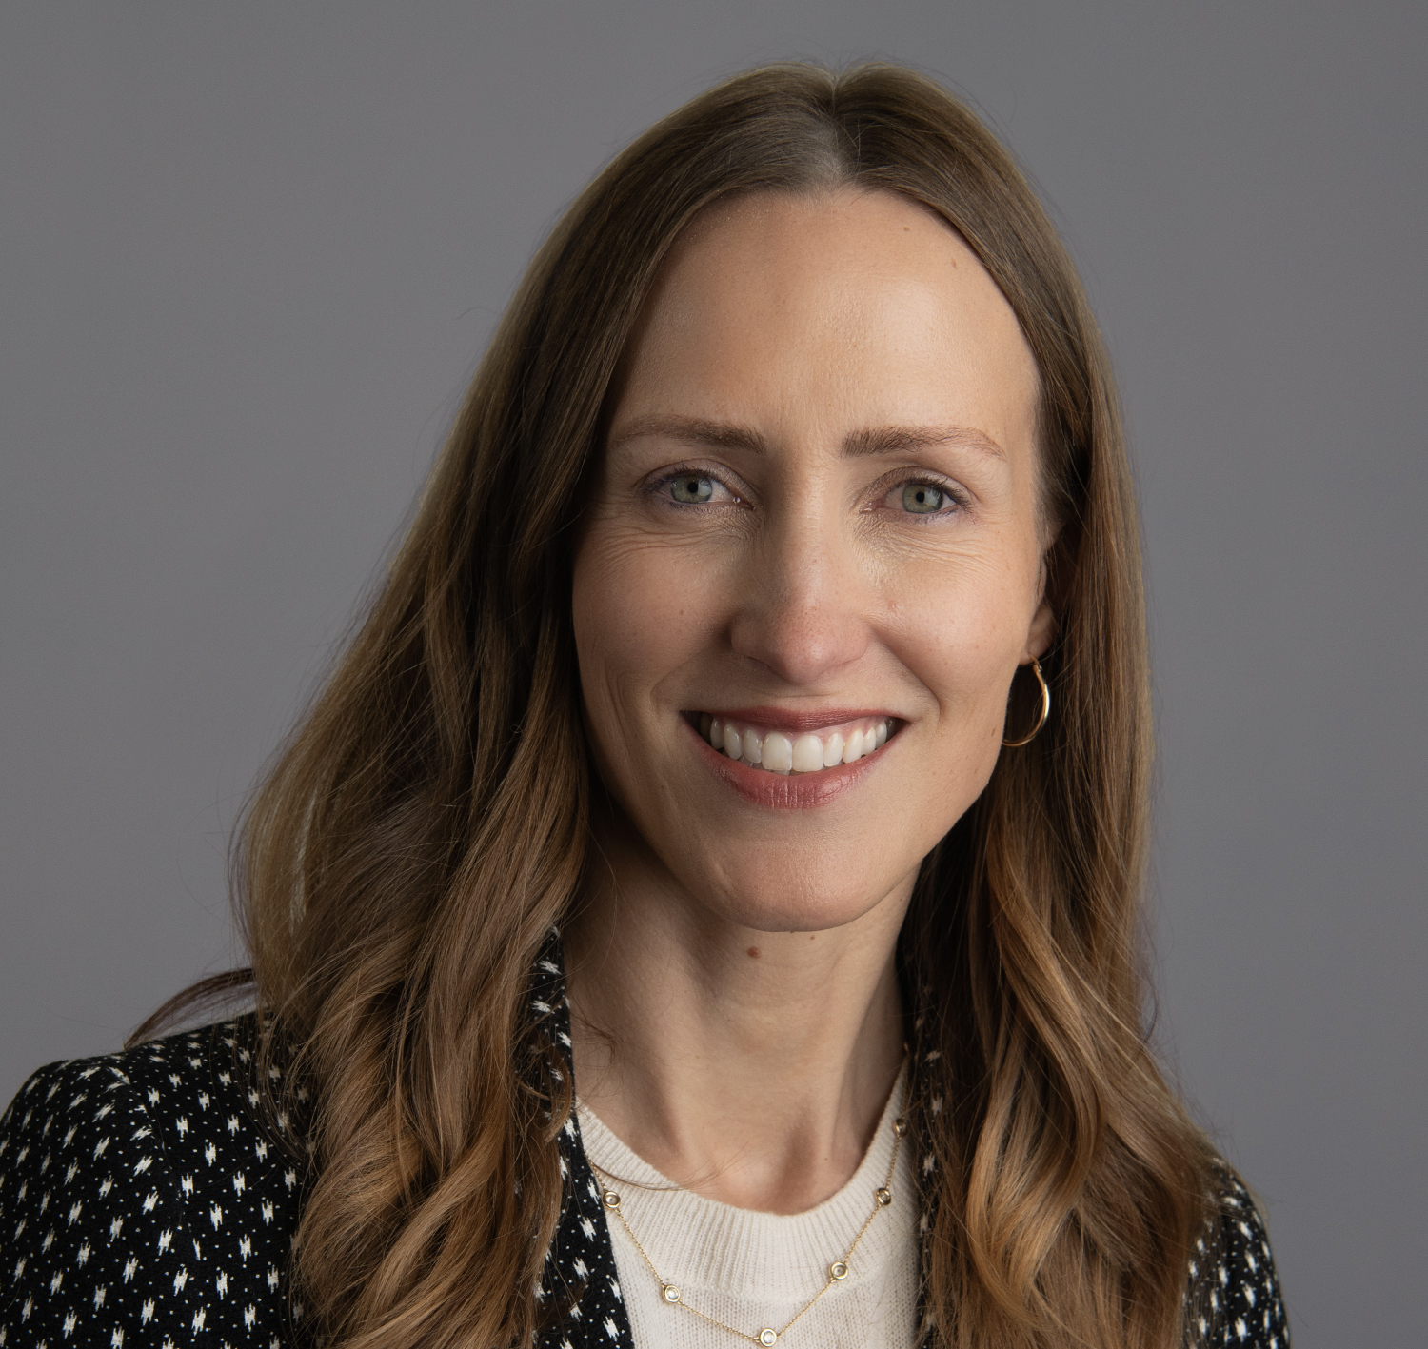
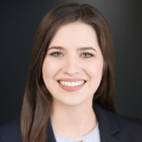

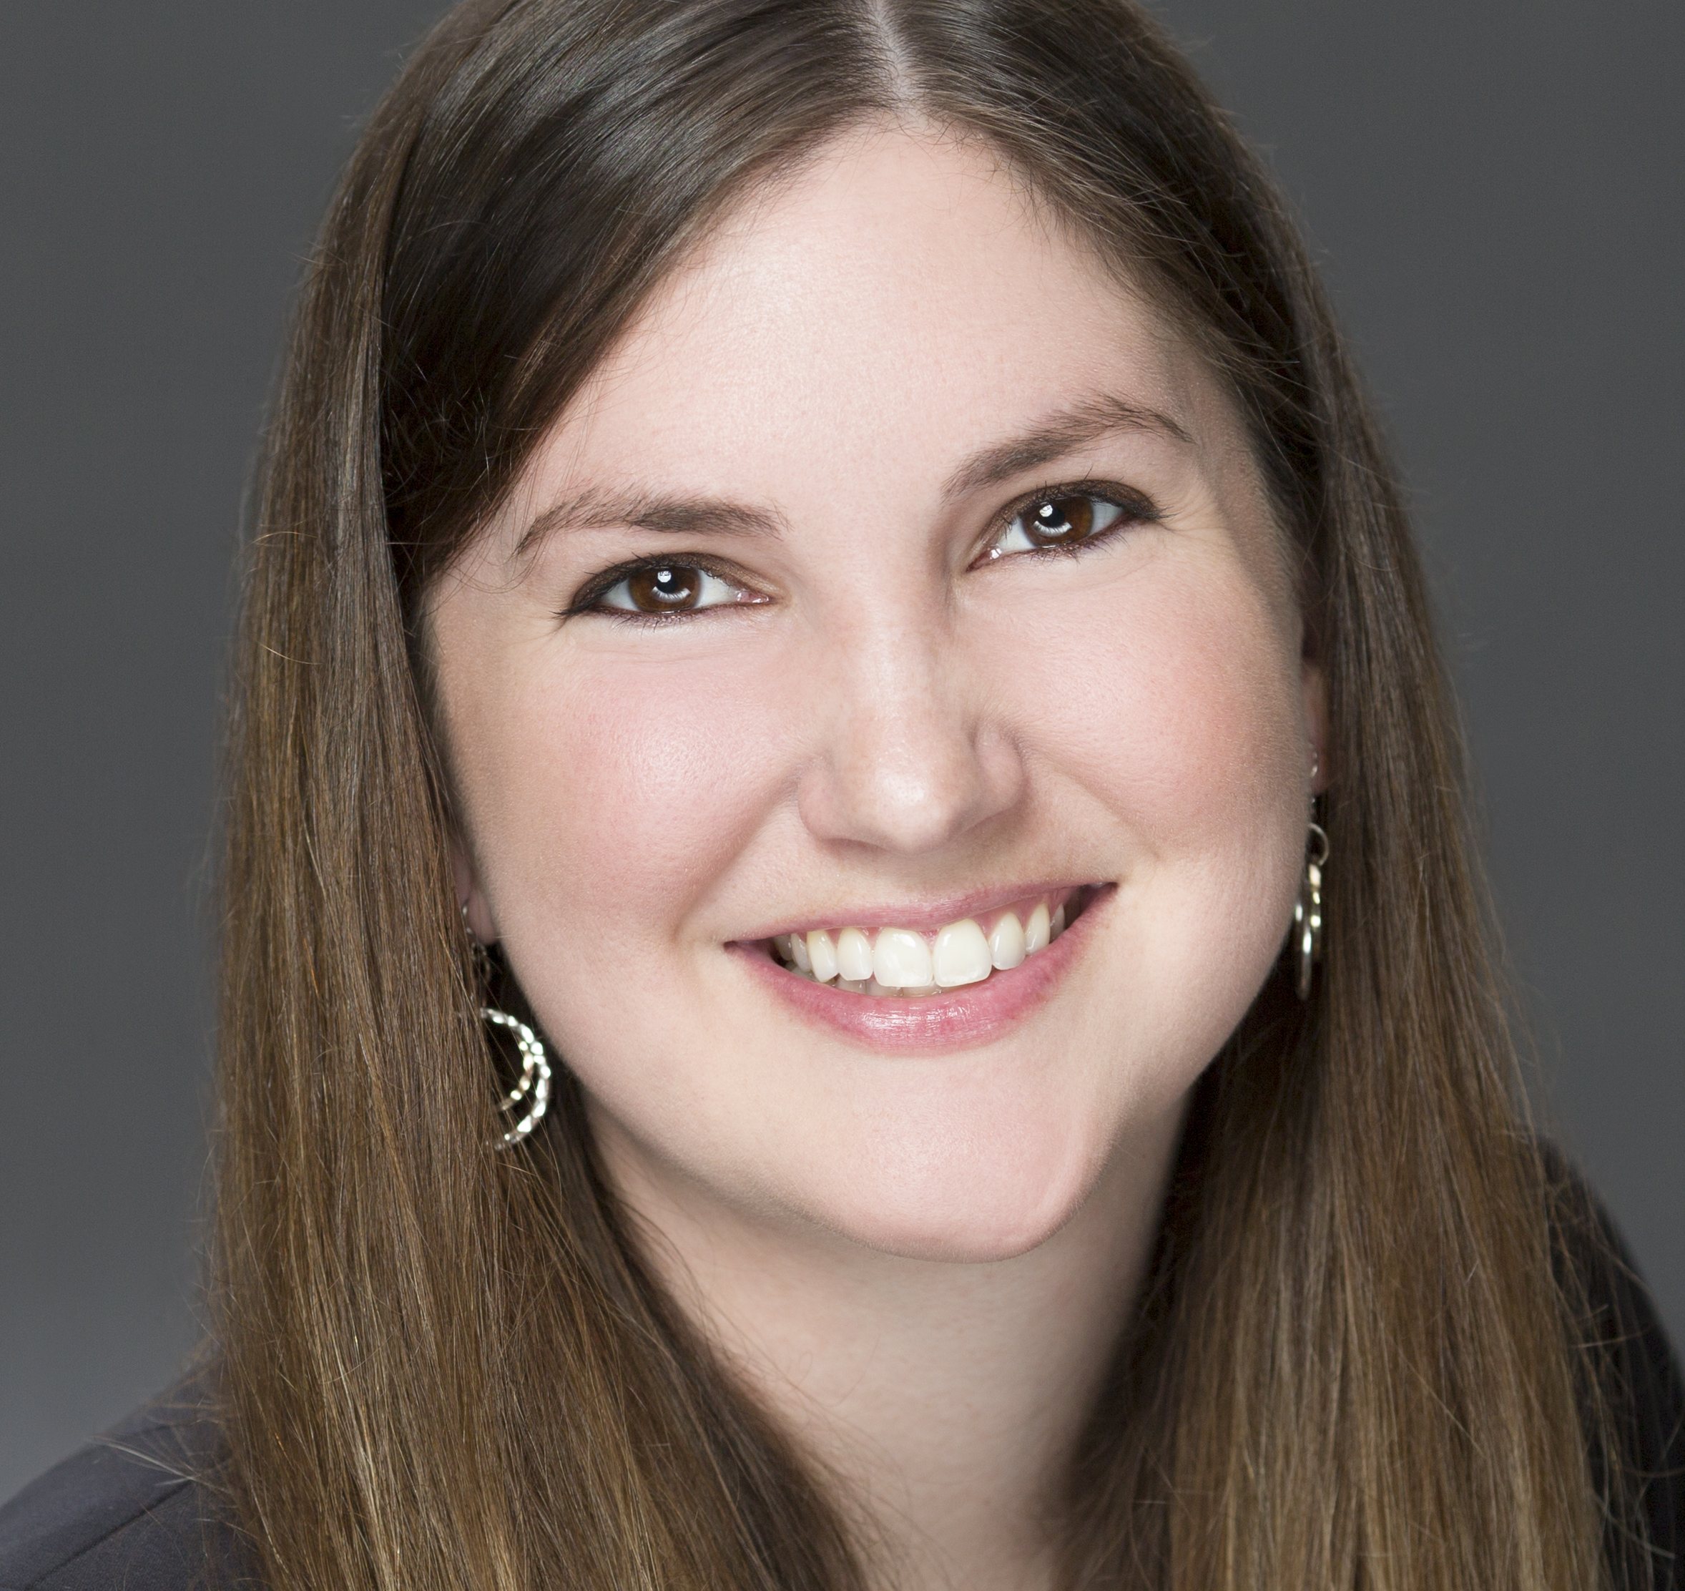
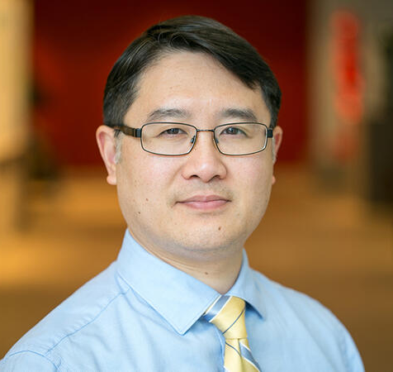
Meet Your Expert Panel
What questions do you have for our panelists?
Liz Goldberg, MD, ScM
Associate Professor
Department of Emergency Medicine
University of Colorado School of Medicine
Claire Bainbridge, PharmD, BCCCP, BCGP
Clinical Pharmacist, Age-Friendly ED,
UCSF Health
Mitchel Erickson, DNP, MS, BSN, BSc, ACNP-C
UCSF Geriatric Age-Friendly ED Consultant
Acute Care Nurse Practitioner, Division of Geriatrics
Clinical Professor, UCSF Department of Physiological Nursing
Rachel M. Skains, MD, MSPH
Assistant Professor
Department of Emergency Medicine
University of Alabama at Birmingham
Birmingham VA Medical Center, GRECC
Chris Fan-Lun, BScPhm, ACPR, BCGP
Clinical Coordinator – Geriatrics, Palliative Care and General Internal Medicine;
Department of Pharmacy, Sunnybrook Health Sciences Centre
Practice-Based Researcher, Sunnybrook Research Institute
Adjunct Lecturer, Leslie Dan Faculty of Pharmacy, University of Toronto

Slide 7
FY25 CMS Age-Friendly Hospitals Measure
 | Title | Measure
Domain 2 | Responsible Medication Management: | Our hospital reviews medications for the purpose of identifying potentially inappropriate medications (PIMs) for older adults as defined by standard evidence-based guidelines, criteria, or protocols

Slide 8
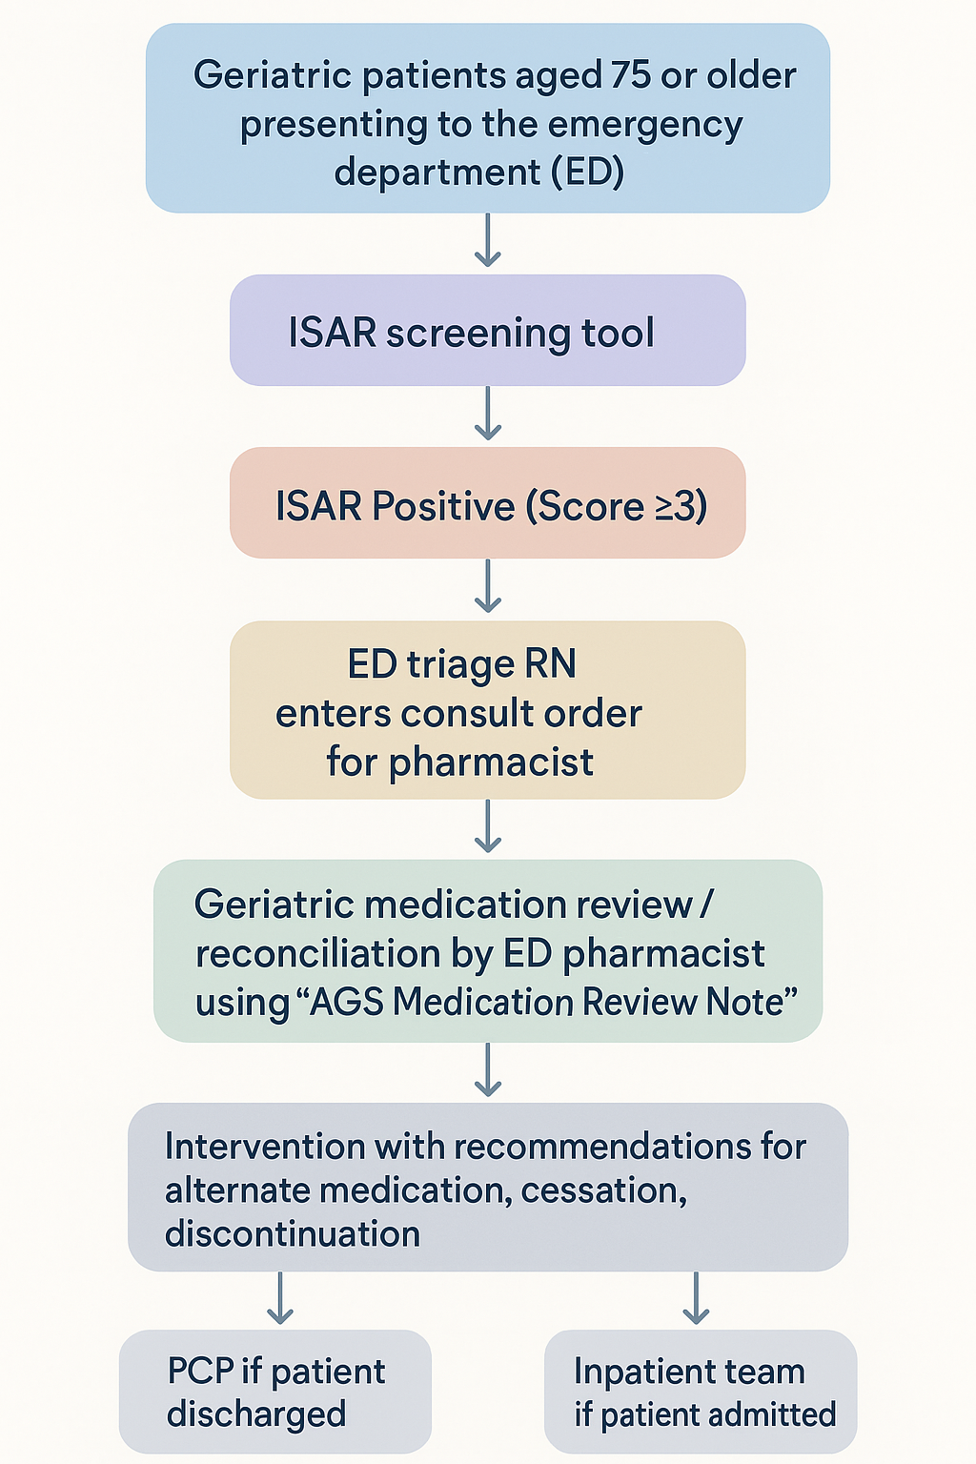

Minimizing PIMs in the Geriatric ED: A Care Process Guideline for Medication Review

Slide 9
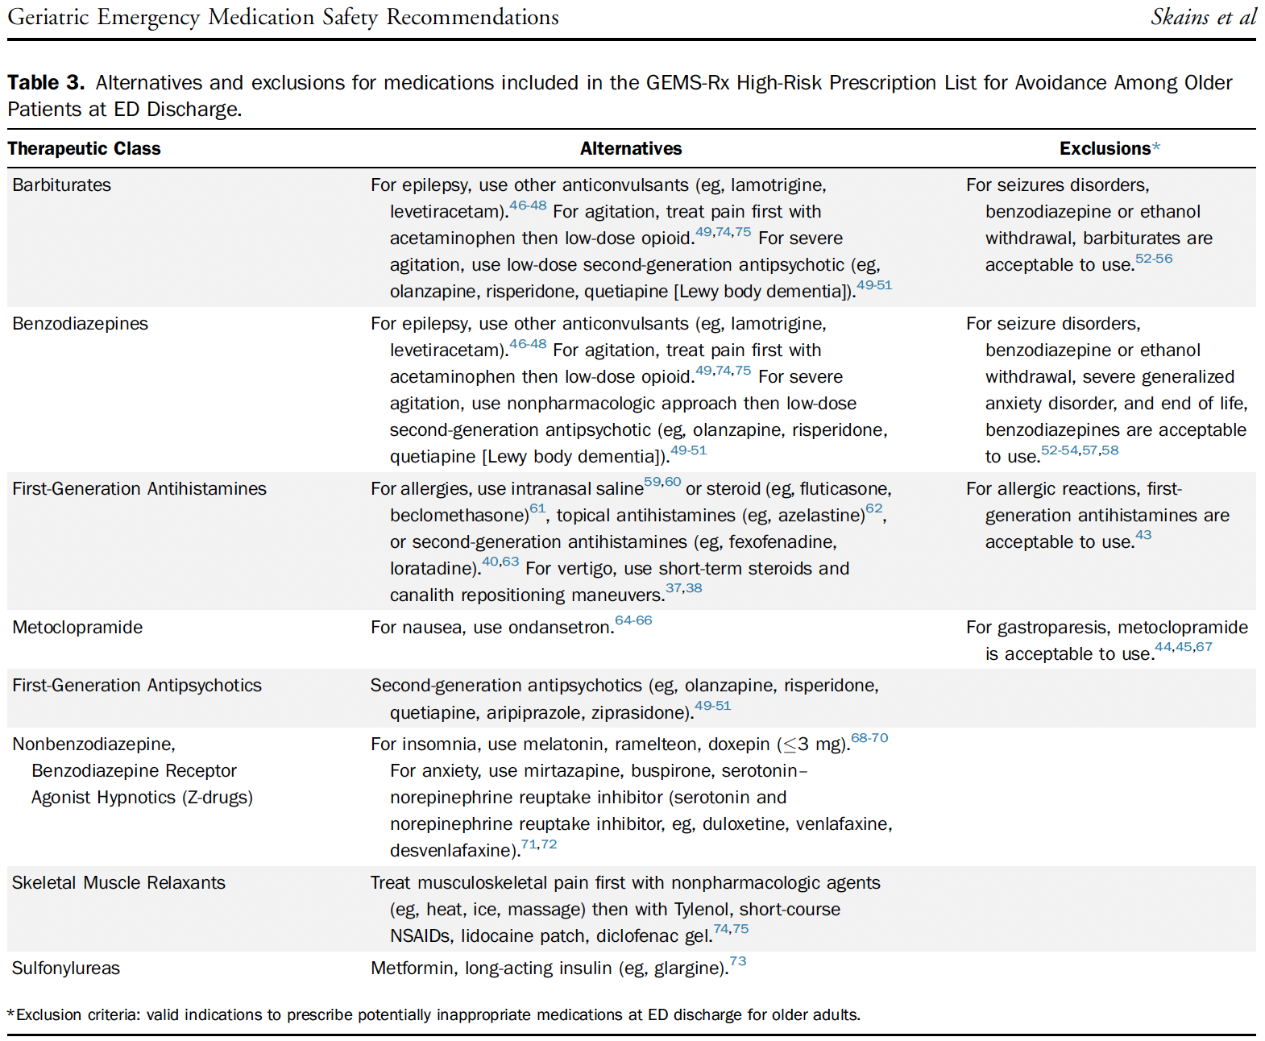
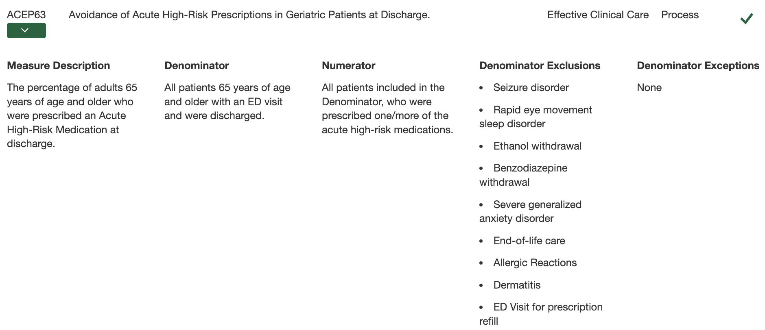
GEMS-RX

Slide 10
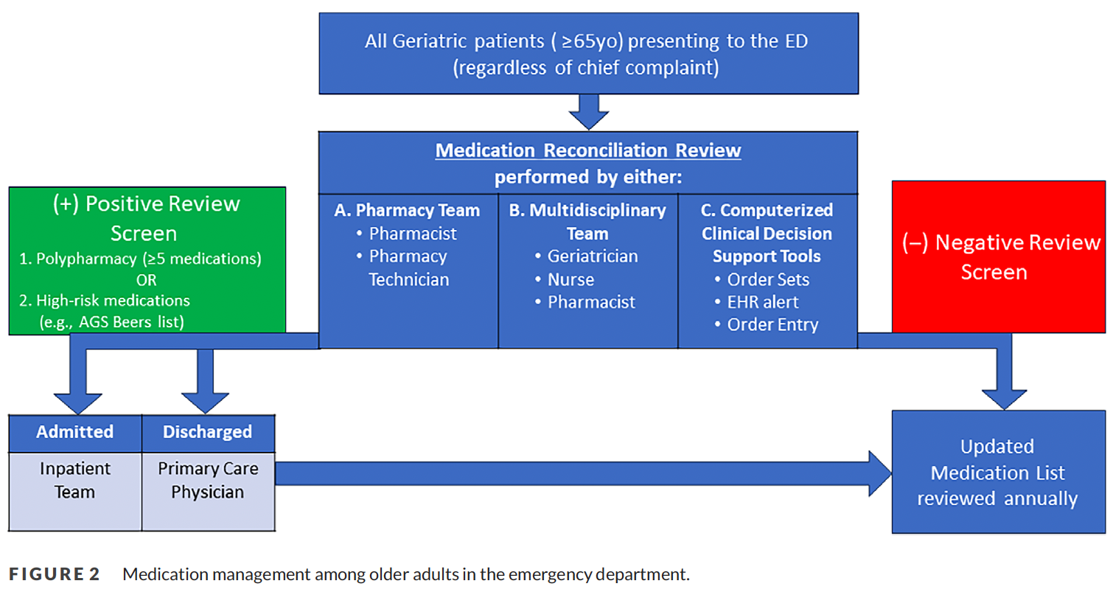
Minimizing PIMs in the Geriatric ED

Slide 11
Take away points: Chris Fan-Lun
Medication reconciliation and medication review are foundational care processes.
Reduce potentially inappropriate medication use.
Interdisciplinary collaboration in the ED enhances medication safety outcomes.
Use the new GEDC Medication Management Toolkit to achieve these 3 things.

Slide 12
Take away points: Claire Bainbridge and Mitchel Erickson
Medication reconciliation needs to include medication management challenges to be an important component as an accurate medication list.
The use of music as an intervention tool in the ED for behavioral expression management can avoid restraint and psychoactive medication interventions.
Using CODE DICE as an early preventative strategy to identify older adults with delirium or dementia behavior risks.

Slide 13
Take away points: Liz Goldberg
Effective strategies exist to identify patients who will most benefit from medication management, for example, those presenting with a fall.
EQUIPPED is a successful strategy to enhance clinician prescribing for older ED patients.
Adding pharmacists to the Geri ED care team is cost- and care-effective intervention.

Slide 14
Take away points: Rachel Skains
Geriatric ED Care Process: A practical, pharmacist-led medication review workflow—triggered by ISAR screening—can be embedded into ED practice to identify and address PIMs in older adults proactively.
GEMS-RX: Clinical decision support tools integrated into ED workflows can meaningfully reduce PIM prescribing, demonstrating a scalable, evidence-based strategy for safer geriatric care.
GED Guidelines 2.0: ED-based medication safety programs—including pharmacist interventions, geriatric consults, and CDS tools—consistently improve ordering, prescribing, and deprescribing practices, reinforcing the importance of interdisciplinary models in geriatric medication management.

Slide 15

Q & A
Ask your questions
in the chat!
We will try to get to everyone

Slide 16
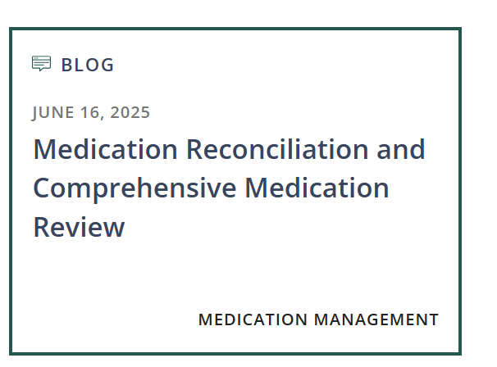
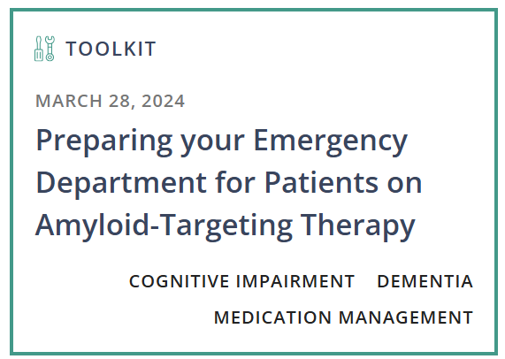
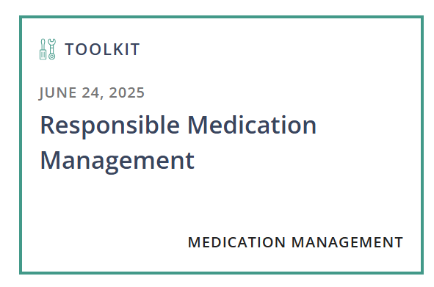
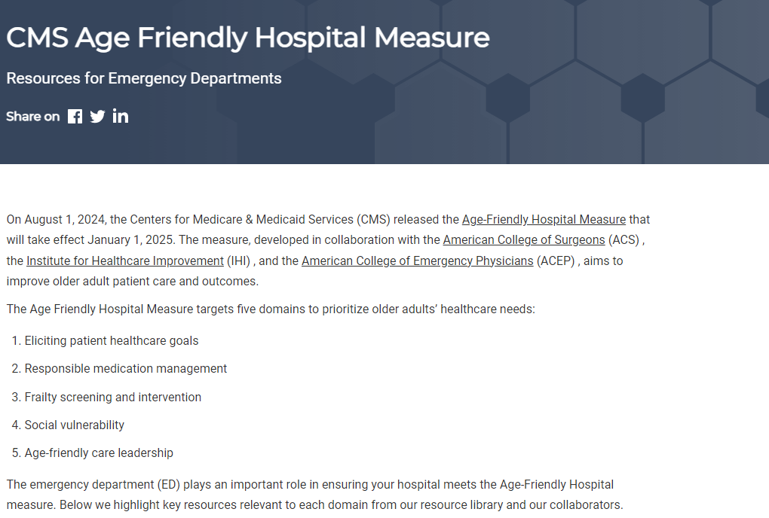
CMS & Medication Resources
NEW TOOLKIT
Medication Management
https://gedcollaborative.com/resource/medication-management/medication-reconciliation-and-comprehensive-medication-review/
https://gedcollaborative.com/article/cms-hospital-measure-resources-for-eds/
https://gedcollaborative.com/resource/preparing-your-emergency-department/
https://gedcollaborative.com/resource/medication-management/responsible-medication-management/

Slide 17


GEDC Consulting Services
IMPROVE GERIATRIC CARE AND OUTCOMES
The GEDC Team will work with your site and health system leaders to create a consulting engagement package that will help your ED or health system reach its goals.
AGE-FRIENDLY GUIDELINES SUPPORT
The GEDC offers specialized Consulting Services to help your site or system meet its unique needs.
  Achieving GED accreditation or leveling up to achieve Level 1 or 2 status
  Excelling on the CMS Age-friendly Guidelines
  Your hospital or system’s needs, challenges, or goals for geriatric care
https://gedcollaborative.com/consulting-and-services/
Notes:
First step: gedc membership (next slide)

Slide 18

OUR NEXT GEDC
EXPERT PANEL WEBINAR
What Matters: Eliciting Patient Healthcare Goals and the CMS Hospital Measure
Part 3 of the CMS Hospital Measure Webinar Series
Register Now
October 27, 2025
3pm EST
https://gedcollaborative.com/resource/what-matters-eliciting-patient-healthcare-goals-and-the-cms-hospital-measure/
Notes:
Title on TEAMS from Don

Slide 19

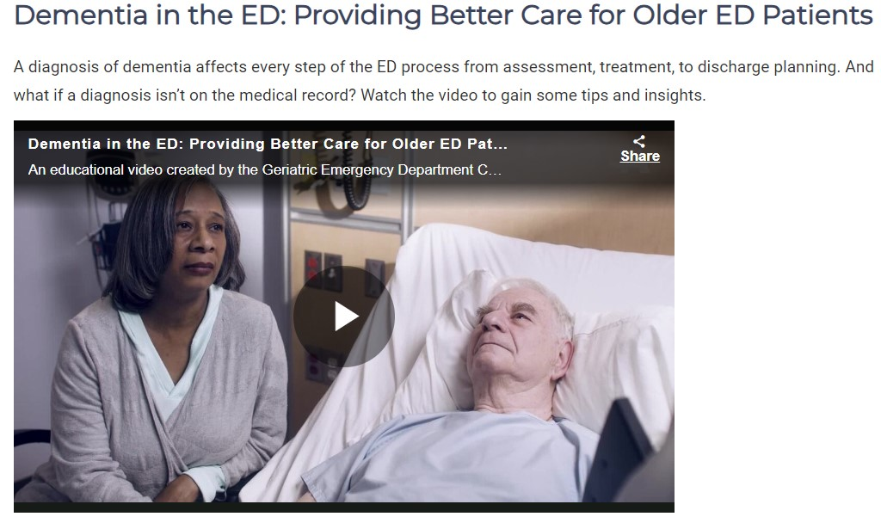
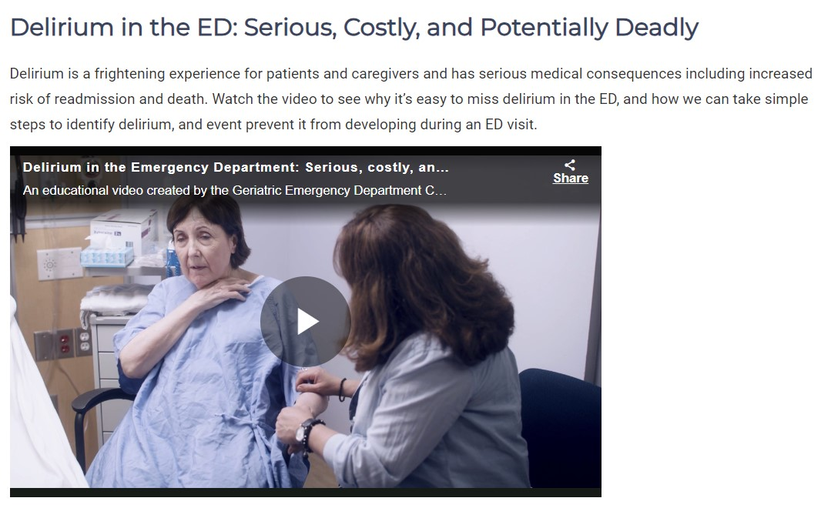
Brain Health in the ED
Educational Videos by AARP
https://gedcollaborative.com/resource/brain-health-in-the-ed-videos/

Slide 20

Join
the
GEDC
gedcollaborative.com
@theGEDC
We bring best practice into action.

Slide 21
Generously supported by

