Slide 1



The CMS Age-Friendly Hospital Measures and the Geriatric ED
Expert Panel Webinar
Monday, April 7, 2025
3–4 pm EST
Generously supported by:
Moderated by:
Don Melady, MD, MSc(Ed)
Professor, University of Toronto
Emergency Physician
Mount Sinai Hospital, Toronto, Canada
GEDC Faculty

Slide 2
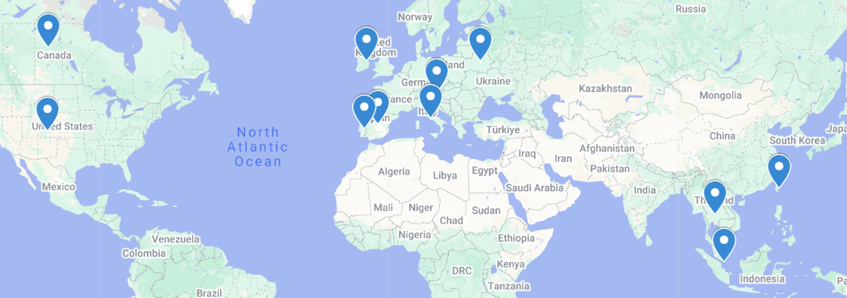
Global attendance joining us today:
United States
Austria
Belarus
Canada
Germany
Spain
Ireland
Italy
Portugal
Singapore
Thailand
Taiwan
440 Registrants across 12 Countries

Slide 3
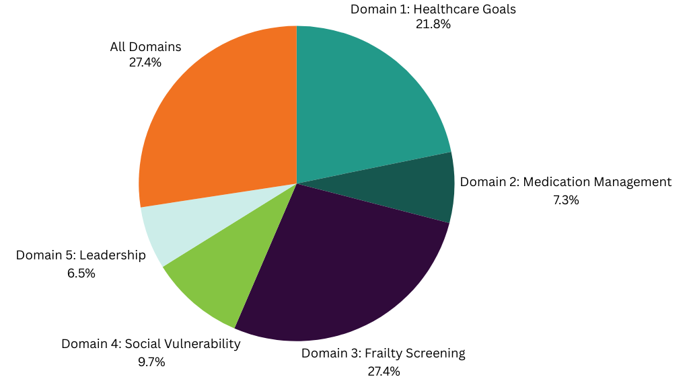
Of the five domains of the CMS Age Friendly Hospital Measures,
which one is most important to you?

Slide 4

Membership
Join the ranks of hospitals that are providing the best possible care to older adults in the ED, while helping to define best practices.
Member Benefits:
Unlock ED Resources
Access Tailored Content
Track your Team’s Progress
Get Individualized Support
Engage in Consulting Engagements
Make Global Connections
Learn about ED Leadership Engagement
gedcollaborative.com
Mission & Vision
A world where all emergency departments provide the highest quality of care for older patients.
We transform and evaluate interdisciplinary best practice in geriatric emergency medicine, and then build and distribute practical, evidence-based clinical curriculum and quality improvement tools that support sustainable, quality care for older adults.
Join the GEDC
https://gedcollaborative.com/membership/

Slide 5
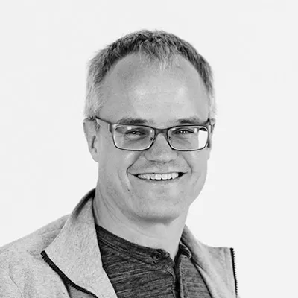
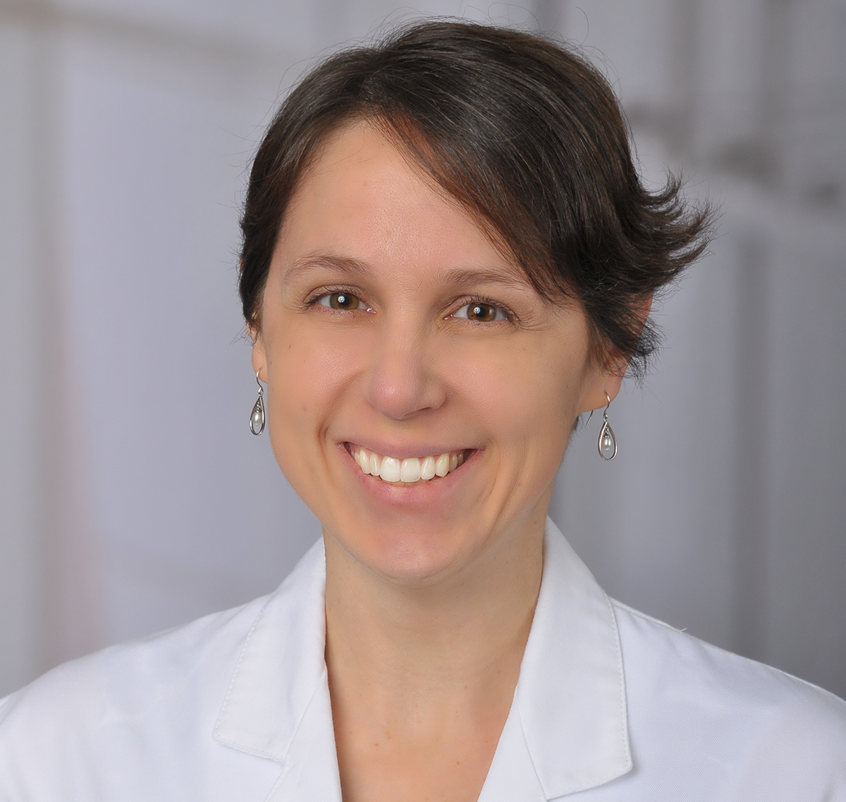
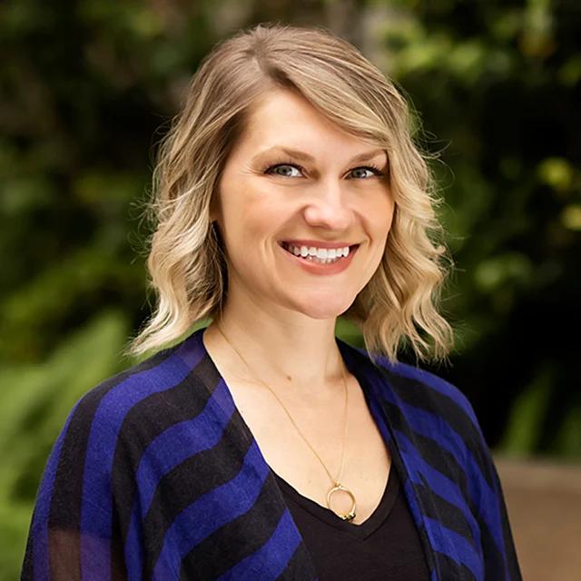
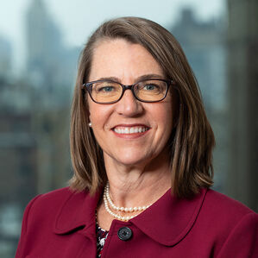
Meet Your Expert Panel
What questions do you have for our panelists?
Kevin Biese, MD, MAT
Vice-Chair, Academic Affairs Director
Division of Geriatric Emergency Medicine
Clinical Associate Professor
Internal Medicine, Division Of Geriatrics
Chapel Hill, NC
Lauren T. Southerland, MD MPH
Associate Professor
Department of Emergency Medicine
The Ohio State University
Special Guest:
Nida Degesys, MD
Director of Age-Friendly Emergency Department
University of California San Francisco
Rani E. Snyder, MPA
Acting President
The John A. Hartford Foundation

Slide 6
Intro by the John A. Hartford Foundation
Rani E. Snyder, MPA
Acting President

Slide 7
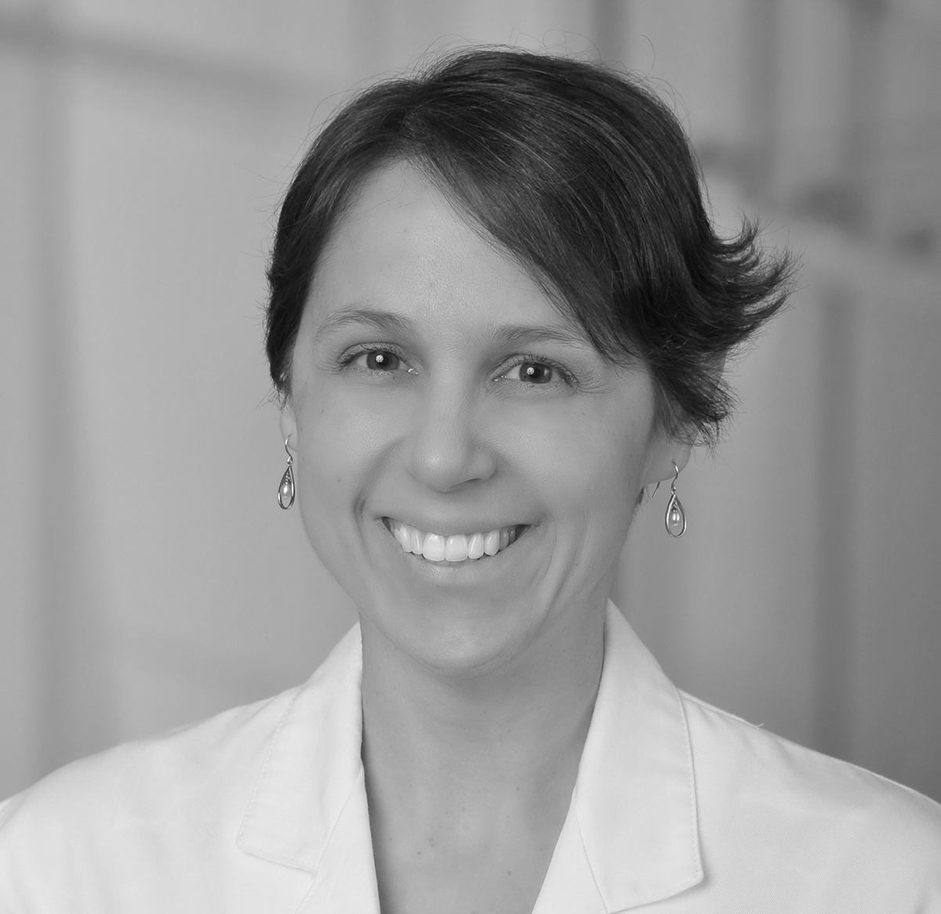
Overview of CMS Measure
Lauren Southerland, MD MPH
Associate Professor
Department of Emergency Medicine
The Ohio State University

Slide 8
Five Domains to Prioritize Older Adults’ Healthcare Needs
Domain 1: Eliciting Patient Healthcare Goals
Domain 2: Responsible Medication Management
Domain 3: Frailty Screening and Intervention
Domain 4: Social Vulnerability
Domain 5: Age-Friendly Care Leadership
8

Slide 9
FY25 CMS Age-Friendly Hospitals Measure
 | Title | Measure
Domain 1 | Eliciting Patient Healthcare Goals: | Our hospital has protocols in place to ensure patient goals related to healthcare (i.e., health goals, treatment goals, living wills, identification of health care proxies, advance care planning) are obtained/reviewed and documented in the medical record. These goals are updated before major procedures and upon significant changes in clinical status.

Slide 10
FY25 CMS Age-Friendly Hospitals Measure
 | Title | Measure
Domain 2 | Responsible Medication Management: | Our hospital reviews medications for the purpose of identifying potentially inappropriate medications (PIMs) for older adults as defined by standard evidence-based guidelines, criteria, or protocols

Slide 11
FY25 CMS Age-Friendly Hospitals Measure
 | Title | Measure
Domain 3 | Frailty Screening and Intervention (Mobility, Mentation, and Malnutrition): | Malnutrition risk screening Delirium risk screening and Mobility plans Fall risk screening, Decubitus ulcers, and 30 day readmissions for patients 65+ Reduce ED delirium by transferring older patients out of the ED within 8 hours of arrival or within 3 hours of admission.

Slide 12
FY25 CMS Age-Friendly Hospitals Measure
 | Title | Measure
Domain 4 | Social Vulnerability (social isolation, economic insecurity, caregiver stress, elder abuse): | Screening for social isolation, economic insecurity, caregiver stress, and elder abuse on admission and again prior to discharge. Positive screens have associated interventions

Slide 13
FY25 CMS Age-Friendly Hospitals Measure
 | Title | Measure
Domain 5 | Age Friendly Care Leadership: | Our hospital designates a point person and/or interprofessional committee to specifically ensure age friendly care issues are prioritized, including those within this measure

Slide 14
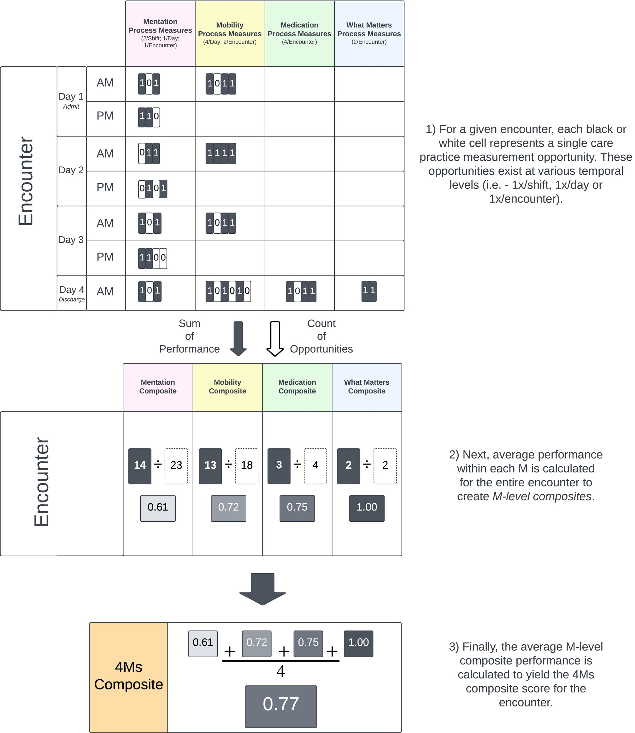
Developing electronic health record‐based measures of the 4Ms to support implementation and evidence generation for Age‐Friendly Health Systems
Thrombley RL, Rogers SE, and Adler-Milstein J. J American Geriatrics Society, Volume: 72, Issue: 3, Pages: 882-891., DOI: (10.1111/jgs.18722)
Notes:
4Ms care composite: encounter‐level.
IF THIS IMAGE HAS BEEN PROVIDED BY OR IS OWNED BY A THIRD PARTY, AS INDICATED IN THE CAPTION LINE, THEN FURTHER PERMISSION MAY BE NEEDED BEFORE ANY FURTHER USE. PLEASE CONTACT WILEY'S PERMISSIONS DEPARTMENT ON PERMISSIONS@WILEY.COM OR USE THE RIGHTSLINK SERVICE BY CLICKING ON THE 'REQUEST PERMISSIONS' LINK ACCOMPANYING THIS ARTICLE. WILEY OR AUTHOR OWNED IMAGES MAY BE USED FOR NON-COMMERCIAL PURPOSES, SUBJECT TO PROPER CITATION OF THE ARTICLE, AUTHOR, AND PUBLISHER.

Slide 15
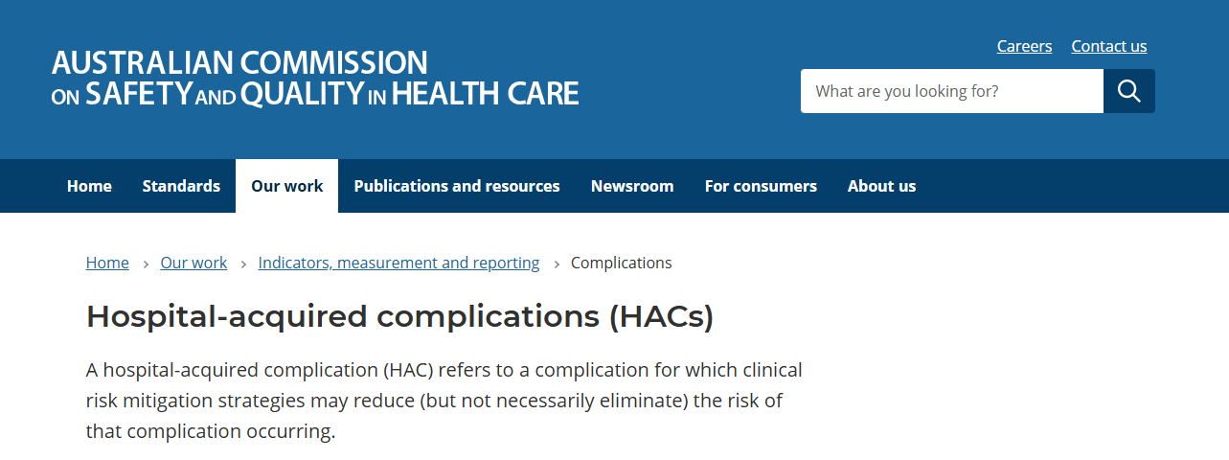
All public hospitals report:
Falls resulting in injury
Pressure injuries (all)
Medication complications (including from psychotropic overuse)
Delirium
Malnutrition
Notes:
https://www.safetyandquality.gov.au/our-work/indicators-measurement-and-reporting/hospital-acquired-complications-hacs

Slide 16
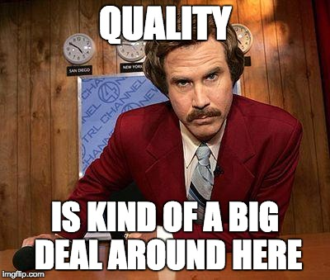
Take away points: Lauren Southerland
Do some digging first.
Work with your ED team and hospital to decide on where to focus.
Needs strong IT assistance to pull data on these.
Advocate for your team!

Slide 17
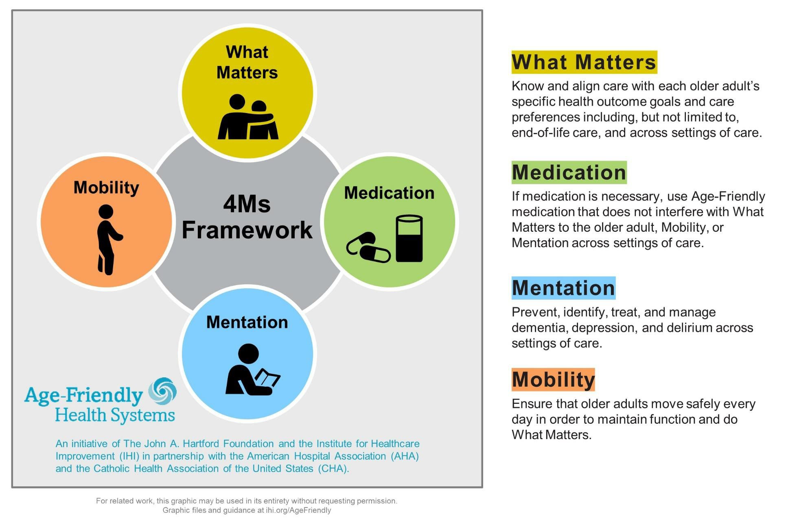
The 4Ms of Age-Friendly Care

Slide 18
Improved Dementia Care in the ED
Nida Degesys, MD
Director of Age-Friendly Emergency Department
University of California at San Francisco
Age-Friendly ED

Slide 19
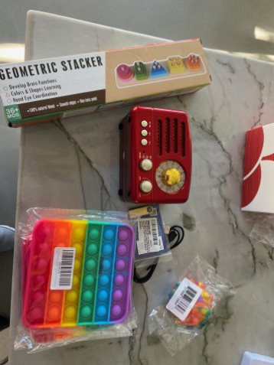
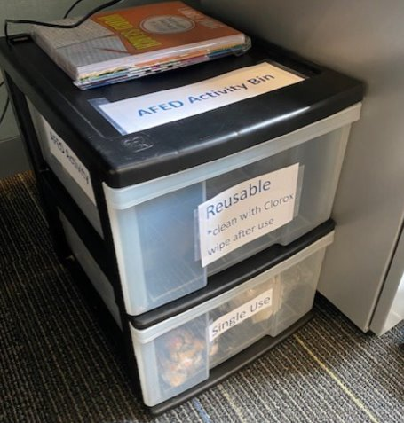
Activity Carts
Reusable vs single use
Nuts/bolts sorters
Activity books/aprons/stackers etc

Slide 20
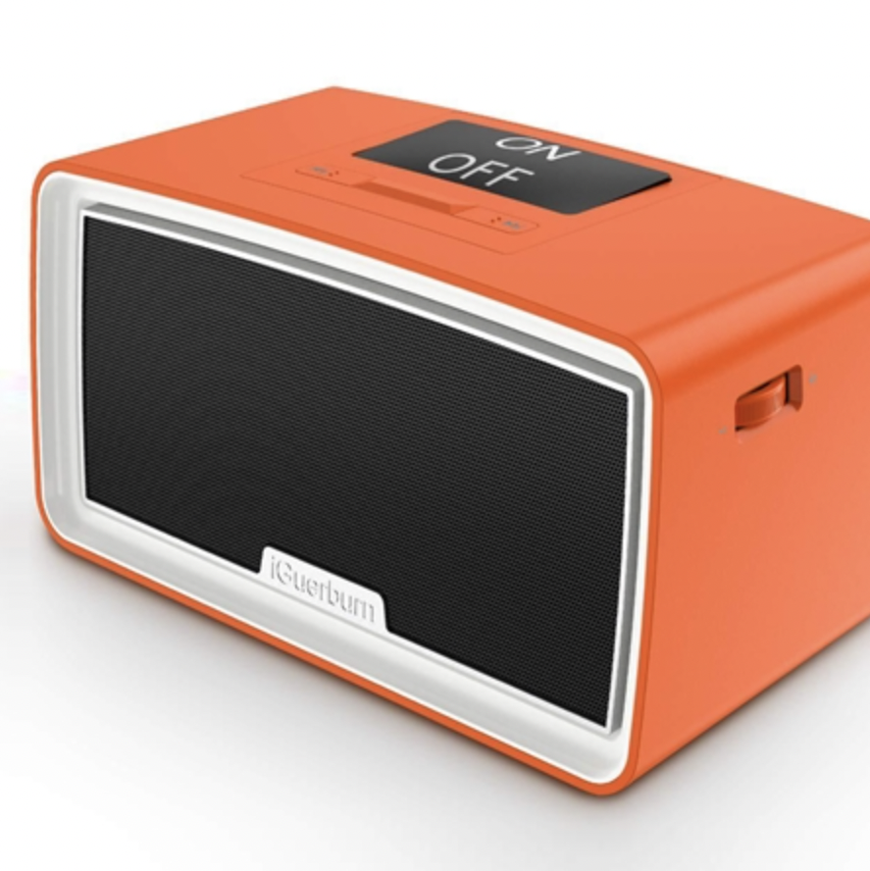
Music
Music is medicine
  Play music from teens/20s
Decreases agitation
Decreases anxiety (caregivers too!)
Improves communication
Cost: $100-200/box
Music therapist is more $
Notes:
https://www.alzstore.com/Seniors-Simple-Music-Player-MP3-Music-Box-p/2127.htm
The long-term memory of music remains intact until the very late stages of disease progression, right before the disease attacks the brainstem. It is currently unknown why Alzheimer’s disease affects this area last. The theory behind musical intervention is that activating this part of the brain can help stimulate other parts of the brain to improve mood and social engagement in people with dementia.

Slide 21
Take away points: Nida Degesys
Low-hanging fruit: activity cart, music, remove NPO as the default
Reduce restraint use, try the DICE method
If you have access to a memory or aging center, work with them to create a referral pathway.

Slide 22
Take away points: Kevin Biese
The measure mandates what we advocate for
Boarding requirement is key, as is Age Friendly Care Leadership
Use the CMS Measure as a tool to Create Change

Slide 23

Q & A
Ask your questions
in the chat!
We will try to get to everyone

Slide 24
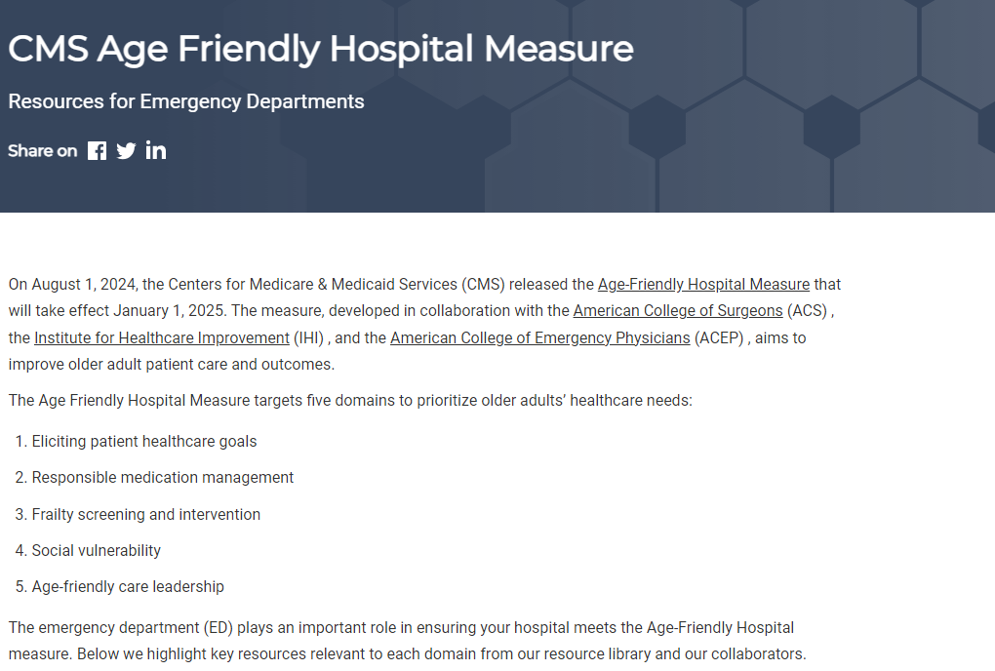
CMS Resources
Resources for each of the 5 domains of the CMS measure
https://gedcollaborative.com/article/cms-hospital-measure-resources-for-eds/

Slide 25


GEDC Consulting Services
IMPROVE GERIATRIC CARE AND OUTCOMES
The GEDC Team will work with your site and health system leaders to reach your ED’s goals.
AGE-FRIENDLY GUIDELINES SUPPORT
The GEDC offers specialized Consulting Services to help your site or system meet its unique needs.
  Excelling on the CMS Age-friendly Guidelines
  Your hospital or system’s needs, challenges, or goals for geriatric care
https://gedcollaborative.com/consulting-and-services/
Notes:
First step: gedc membership (next slide)

Slide 26

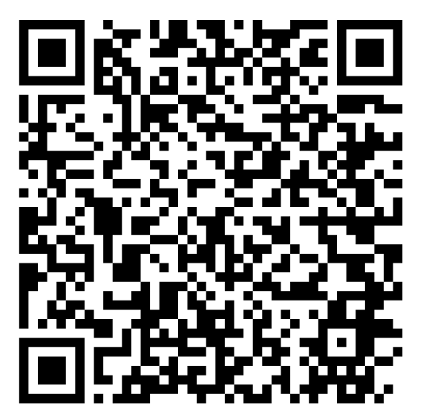
OUR NEXT GEDC
EXPERT PANEL WEBINAR
Medication Management and the CMS Hospital Measure
Part 2 of the CMS Hospital Measure Webinar Series
Register Now
July 14, 2025
3pm EST
https://gedcollaborative.com/resource/medication-management-and-the-cms-hospital-measure/
Notes:
Title on TEAMS from Don

Slide 27

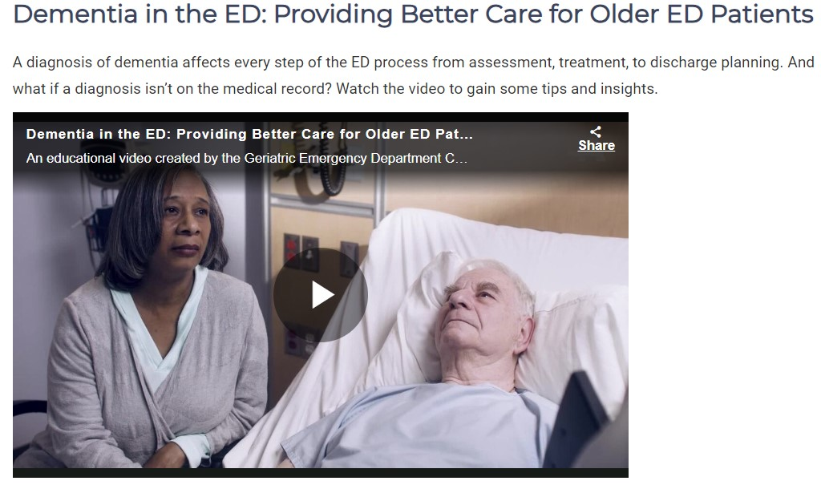
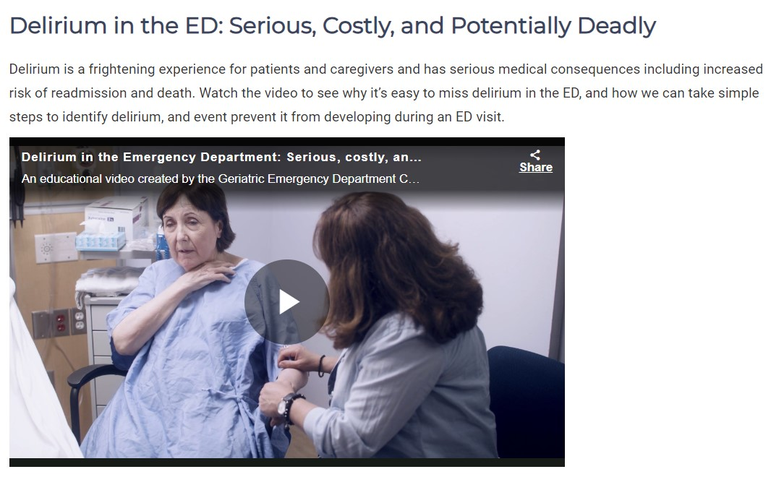
Brain Health in the ED
Educational Videos by AARP
https://gedcollaborative.com/resource/brain-health-in-the-ed-videos/

Slide 28

Join
the
GEDC
gedcollaborative.com
@theGEDC
We bring best practice into action.

Slide 29
Generously supported by

