Slide 1
Consulting Engagement Onboarding
Thursday, April 4, 2024

Slide 2
Meet Our Team
World-class experts in Healthcare Administration & Geriatric Emergency Departments
Dr. Kevin Biese, MD, MAT Principal Investigator
Aaron Malsch, RN, MSN, GCNS-BC Core Faculty
Alex Ostberg, MPH Program Manager
Megan Donovan, MBA Consultant
Executive Leader providing oversight and guidance
Subject Matter Expert conducting analysis and producing recommendations
Primary Point of Contract managing the engagement from kick-off to completion
Advisor providing strategic recommendations for the engagement

Slide 3
Key Priorities (November 2023)
Admission & readmission rates in 65+ patients
Admissions within a culturally diverse population
Preventable admissions
Length of stay

Slide 4
Current State & Goals
Let us help you meet your system & hospital goals.
What are your current pain points?
What are your current priorities?
What does success look like?
How do you plan to use our final report?
Notes:
KEVIN

Slide 5
Our Proven Process
Is this a feasible timeline?
4.04.24
4.18.24
5.02.24
Onboarding
Discovery
Kick-Off
ED
Evaluation
Wrap-Up
Final Report
6.20.24
6.06.24
5.16.24

Slide 6
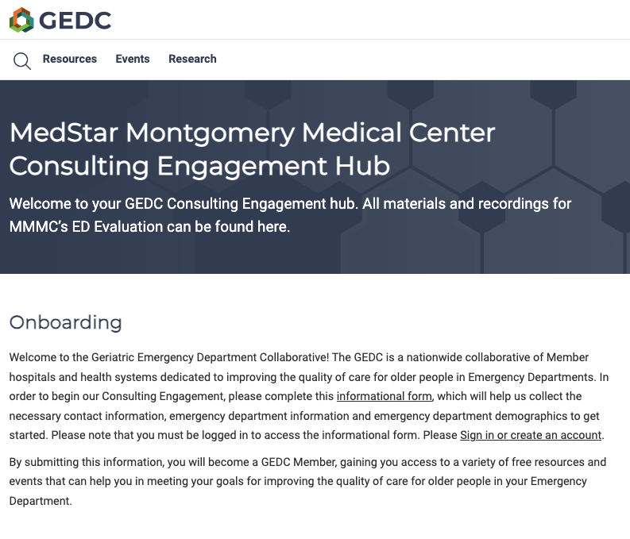
Your Consulting Engagement Hub
https://gedcollaborative.com/mmmc-consulting-engagement-hub/
All materials and recordings for MMMC’s ED Evaluation will be housed on the Hub.

Slide 7
Discovery Next Steps for MMMC
Target Completion: 4.18.24
Once GEDC has the information and data it needs to get started, kick-off and ED Evaluation can begin.
Identify Project Team Complete Stakeholder Map
Provide Contact Information Complete Informational Form linked on the Hub
Identify Key Goals & Pain Points Prepare for the Next Meeting

Slide 8
Future Steps
Provide Clinical Policies
Complete Discovery Survey*
Provide Baseline Data
Complete Discovery Survey*
*We are consolidating policies & baseline data submissions into one Discovery Survey. This will be sent after our next meeting.

Slide 9
Consulting Engagement Onboarding
Thursday, April 4, 2024

