Slide 1



Research and the Geriatric ED
Expert Panel Webinar
Monday, October 7, 2024
3–4 pm EST
Generously supported by:
Moderated by:
Don Melady, MD, MSc(Ed)
Professor, University of Toronto
Emergency Physician
Mount Sinai Hospital, Toronto, Canada
GEDC Faculty

Slide 2
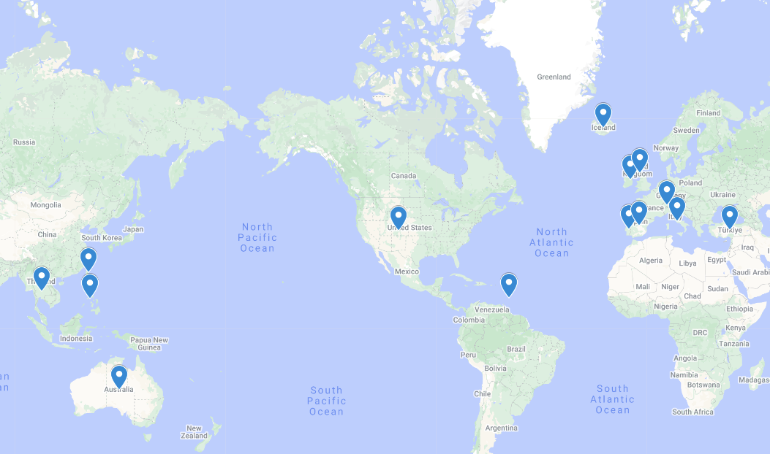
What is the most important topic for additional research
in care of older adults in the ED?
Canada
Australia
Barbados
Iceland
Ireland
Italy
Philippines
Portugal
Spain
Switzerland
Taiwan
Thailand
Turkey
United Kingdom
United States
218 Registrants across 15 Countries

Slide 3

What is the most important topic for additional research
in care of older adults in the ED?
Dementia
Pre-hospital care processes
Delirium interventions and delirium screening
How to integrate frailty assessment
Falls assessment
Trauma management of older adults
Impact of boarding
Care of diverse populations including under- represented minorities and LGBTQ+ populations
Impact of technology and AI
Patient-related Outcome Measures
ED at Home
Hospital at Home/Alternatives to admission
Elder abuse interventions
Palliative and end-of-life care
Transitions of care
Transgender older adults in the ED and their experience

Slide 4

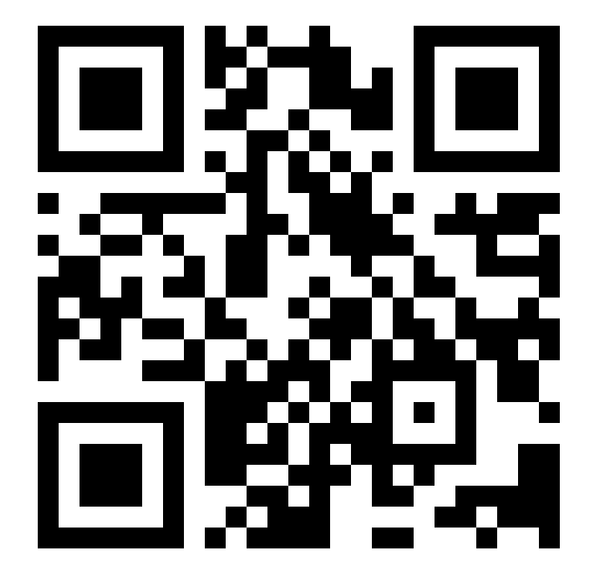
Membership
GEDC Members work together to transform ED care of older adults; catalyze action at local and national levels to support these care transformations; and evaluate the impact of these new models of care for older people.
Make your plan to become a GED
Access to GEDC Community
Participate in consulting services
Access to education tools
Implementation tools and training
Evaluation resources
gedcollaborative.com
Mission & Vision
A world where all emergency departments provide the highest quality of care for older patients.
We transform and evaluate interdisciplinary best practice in geriatric emergency medicine, and then build and distribute practical, evidence-based clinical curriculum and quality improvement tools that support sustainable, quality care for older adults.
Join
the
GEDC
https://gedcollaborative.com/membership/

Slide 5
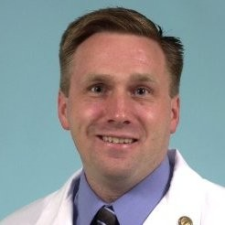
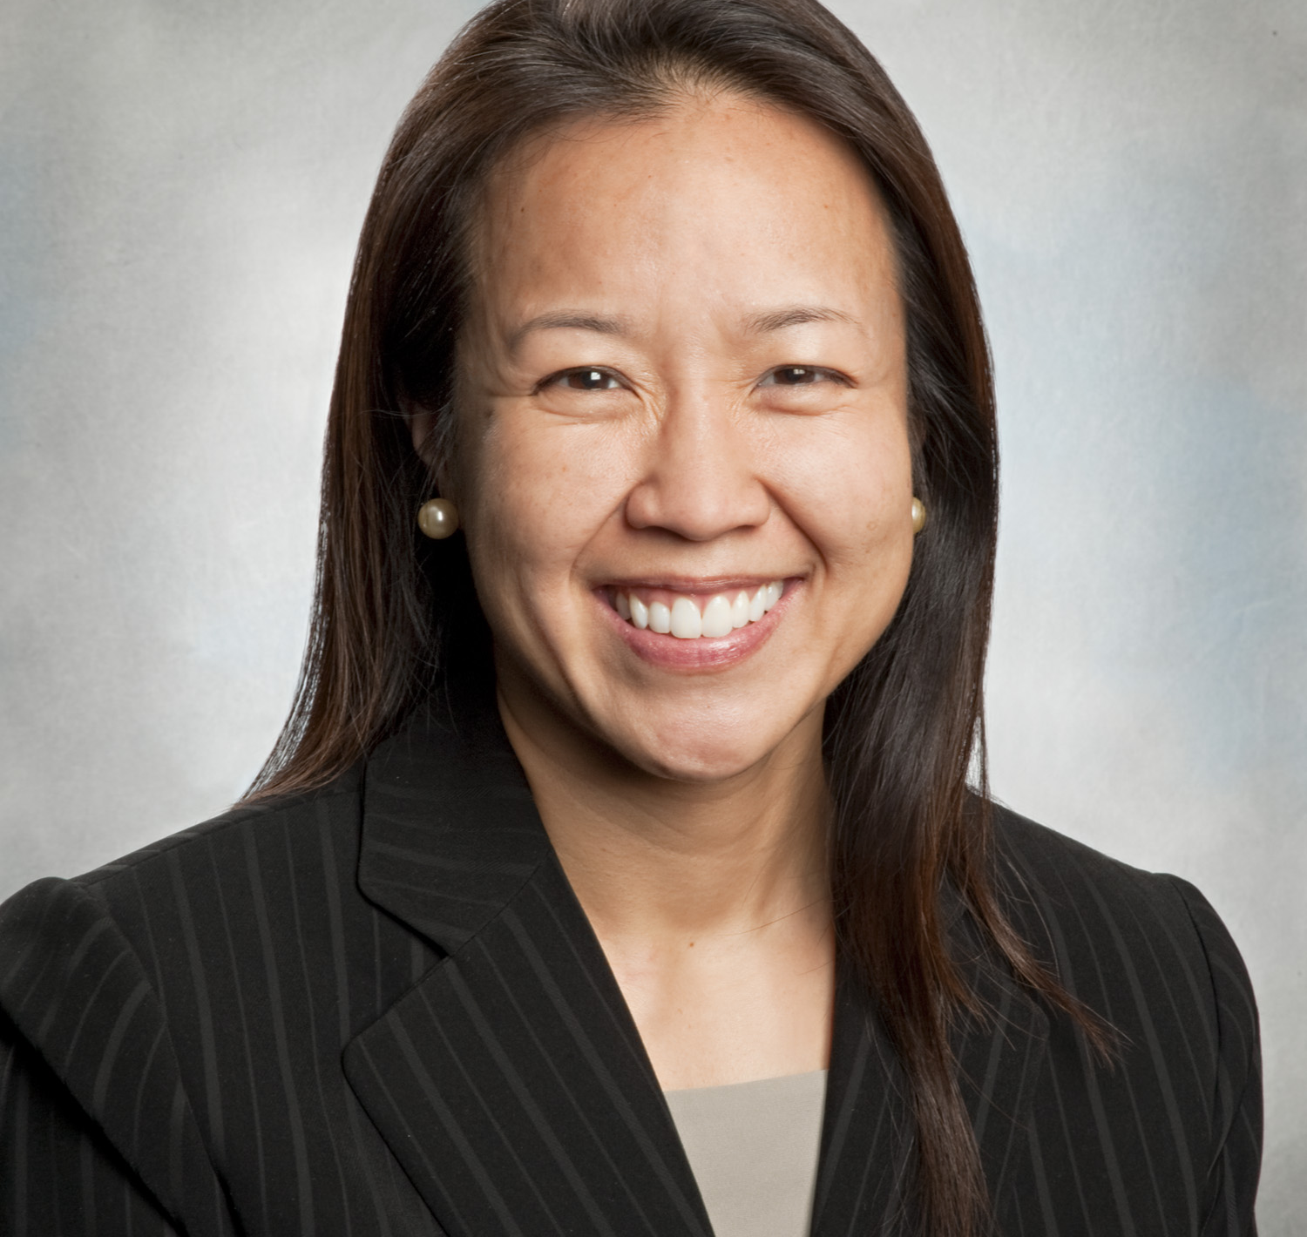
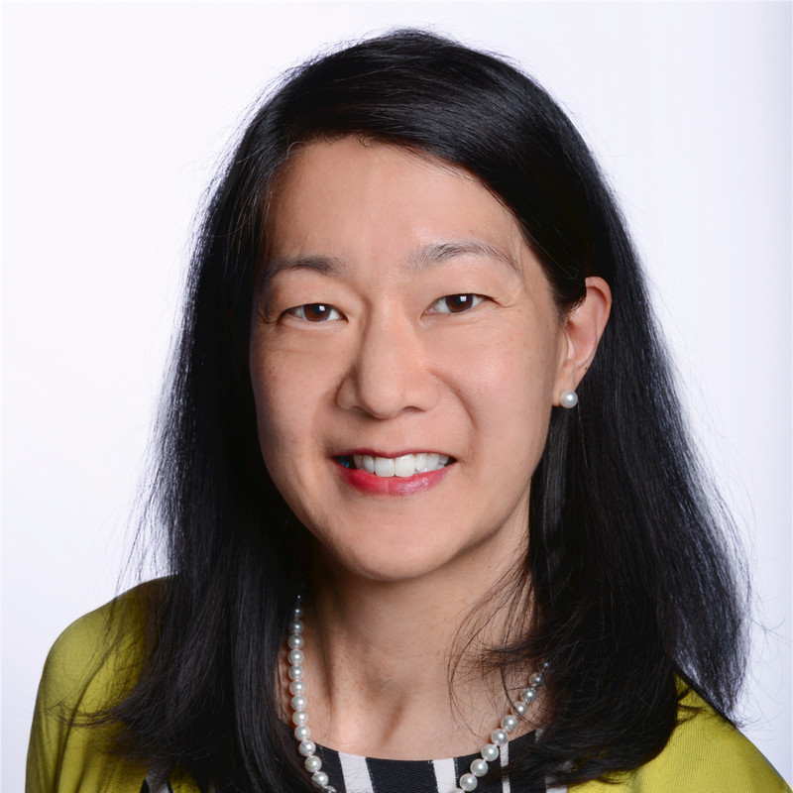
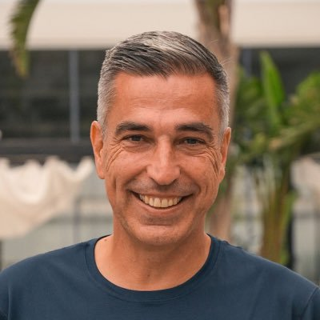
Meet Your Expert Panel
What questions do you have for our panelists?
Chris Carpenter, MD, MSC, FACEP, FAAEM
Vice Chair & Professor of Emergency Medicine | Mayo Clinic
Associate Editor | Annals of Internal Medicine’s ACP Journal Club
Deputy Editor-in-Chief, Academic Emergency Medicine Associate Editor | Journal of the American Geriatrics Society
Shan Liu, MD, SD
Geriatric Emergency Medicine Fellowship Director
Massachusetts General Hospital
Associate Professor of Emergency Medicine
Harvard Medical School
Christian Nickel, MD
Emergency Department University
Associate Professor of Emergency Medicine
Vice Chair Emergency Department
University Hospital Basel
Switzerland
Ula Hwang, MD, MPH, FACEP
Professor of Emergency Medicine and Population Health
Medical Director of Geriatric Emergency Medicine | New York University Grossman School of Medicine
Core investigator of the Geriatrics Research, Education
and Clinical Center (GRECC) | James J. Peters Bronx VAMC
PI of Geriatric Emergency Care Applied Research (GEAR) Network
MPI of Geriatric Emergency Care Applied Research (GEAR) 2.0 – Advancing Dementia Care
Co-PI of the Geriatric Emergency Department Collaborative

Slide 6

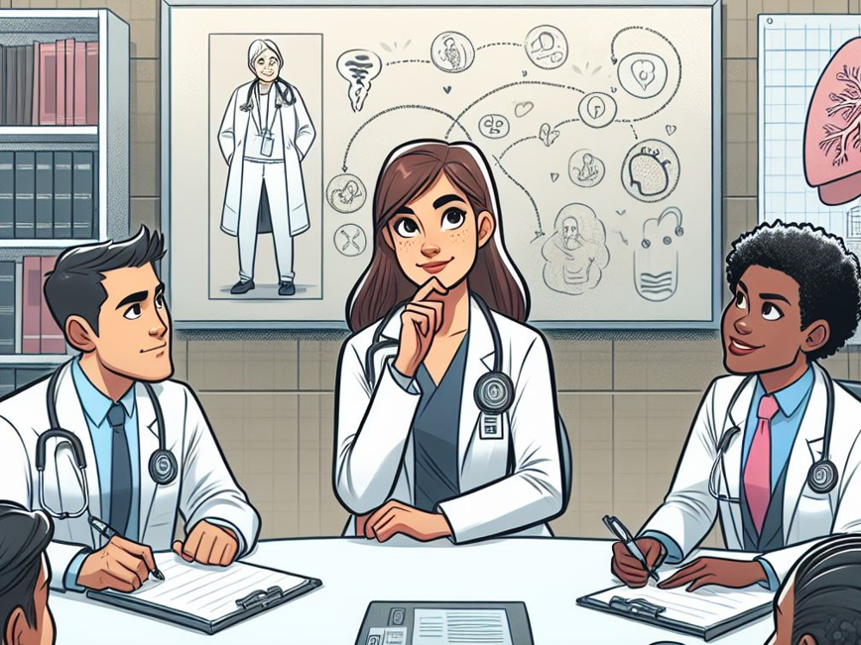
A Brief History of
Geriatric EM Research
Christopher R. Carpenter, MD, FACEP, AGSF

Slide 7
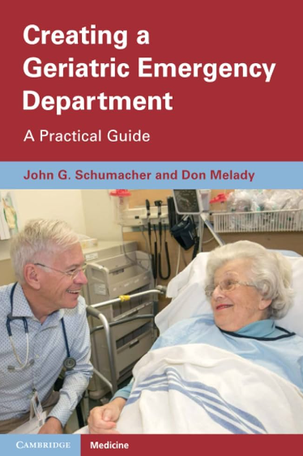
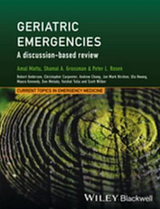
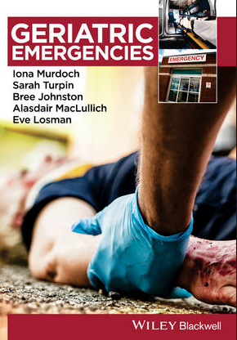
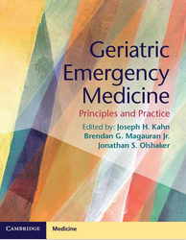
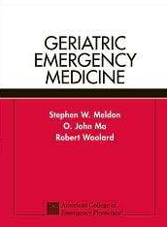
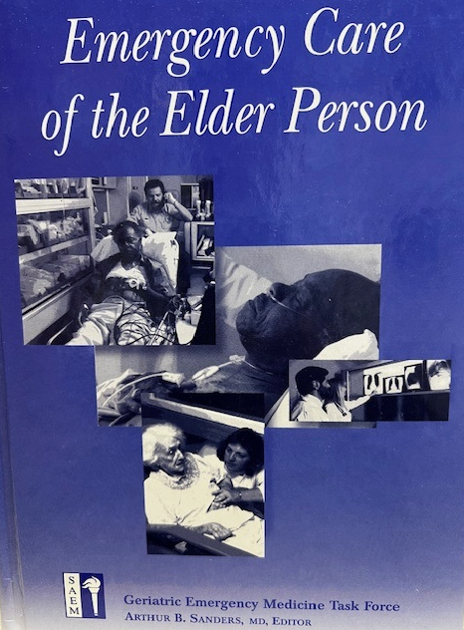
Textbooks
2023
2016
2015
2014
2004
1996
Notes:
In the intervening years, there has been a veritable explosion in education resources for clinicians wishing to learn more about GeriEM.

Slide 8
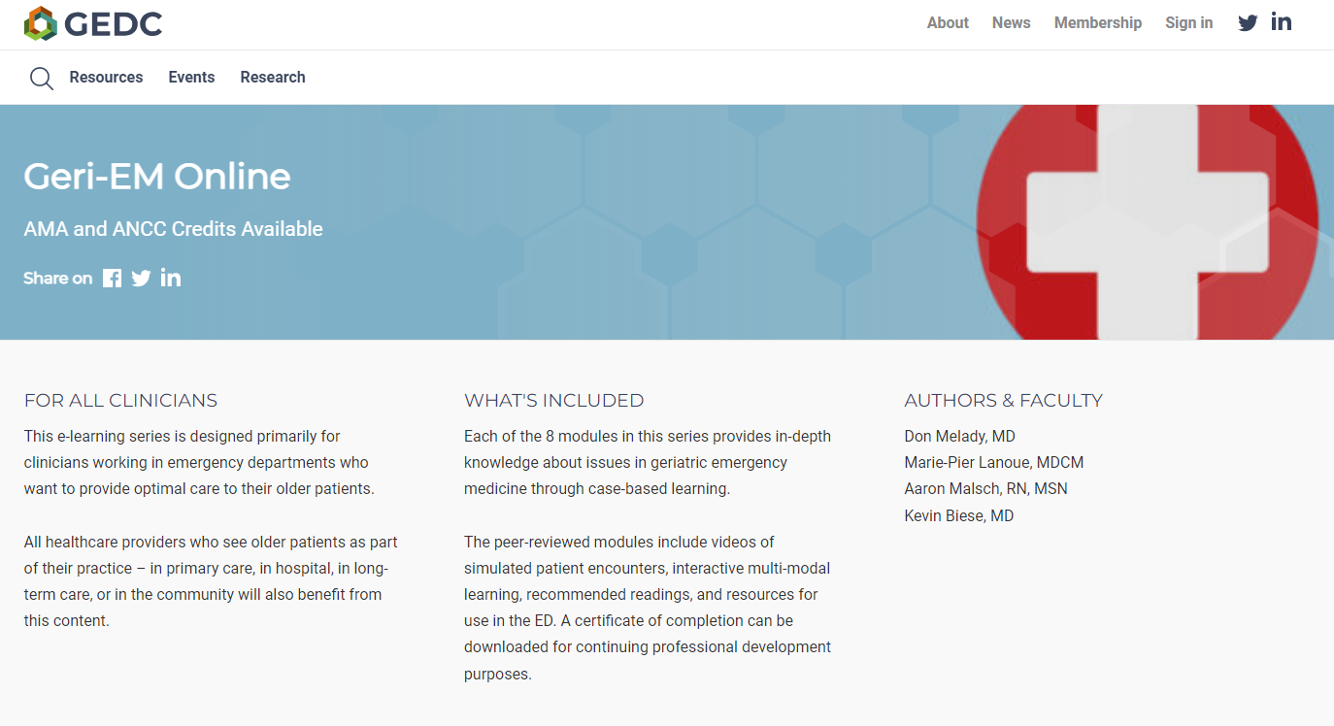
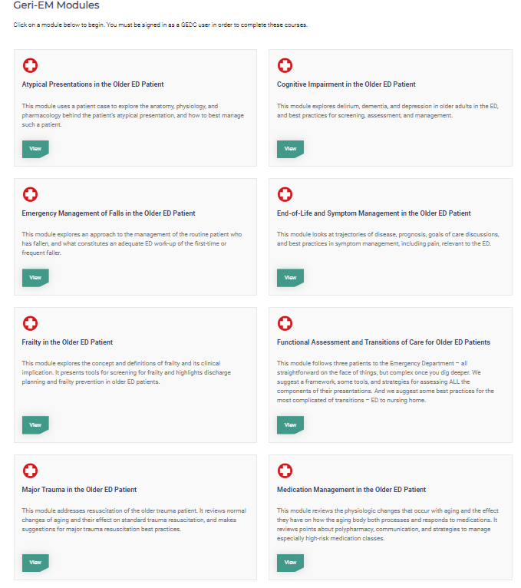
http://geri-em.com/
Notes:
In addition to textbooks, online curricula popped up for physicians and nurses to obtain CME credit for various aspects of geriatric emergency care and management.

Slide 9
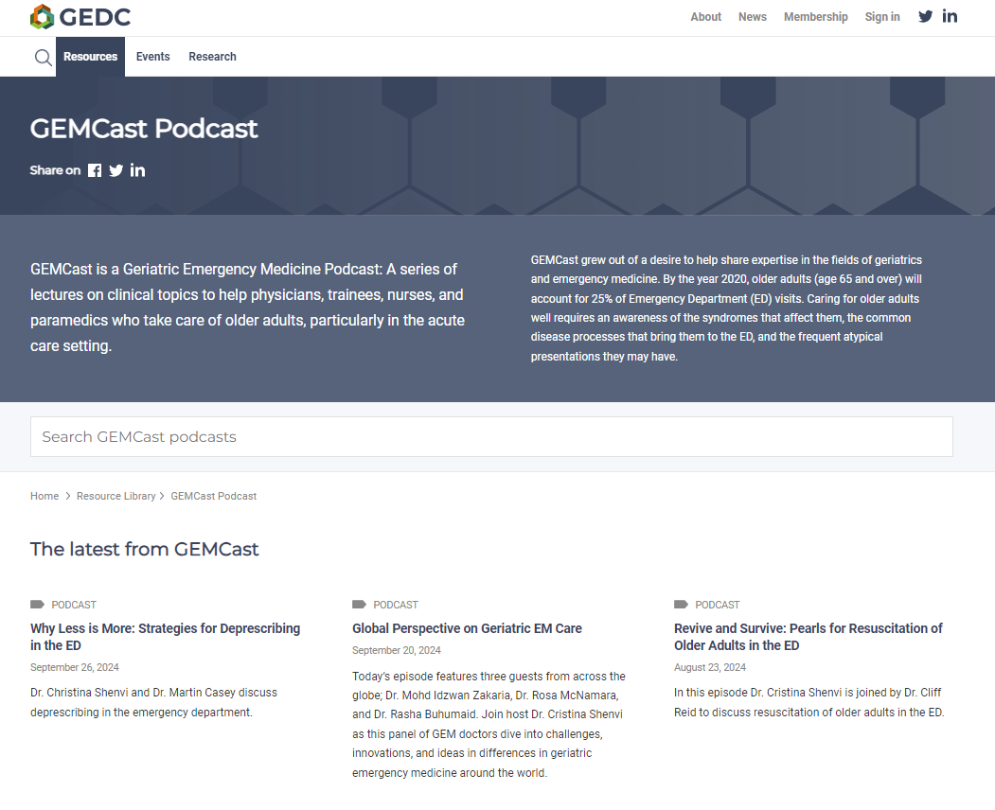
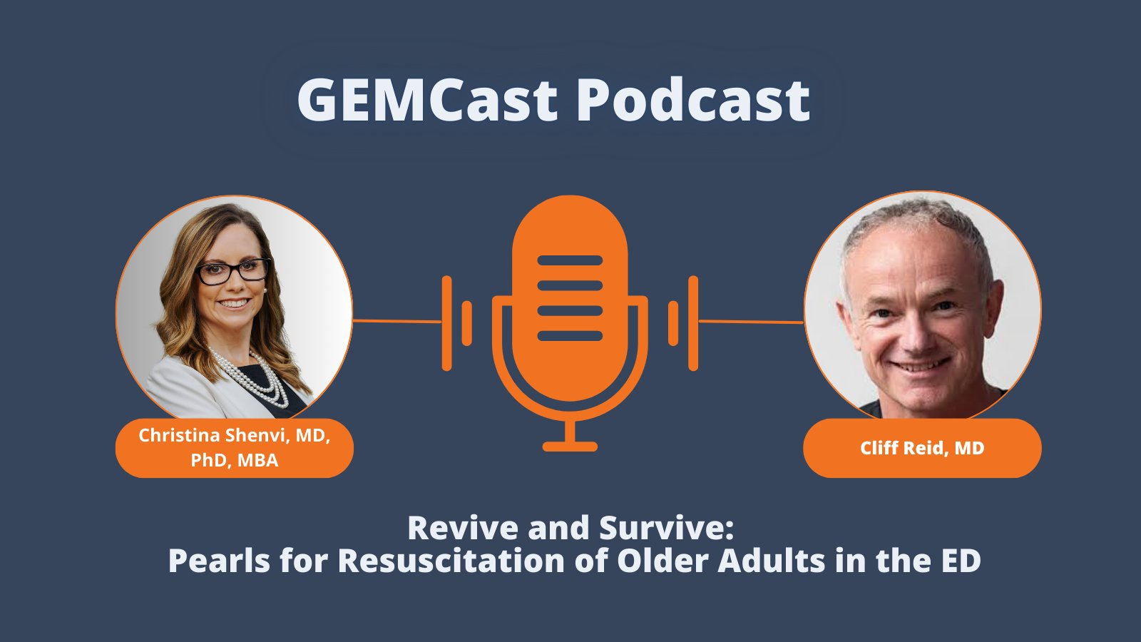
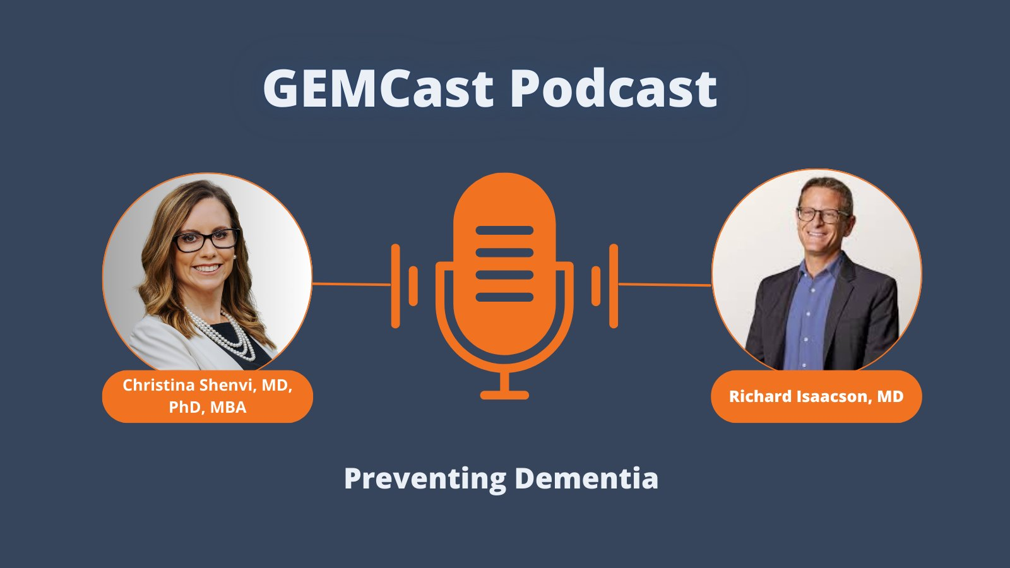
https://gempodcast.com
Notes:
Since a new generation of learners values alternative methods for knowledge acquisition, podcasts emerged to fill a niche within this educational space.

Slide 10

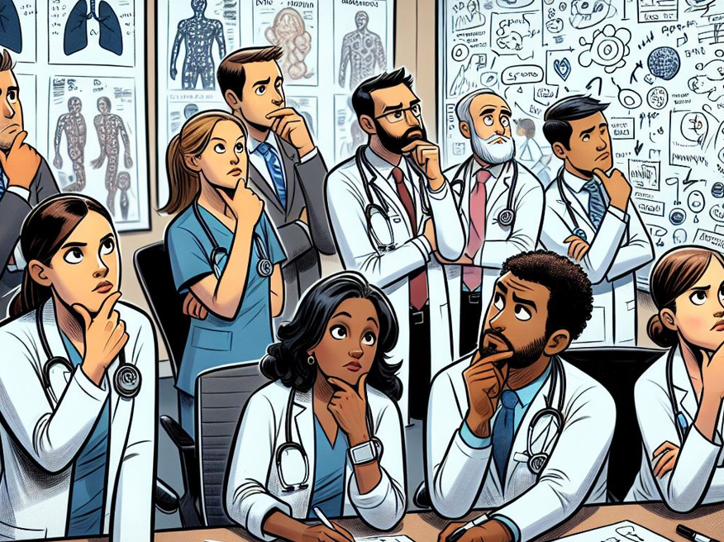

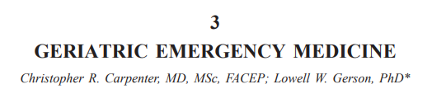
2005
2008
https://newfrontiers.americangeriatrics.org/
Notes:
AGS recognized a need to prioritize age-friendly research across specialties 20 years ago and supported the New Frontiers Research Agenda setting process. Emergency Medicine was among the specialties included in this effort to identify the highest priority geriatric research questions germane to our specialty. The first version of this effort was published in 2005 and an update in 2008.

Slide 11
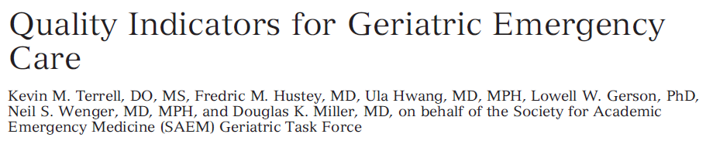
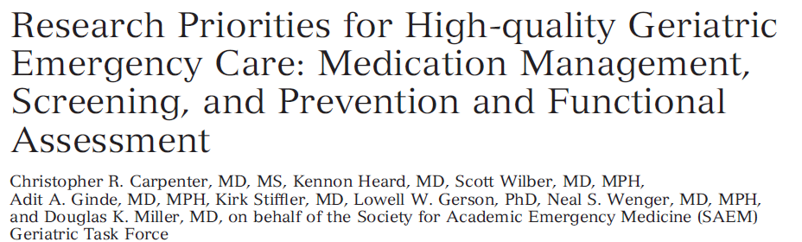
Acad Emerg Med 2009; 16: 441-449
Acad Emerg Med 2011; 18: 644-654
Notes:
Shortly thereafter, a wider group that included the new Geriatric EM Interest Group at SAEM and the RAND corporation expanded the research prioritization effort along with NIA funders.

Slide 12

Original research
18%
variable
Negative Results
Dickersin, 1987
Submission
46%
0.5 year
Kumar, 1992
Koren, 1989
Acceptance
It takes 17 years to turn 14% of original research
to the benefit of patient care.
Negative Results
0.6 year
Kumar, 1992
Publication
35%
0.3 year
Poyer, 1982
Lack of Numbers
Balas, 1995
Bibliographic databases
50%
6. 0 - 13.0 years
Poynard, 1985
Reviews, guidelines, textbook
Antman, 1992
9.3 years
Inconsistent Indexing
Implementation
E.A. Balas, 2000
Notes:
Yet we know that designing research, obtaining funding for that research, analyzing results, and publishing those findings often takes years. Meanwhile, 10,000 Baby Boomers began turning 65 every day in 2011.

Slide 13
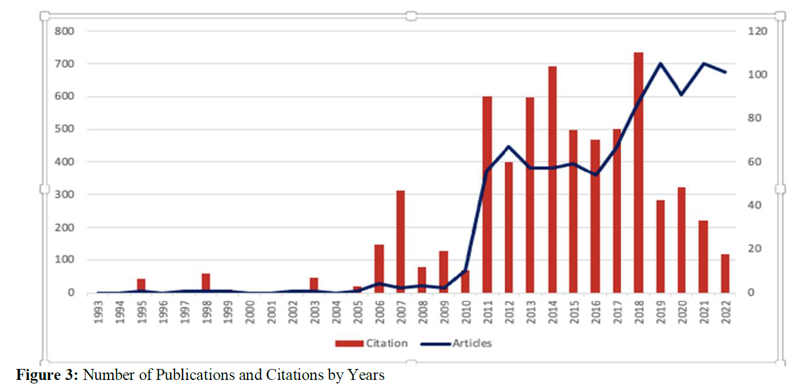
https://medscidiscovery.com/index.php/msd/article/view/1076
Bibliometric Study on Geriatric Emergencies: Intellectual Structure, Prominent Themes, and Future-Directing Topics | Medical Science and Discovery
Sönmez et al, Med Sci Discovery 2023
Notes:
This open access study sought to quantify the growth of geriatric EM research over the last 30 years and seems to demonstrate a rapid growth in this area though an unexpected decline around the time of COVID-19.

Slide 14
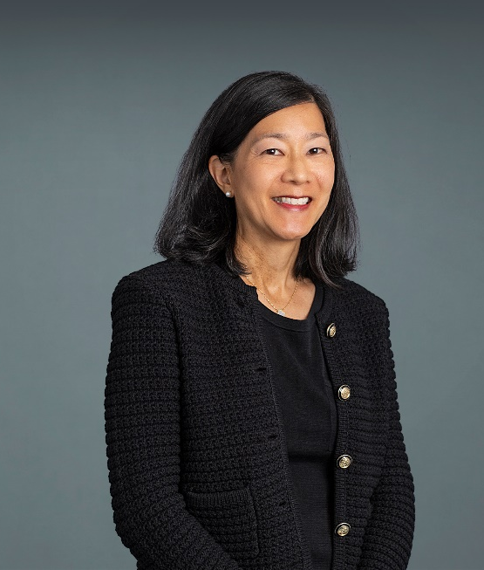
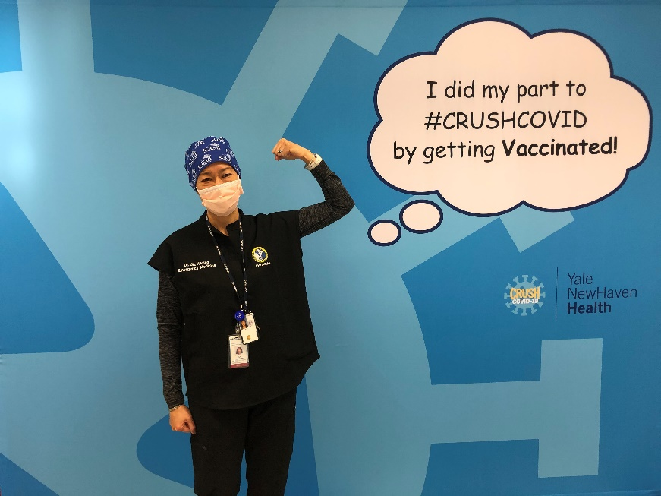
Emergency Physician & Researcher
ULA HWANG, MD, MPH
Professor
Emergency Medicine & Population Health
NYU Grossman School of Medicine
Medical Director,
Geriatric Emergency Medicine
NYU Langone Health

Slide 15
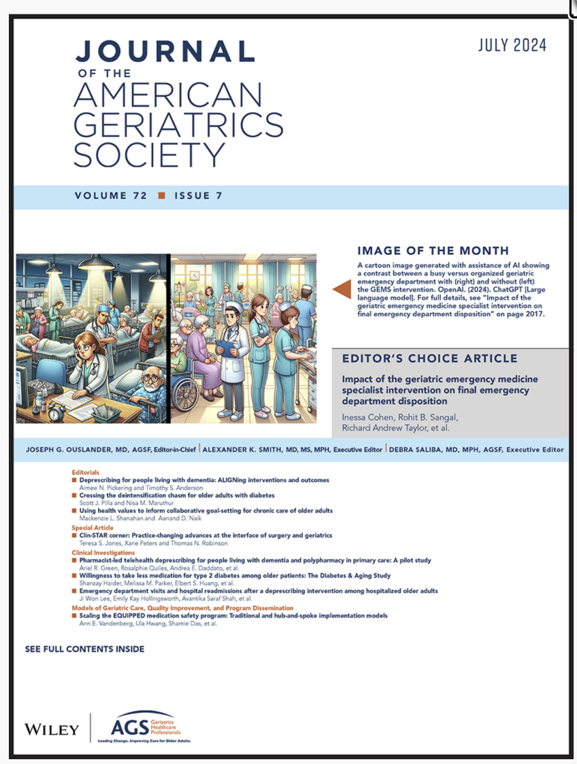
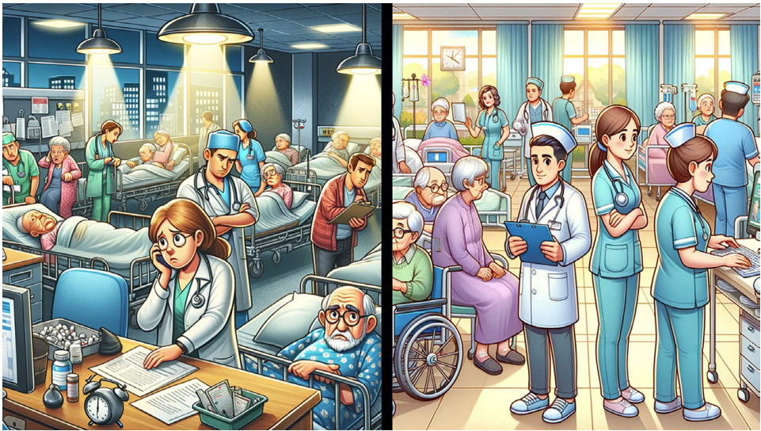
Cohen I, et.al. J Am Geriatr Soc. 2024 Jul;72(7):2017-2026.
doi: 10.1111/jgs.18908.

Slide 17
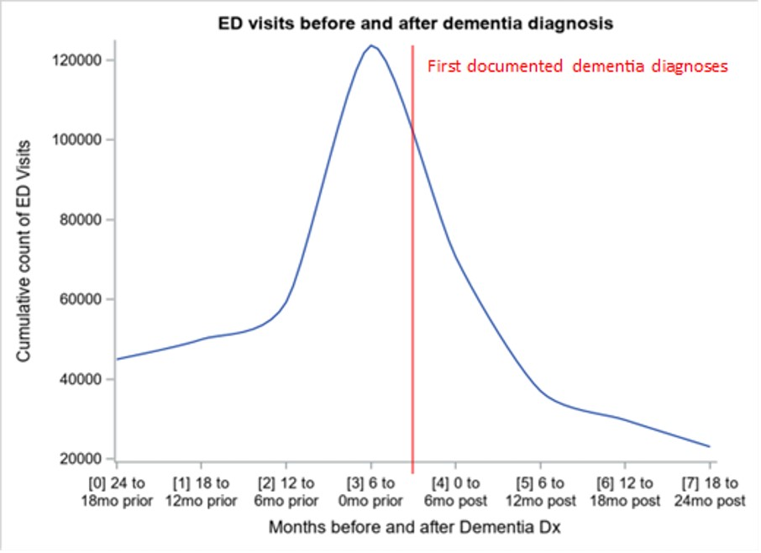
Data can tell a story. Highlight an opportunity.
Seidenfeld J, et.al. Acad Emerg Med. 2023
doi: 10.1111/acem.14832. PMC11074234.

Slide 18
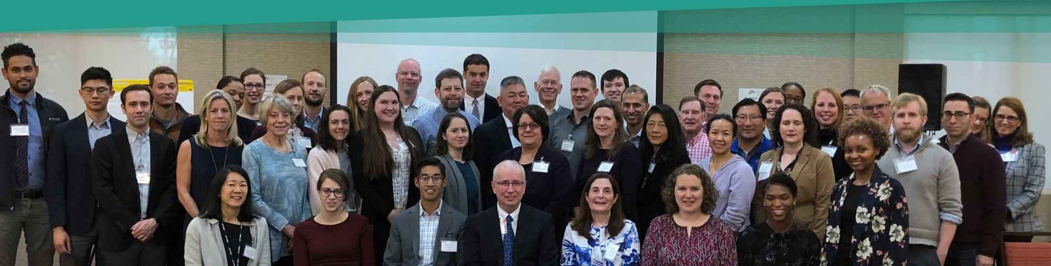
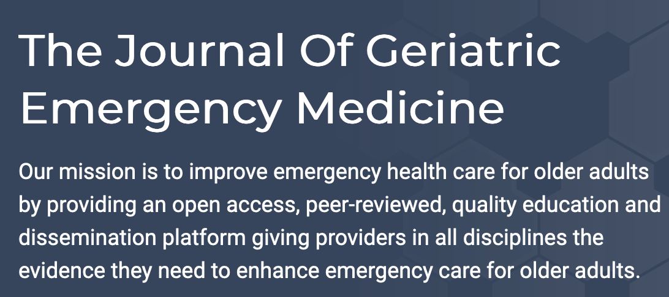
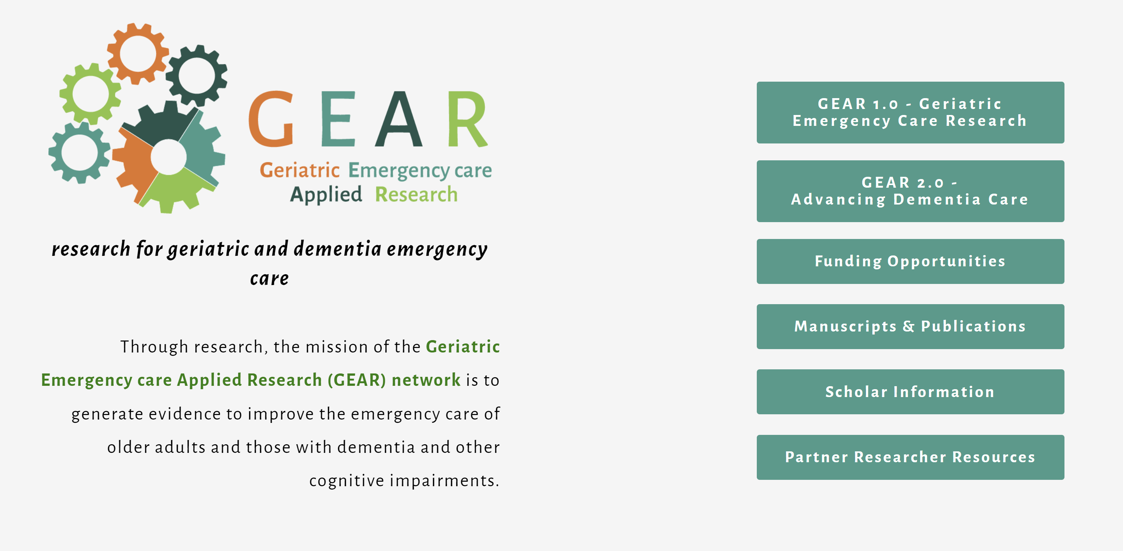
GED Guideline
Systematic Reviews
Coming Soon

Slide 19
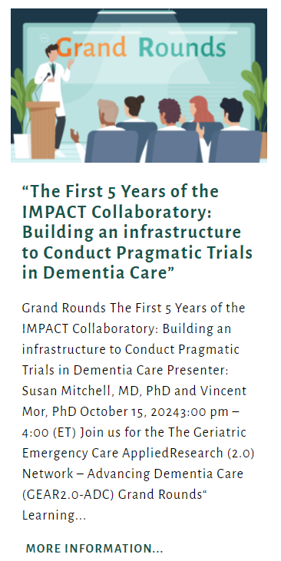
GEAR Grand Rounds
October 15, 2024
3-4pm ET
https://gearnetwork.org/2024/09/20/elementor-7381/
Learning objectives:
Understand the IMPACT Collaboratory’s mission to build an infrastructure to enable pragmatic trials in dementia care.
Learn about building real-world data platforms in health care systems to conduct pragmatic trials.
Gain knowledge about opportunities for collaboration between IMPACT and geriatric and dementia emergency care.
Notes:
https://gearnetwork.org/2024/09/20/elementor-7381/

Slide 20

Christian Nickel, MD
Emergency Department
University
Associate Professor of
Emergency Medicine
Vice Chair
Emergency Department
University Hospital Basel
Switzerland
Notes:
At the end of the video, we’ll leave slides at the start of Shan’s segment. And come back for Take Home and concluding slides.

Slide 21
Take away points: Chris Carpenter
Research is the foundation of geriatric emergency medicine guidelines and accreditation.
Various stakeholders have been prioritizing geriatric emergency medicine research since 2005.
Beginning in 2011, the volume of published geriatric emergency medicine research increased from <100 annually to >400 manuscripts per year.

Slide 22
Take away points: Ula Hwang
You can study routine clinical care with everyday data to highlight high- or low-quality care and outcomes to find opportunities.
Top Geriatric ED papers showing impact of interventions:
  Cohen et.al., “Impact of the geriatric emergency medicine specialist intervention on final emergency department disposition.” J Am Geriatr Soc. 2024
  Haynesworth et.al., “Clinical and financial outcome impacts of comprehensive geriatric assessment in a level 1 geriatric emergency department.” J Am Geriatr Soc. 2023
  Keene et.al. “Implementation of a geriatric emergency medicine assessment team decreases hospital length of stay.” Am J Emerg Med. 2022
  Vaughan et.al. “Early prescribing outcomes after exporting the EQUIPPED medication safety improvement programme.” BMJ Open Qual. 2021
  Hwang et.al. “Geriatric Emergency Department Innovations in Care Through Workforce, Informatics, and Structural Enhancement (GEDI WISE) Investigators. Association of a Geriatric Emergency Department Innovation Program With Cost Outcomes Among Medicare Beneficiaries.” JAMA Netw Open. 2021
  Dresden et.al. “Geriatric Emergency Department Innovations: The Impact of Transitional Care Nurses on 30-day Readmissions for Older Adults.” Acad Emerg Med. 2020
  Hwang et.al. “Geriatric Emergency Department Innovations: Transitional Care Nurses and Hospital Use.” J Am Geriatr Soc. 2018
  Bibliometric Study on Geriatric Emergencies: Intellectual Structure, Prominent Themes, and Future-Directing Topics

Slide 23
Take away points: Christian Nickel
There are no simple solutions for complex problems: research can help develop answers.
(International) team-work can move mountains in the creation of new knowledge.
Sustainability of interventions is an important subject of research.

Slide 24
Take away points: Shan Liu
Clinical questions have always informed my research questions
We are updating the Geriatric ED guidelines to help clinicians improve geriatric EM care
Clinicians are central to implementing any guidelines. It is a two-way street

Slide 25

Q & A
Ask your questions
in the chat!
We will try to get to everyone

Slide 26
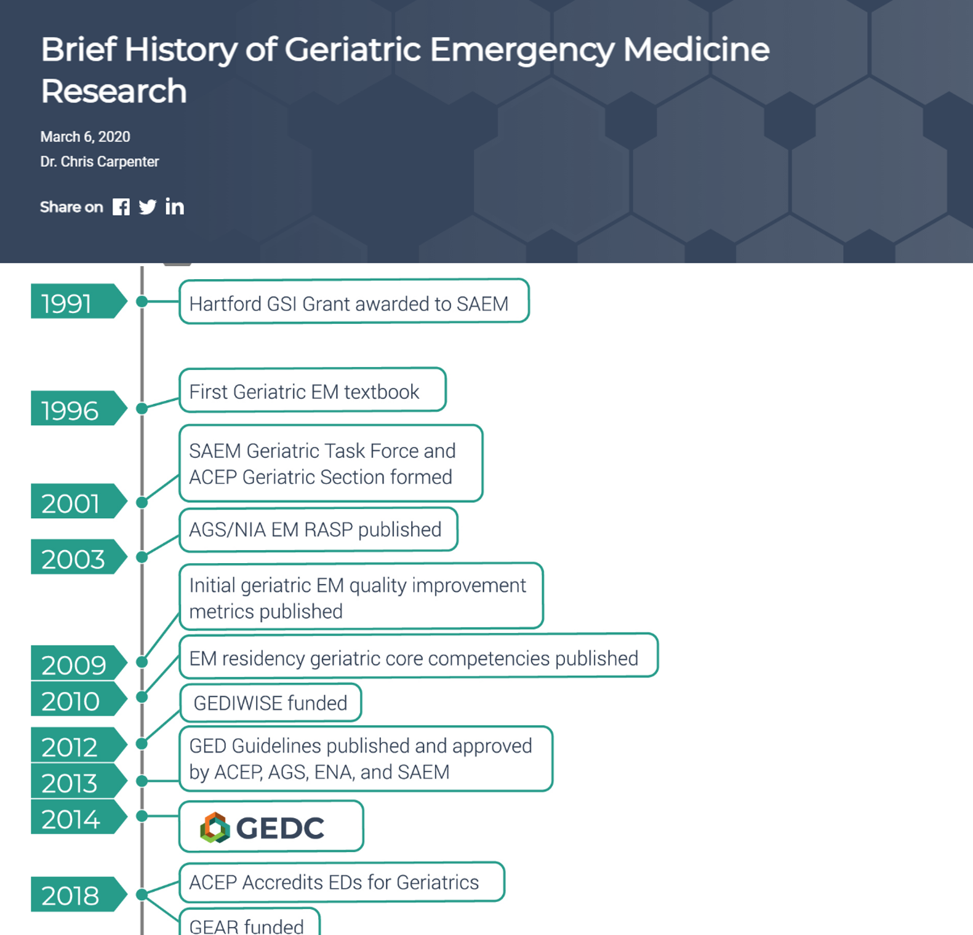
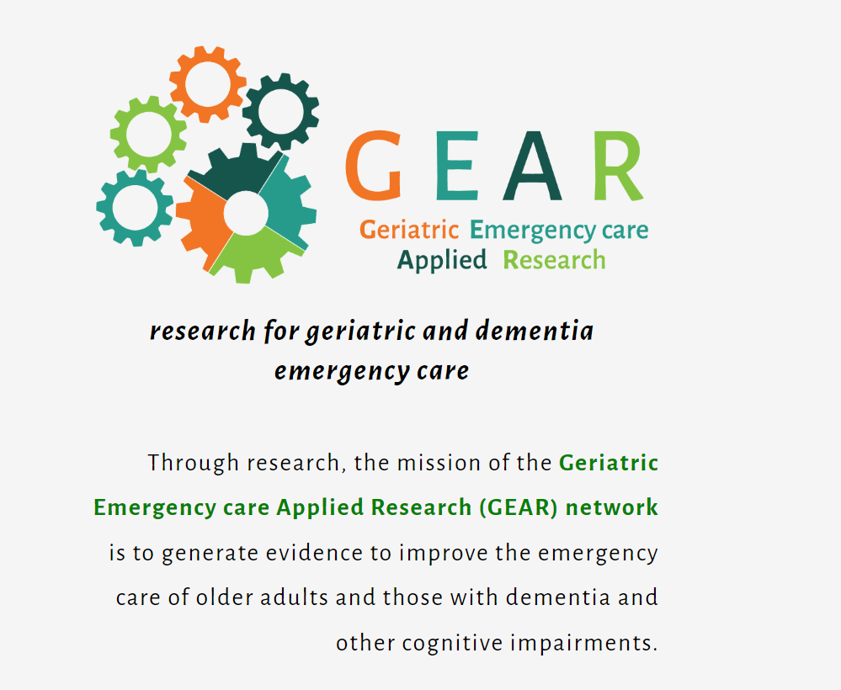
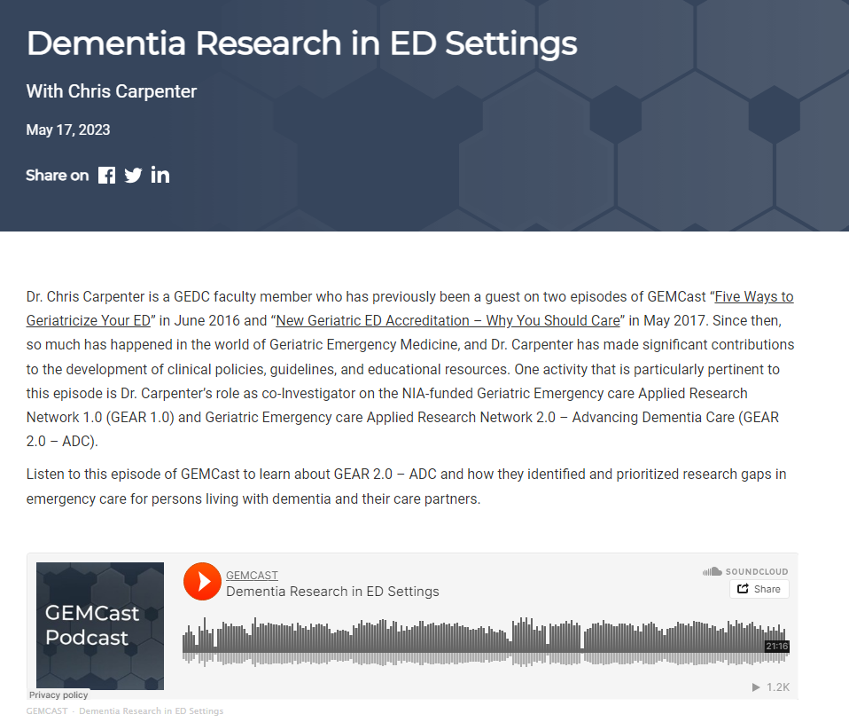
Research Resources
https://gearnetwork.org/
https://gedcollaborative.com/article/history-of-geriatric-emergency-medicine-research/
https://gedcollaborative.com/podcast/dementia-research-in-ed-settings/

Slide 27

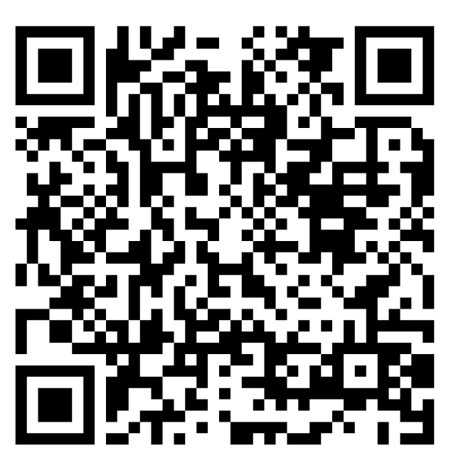
OUR NEXT GEDC
EXPERT PANEL WEBINAR
Transitions of Care
in the Geriatric ED
Register Now
February 3, 2025
3pm EST
https://zoom.us/webinar/register/WN_n1Gz3IP3Ts2kwTEvXnJ-8A#/registration
Notes:
Title on TEAMS from Don

Slide 28
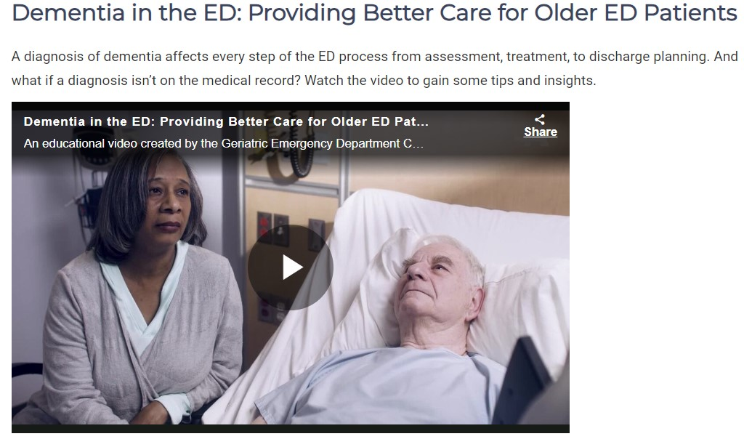
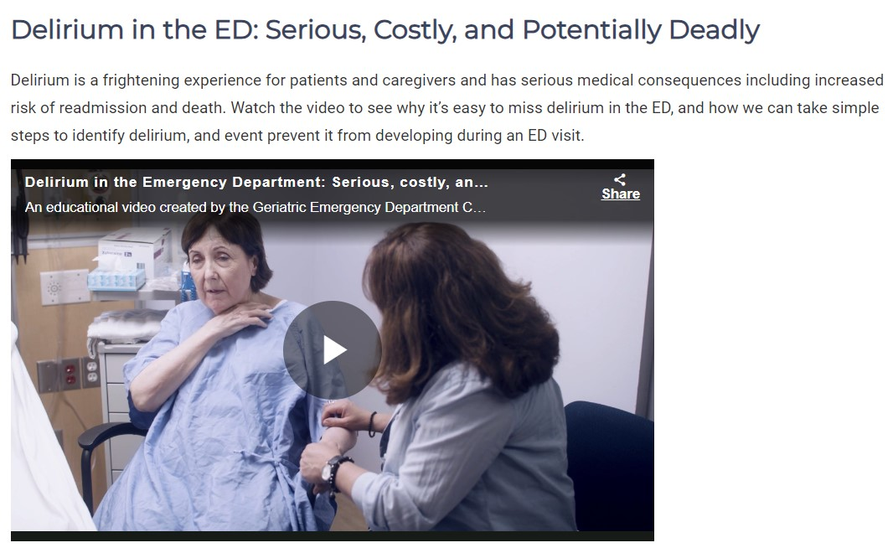
Brain Health in the ED
Educational Videos by AARP
https://gedcollaborative.com/article/brain-health-in-the-ed-videos/

Slide 29

Join the GEDC
Scan the QR Code to access the GEDC membership application
gedcollaborative.com
@theGEDC
We bring best practice into action.

Slide 30
Generously supported by

Slide 31
Resources
Studies showing impact of Geri ED implementation:
  Cohen et.al., “Impact of the geriatric emergency medicine specialist intervention on final emergency department disposition.” J Am Geriatr Soc. 2024
  Haynesworth et.al., “Clinical and financial outcome impacts of comprehensive geriatric assessment in a level 1 geriatric emergency department.” J Am Geriatr Soc. 2023
  Keene et.al. “Implementation of a geriatric emergency medicine assessment team decreases hospital length of stay.” Am J Emerg Med. 2022
  Vaughan et.al. “Early prescribing outcomes after exporting the EQUIPPED medication safety improvement programme.” BMJ Open Qual. 2021
  Hwang et.al. “Geriatric Emergency Department Innovations in Care Through Workforce, Informatics, and Structural Enhancement (GEDI WISE) Investigators. Association of a Geriatric Emergency Department Innovation Program With Cost Outcomes Among Medicare Beneficiaries.” JAMA Netw Open. 2021
  Dresden et.al. “Geriatric Emergency Department Innovations: The Impact of Transitional Care Nurses on 30-day Readmissions for Older Adults.” Acad Emerg Med. 2020
  Hwang et.al. “Geriatric Emergency Department Innovations: Transitional Care Nurses and Hospital Use.” J Am Geriatr Soc. 2018
  Bibliometric Study on Geriatric Emergencies: Intellectual Structure, Prominent Themes, and Future-Directing Topics
https://gedcollaborative.com/
https://www.johnahartford.org/
https://westhealth.org/
https://gedcollaborative.com/membership/
https://gearnetwork.org/
Don’s book https://bit.ly/GeriatricEDGuide
https://gedcollaborative.com/download/22943/ Geriatric-EM.pdf
https://gedcollaborative.com/download/22940/ Bibliometric-Study-on-GEMs.pdf
https://gearnetwork.org/scholar-seminars/
https://gearnetwork.org/info-videos/
https://institutionalrepository.aah.org/jgem/
http://geri-em.com/
https://gedcollaborative.com/download/22945/ High-Yield-Opportunities-in-GEM.pdf
https://gempodcast.com/
https://newfrontiers.americangeriatrics.org/
https://gedcollaborative.com/download/22947/ Research-Priorities-for-High-Quality-GEM.pdf
https://medscidiscovery.com/index.php/msd/article/view/1076
https://pubmed.ncbi.nlm.nih.gov/38667266/
https://pubmed.ncbi.nlm.nih.gov/37935451/
https://gearnetwork.org/
https://gedcollaborative.com/article/history-of-geriatric-emergency-medicine-research/
https://gedcollaborative.com/podcast/dementia-research-in-ed-settings/
Next GEDC webinar https://zoom.us/webinar/register/WN_n1Gz3IP3Ts2kwTEvXnJ-8A#/registration
AARP Videos: https://gedcollaborative.com/article/brain-health-in-the-ed-videos/
https://gedcollaborative.com/membership/
Shan Liu
https://pubmed.ncbi.nlm.nih.gov/38757369/
https://pubmed.ncbi.nlm.nih.gov/38847070/
https://pubmed.ncbi.nlm.nih.gov/37423026/
https://pubmed.ncbi.nlm.nih.gov/36330667/
https://pubmed.ncbi.nlm.nih.gov/38162531/
Notes:
I (Don) decided to move this up and at least point it out to the audience as a way of getting them back to the website.

