Slide 1

The Value of Geriatric EDs
How a Geriatric Emergency Department will help your hospital
Produced by:
The Geriatric Emergency Department Collaborative

Slide 2





ED Care for an Aging Population
Older adults engage with the health care system across many touchpoints,
perhaps none as frequently or as importantly as the emergency department.
Patients over 65 years of age account for a disproportionate number of potentially avoidable hospital admissions from the ED.
10,000
29 Million
46%
60%
Baby Boomers in the U.S. turn 65 each day.
Annual ED visits were made by patients aged 60+ (2014-2017)
of all ED visits resulting in hospitalization are for older adults
of avoidable hospital admissions are for patients 65+
Notes:
Speakers notes: The US population is aging. Older adults frequently visit the ED and account for 46% of ED visits resulting in admission to hospital. During 2014–2017, 20% of all emergency department (ED) visits in the United States were made by patients aged 60 and over, representing an annual average of approximately 29 million ED visits (3–6). https://www.cdc.gov/nchs/data/databriefs/db367-h.pdf
Many of these hospital admissions could be avoided through geriatric-specific ED screening and processes. Often the arrival of an older adult in the ED is a sentinel event – it’s essential that they receive the specialized care they need. What happens to them in the ED could predict their 1-year morbidity and mortality.
References:
WHI. Geriatric Emergency Department Factsheet (2013 HCUP-NEDS data). West Health Institute;2017.
Stranges E, Stocks C. Potentially Preventable Hospitalizations for Acute and Chronic Conditions, 2008. Rockville, MD: Agency for Healthcare Research and Quality; 2010.

Slide 3
What Is a
Geriatric ED?
Geriatric EDs embrace a variety of best practices including:
A geriatric ED may be either a separate space designated for older adults, or more likely, the integration of best practices for older adults into an existing ED.
Similar to the concept of pediatric emergency departments, geriatric emergency departments provide specialized care to a population with unique needs.
Ensuring geriatric-focused education and interdisciplinary staffing.
Providing standardized approaches to care that address common geriatric issues.
Ensuring optimal transitions of care from the ED to other settings (inpatient, home, community-based care, rehabilitation, long-term care)
Promoting geriatric-focused quality improvement and enhancements of the physical environment and supplies
Notes:
Suggested Speaker Notes: Every emergency department and health system has a unique path toward becoming a geriatric ED. The Geriatric Emergency Department Collaborative can help with consulting engagements such as gap analysis, leadership consulting, and Bootcamp trainings for multiple sites. Should you already know which intervention you’re interested in implementing, a number of slides at the bottom of this presentation provide evidence to support different interventions.
References:
https://gedcollaborative.com/article/a-geriatric-emergency-department-checklist/
https://gedcollaborative.com/event/geriatric-em-management-nurses-in-the-geriatric-ed/
https://www.acep.org/geda

Slide 4



What can a
Geriatric ED do for my hospital?
Decrease Admissions & Return Visits
Readmissions and returns to the ED for high-risk populations are lower in communities with Geriatric EDs.^{3,4}
Senior-specific protocols in the ED are linked to reduced likelihood of admission from the ED²⁻⁴ without increasing mortality risk.⁵⁻⁷
Increase Patient Satisfaction
Older adult patients who receive comprehensive geriatric assessment and geriatric-focused transition of care services report higher patient satisfaction.⁹
Increase Market Share
GEDs demonstrate a commitment to excellent care and improve management of existing patients by providing specialized care to those who need it.⁸
Better Census Management
Hospitals with Geriatric EDs have up to 16% fewer hospital admissions and a decreased inpatient length-of-stay for admitted older patients.³
Geriatric-specific protocols in the ED are linked to reduced length of stay for admitted patients.⁸
Greater Staff Satisfaction
Greater staff satisfaction reported in EDs with Geriatric Nurse Coordinator.¹⁰
GEDs help staff know that they are doing an excellent job caring for their patients.¹⁰
Notes:
Suggested Speaking Points:
The return on investment for Geriatric Emergency Departments is clear and a growing body of evidence supports making geriatric-focused changes in the ED.
Geriatric process improvements are associated with fewer revisits, fewer admissions, decreased length of stay for admitted patients, thus keeping beds open for surgeries and other high-revenue procedures. Moreover, they improve patient satisfaction and ED clinician/staff satisfaction. Geriatric process improvement benefit everyone.
References:
Stranges E, Stocks C. Potentially Preventable Hospitalizations for Acute and Chronic Conditions, 2008. Rockville, MD: Agency for Healthcare Research and Quality; 2010
Hwang, U., Dresden, S.M., Rosenberg, M.S., Garrido, M.M., Loo, G., Sze, J., Gravenor, S., Courtney, D.M., Kang, R., Zhu, C.W., Vargas-Torres, C., Grudzen, C.R., Richardson, L.D. and (2018), Geriatric Emergency Department Innovations: Transitional Care Nurses and Hospital Use. J Am Geriatr Soc, 66: 459-466. https://doi.org/10.1111/jgs.1523
Hwang U, Dresden SM, Vargas-Torres C, et al. Association of a Geriatric Emergency Department Innovation Program with Cost Outcomes Among Medicare Beneficiaries. JAMA Netw Open. 2021;4(3):e2037334. doi:10.1001/jamanetworkopen.2020.3733
Wallis M, Marsden E, Taylor A, et al. The Geriatric Emergency Department Intervention model of care: a trial. BMC Geriatrics. 2018;18(1):297
Spragmaticilvester KM, Mohammed MA, Harriman P, et al. Timely care for frail older people referred to hospital improves efficiency and reduces mortality without the need for extra resources. Age and Ageing. 2014;43(4):472-477
Ellis G, Whitehead MA, Robinson D, et al. Comprehensive geriatric assessment for older adults admitted to hospital: meta-analysis of randomised controlled trials. BMJ. 2011;343
Keene SE, Cameron-Comasco L. Implementation of a geriatric emergency medicine assessment team decreases hospital length of stay. Am J Emerg Med. 2022 May;55:45-50. doi: 10.1016/j.ajem.2022.02.027. Epub 2022 Feb 21. PMID: 35276545
Lesser A, Israni J, Kent T, Ko KJ. Association Between Physical Therapy in the Emergency Department and Emergency Department Revisits for Older Adult Fallers: A Nationally Representative Analysis. J Am Geriatr Soc. 2018 Nov;66(11):2205-2212. doi: 10.1111/jgs.15469. Epub 2018 Aug 21. PMID: 30132800
Guttman A, Afilalo M, Guttman R, Colacone A, Robitaille C, Lang E, Rosenthal S. An emergency department-based nurse discharge coordinator for elder patients: does it make a difference? Acad Emerg Med. 2004 Dec;11(12):1318-27. doi: 10.1197/j.aem.2004.07.006. Erratum in: Acad Emerg Med.2005 Jan;12(1):12. PMID: 15576523.

Slide 5

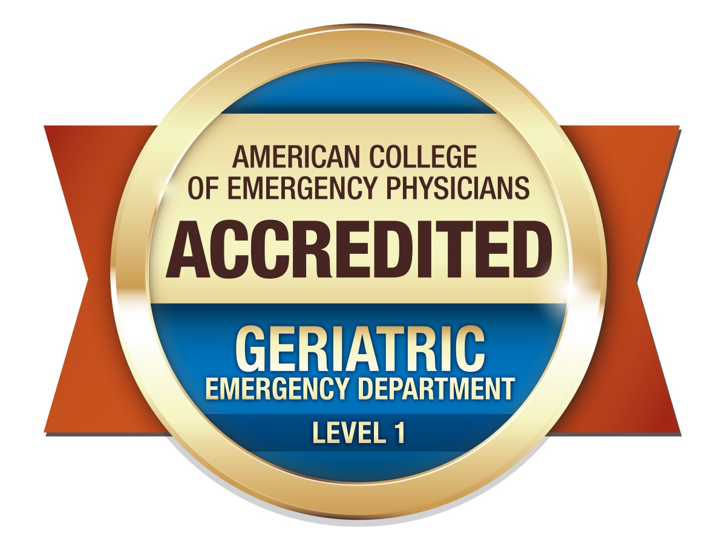
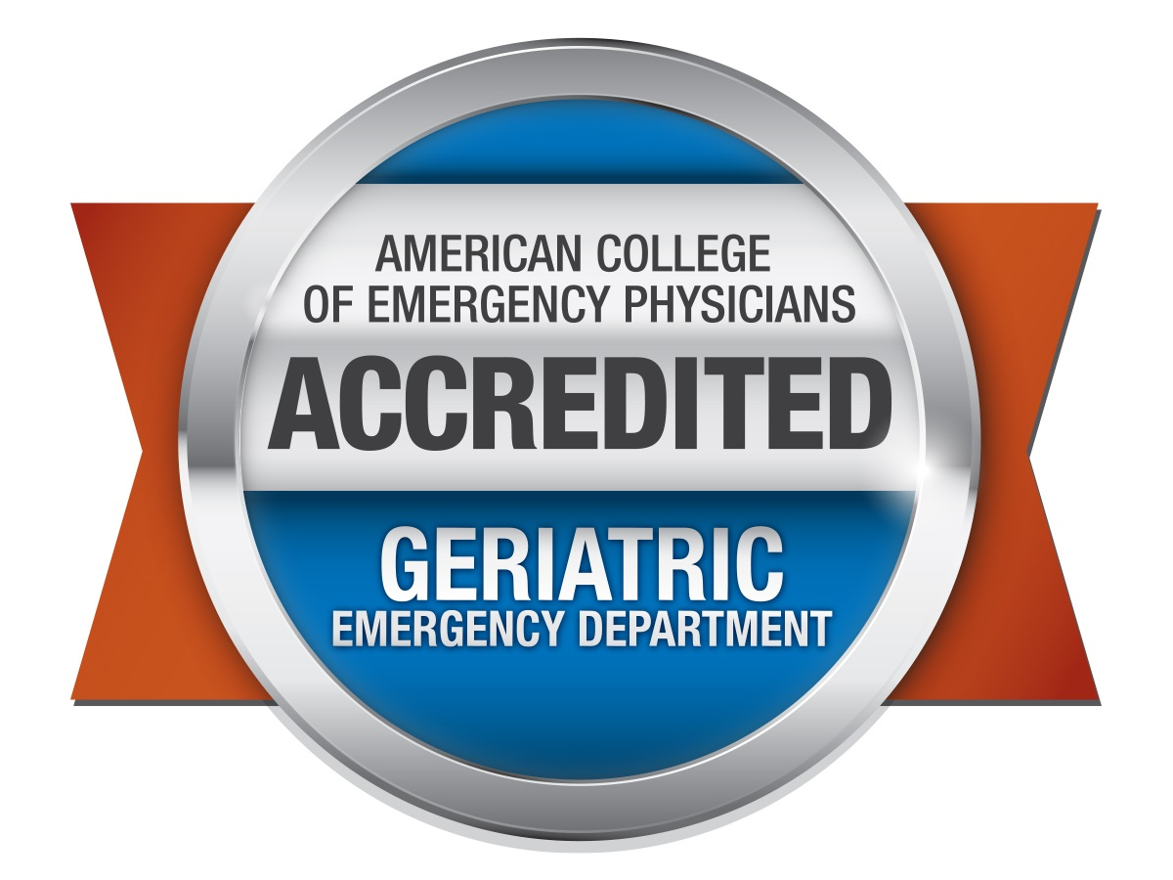
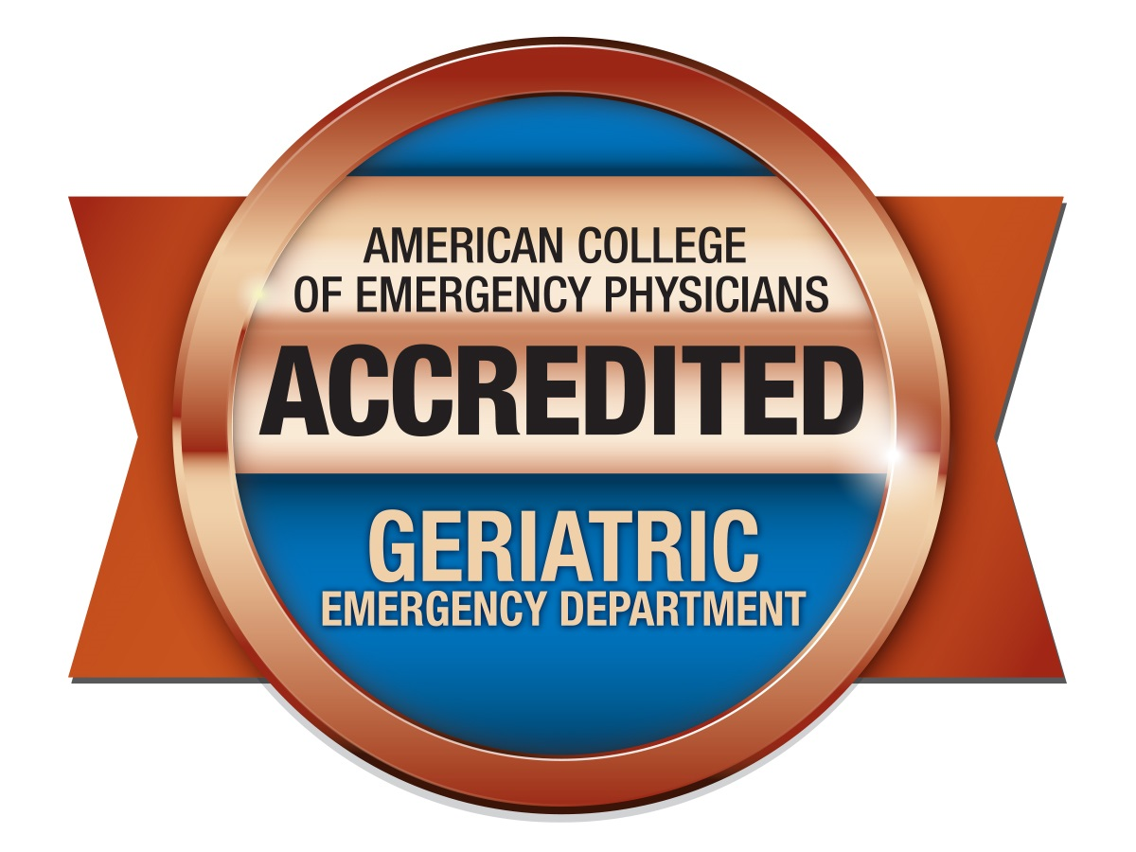
Geriatric ED Accreditation
The Geriatric ED Accreditation (GEDA) program was developed by leaders in emergency medicine to ensure older patients receive well-coordinated, quality care at the appropriate level at every ED encounter.
There are 464 Accredited Sites (2023) and counting. Join this group of emergency departments providing excellent care to their older patients.
Level 1 GED: Top level of accreditation. Gold standard of geriatric emergency care.
Level 2 GED: Excellent care processes and access to geriatric-specific resources.
Level 3 GED: Geriatric care obtainable by ALL U.S. Emergency Departments.
Notes:
Suggested Speaker Notes: There are already a lot of hospitals providing geriatric care, and in order to keep up with standards we should too. Not only that, but we’ve already demonstrated that an investment in these care processes will pay off in improved patient outcomes, better staff satisfaction, and greater market share through preventing needless admissions and reducing LOS. Accreditation is a bonus. We can get help with accreditation and preparing for accreditation through GEDC and GEDA.
References: https://www.acep.org/geda

Slide 6
Investing in a Geriatric Emergency Department
Summary
01
Improve Your Patient Outcomes & Satisfaction
02
Improve ED Operations & Market Share
03
Become Nationally Accredited as a Geriatric ED
Prevent unnecessary admissions
Connect patients with community resources
Take steps to prevent potentially fatal conditions like delirium, or iatrogenic conditions
Identify high-risk patents (frailty, polypharmacy, dementia, delirium)
Prevent overprescribing and promote deprescribing
Improve patient satisfaction
Reduce hospital admissions
Reduce ED 30-day and 60-day revisit rates
Prevent unnecessary admissions
Leverage the interdisciplinary team
Improve staff satisfaction
Join a growing group of emergency departments providing excellent care for older adults.
And join the Geriatric Emergency Department Collaborative to gain access to education and resources for your clinicians.
Notes:
Suggested Speaker Notes: If you’re ready to begin quality improvement processes in your ED and need help with designing your quality improvement process and engaging your staff at either one or multiple sites, please reach out to the Geriatric Emergency Department Collaborative.
Learn more at Gedcollaborative.com.
Become a GEDC Member to access resources, customized education for your staff, and engage with a community of Geriatric Focused emergency clinicians.

Slide 7

Want more guidance? Get connected with experts in geriatric emergency medicine:
GEDC Consulting and Services
Resources to get started at gedcollaborative.com
Toolkits
ED EVALUATION: Our experts determine what you’ll need to achieve your QI or accreditation goals and provide recommendations.
BOOTCAMP: Immersive engagement to equip your team with tools to launch a Geriatric Emergency QI project.
Learn more:
gedcollaborative.com/consulting-and-services
Online Learning
Podcasts
Articles
The Journal of Geriatric Emergency Medicine
Notes:
Suggested Speaker Notes: Every emergency department and health system has a unique path toward becoming a geriatric ED. The Geriatric Emergency Department Collaborative can help with consulting engagements such as gap analysis, leadership consulting, and Bootcamp trainings for multiple sites. Should you already know which intervention you’re interested in implementing, a number of slides at the bottom of this presentation provide evidence to support different interventions.
References:
https://gedcollaborative.com/article/a-geriatric-emergency-department-checklist/
https://gedcollaborative.com/event/geriatric-em-management-nurses-in-the-geriatric-ed/
https://www.acep.org/geda

Slide 8

Geriatric-Friendly ED Processes
The following slides provide specific research-based findings highlighting the benefits of specific geriatric-friendly ED interventions.
Notes:
Lindsey continue the slides here. ☺

Slide 9
Value Breakdown
Starting Salary for Physical Therapist: $76,303
Adjustment for Taxes/Benefits (*1.25): $95,378
Project Annual Growth in ED PT visits: 217
Projected Annual Growth in Outpatient PT visits (w/ average of 4.2 visits/referral) : 919
Average Reimbursement Rate: $176
Potential conservative estimate of Revenue/Charges Generated: $199,936
Falls Intervention in the ED – Physical Therapy Consult
Falls are common in older adults and often the reason we see older adults in our emergency departments.
In 2018, medical spending on non-fatal falls was about $49.6 billion
Overall medical spending on fatal falls was an estimated $754 million
Notes:
References:
https://gedcollaborative.com/course/skills-fair-falls-mobility-module-5/

Slide 10

Physical Therapy in the ED
Falls are the leading cause of injury-related morbidity and mortality among Americans aged 65 and older, resulting in over 2.8 million ED visits¹ and $31.9 billion² in direct medical costs to Medicare annually.
Fewer Return Visits The odds of returning to the ED were 65% less for falls patients who received physical therapy vs. those who didn’t at both 30 and 60 days.
Reduced Costs
Early physical therapy following an ED visit was associated with a reduced risk of using some types of health care and reduced health care costs in the 12 months following the ED visit.³
Notes:
Speakers Notes: Many of the older adults we see in the emergency department arrive because they have had a fall from standing. These falls can be very serious for high-risk older adults and result in serious morbidity and mortality. An intervention involving physical therapy consult and enhanced follow up care can reduce morbidity, mortality, revisit rates, and healthcare costs.
References:
Bergen G, Stevens MR, Burns ER. Falls and Fall Injuries Among Adults Aged ≥65 Years — United States, 2014. Centers for Disease Control and Prevention Morbidity and Mortality Weekly Report. 2016;65(37):993–998
Burns E, Stevens J, Lee R. The direct costs of fatal and non-fatal falls among older adults – United States. J Safety Res. 2016;58:99-103.
Lesser, A., Israni, J., Kent, T., & Ko, K. J. (2018). Association between physical therapy in the emergency department and emergency department revisits for older adult fallers: a nationally representative analysis. Journal of the American Geriatrics Society, 66(11), 2205-2212

Slide 11
Geriatric Emergency Management (GEM) Nurse: ROI
Geriatrics-focused emergency care quality improvement efforts administered by nurses trained in geriatric-focused assessments are associated with:
Reduced risk of hospital admission^{1,2}
Reduced risk of 30-day readmissions^{1,2}
Decreased length of ED stay³
GEM nurses are equipped to handle complex older adults arriving in the ED with atypical presentations, frailty, multi-morbidity, cognitive impairment, and polypharmacy.
Receipt of care from GED transitional care nurses and/or GED Social Workers (SWs) is associated with Medicare savings of up to $2436 to $2905 per patient within 30 days after an initial ED visit. These savings are sustained at 60 days, ranging from $1200 to $3202.⁴
Notes:
Suggested Speaker Notes: A geriatric nurse case manager capable of identifying frailty, delirium, or other risk factors among older adult patients as well as facilitating successful transitions of care can greatly improve the quality of patient care, reduce admissions, reduce readmissions, decrease length of stay for admitted patients, and result in healthcare savings.
References:
Hwang U, Dresden SM, Rosenberg MS, et al; GEDI WISE Investigators. Geriatric emergency department innovations: transitional care nurses and hospital use. J Am Geriatr Soc. 2018;66(3):459-466. doi:10.1111/jgs.15235
Dresden SM, Hwang U, Garrido MM, et al. Geriatric emergency department innovations: the impact of transitional care nurses on 30-day readmissions for older adults. Acad Emerg Med. 2020;27(1):43-53. doi:10.1111/acem.13880
Keyes DC, Singal B, Kropf CW, Fisk A. Impact of a new senior emergency department on emergency department recidivism, rate of hospital admission, and hospital length of stay. Ann Emerg Med. 2014;63(5):517-524. doi:10.1016/j.annemergmed.2013.10.033
Hwang U, Dresden SM, Vargas-Torres C, et al. Association of a Geriatric Emergency Department Innovation Program With Cost Outcomes Among Medicare Beneficiaries. JAMA Netw Open. 2021;4(3):e2037334. doi:10.1001/jamanetworkopen.2020.37334

Slide 12
Transitions of Care & Social Worker Consult in the ED
01
Care Transition Protocols
Care transition protocols improve disease management and are associated with reduced ED utilization. ²
02
Senior-Specific Protocols
Senior-specific protocols and enhanced transitions of care planning in the ED may reduce³ or delay SNF admission by 70%,⁴ enabling seniors to age in place at reduced costs.
ED encounters are often sentinel events unmasking unmet social and functional needs. SW assessment is crucial to explore patients’ psychosocial needs and connecting patients with the proper community resources so they can safely return home and avoid unnecessary admissions.¹
03
Medicare Savings
Receipt of care from GED TCNs and/or GED Social Workers (SWs) is associated with Medicare savings of ranging from $2436 to $2905 per patient within 30 days after an initial ED visit. These savings are sustained at 60 days, ranging from $1200 to $3202.⁵
Notes:
Suggested Speaker Notes: Successful care transitions and discharge planning can prevent revisits and readmissions. It also supports the 4 M’s framework for what matters, allowing seniors to age in place for longer. Including a social work consult for complex older patients before discharge and to follow up on care can improve patient outcomes and lead to healthcare savings.
References:
Sanon M, Hwang U, Abraham G, Goldhirsch S, Richardson LD, Investigators GW. ACE Model for Older Adults in ED. Geriatrics. 2019; 4(1):24. https://doi.org/10.3390/geriatrics4010024
Wolinsky FD, Liu L, Miller TR, et al. Emergency Department Utilization Patterns Among Older Adults. The Journals of Gerontology: Series A. 2008;63(2):204-209.McCusker J, Cole M, Abrahamowicz M, et al. Delirium Predicts 12-Month Mortality. Archives of Internal Medicine. 2002;162(4):457-463
Ellis G, Whitehead MA, Robinson D, et al. Comprehensive geriatric assessment for older adults admitted to hospital: meta-analysis of randomised controlled trials. BMJ. 2011;343
Mion LC, Palmer RM, Meldon SW, et al. Case finding and referral model for emergency department elders: A randomized clinical trial. Annals of Emergency Medicine. 2003;41(1):57-68
Hwang U, Dresden SM, Vargas-Torres C, et al. Association of a Geriatric Emergency Department Innovation Program With Cost Outcomes Among Medicare Beneficiaries. JAMA Netw Open. 2021;4(3):e2037334. Doi:10.1001/jamanetworkopen.2020.37334

Slide 13
Delirium Screening and Protocols in the ED
01
Delirium is common: Of the nearly 20 million older adults seen in the ED each year¹, approximately 8-17%² present to the ED suffering from delirium.
EDs that screen for delirium and incorporate delirium protocols help reduce missed delirium diagnoses and can even prevent this potentially fatal condition.
02
Delirium is often overlooked: 65-85%5 of the time, delirium is overlooked because it is not screened for.
03
Delirium can be fatal: Patients with delirium have a 12-month mortality rate between 10-26%.^{3,4}
04
Delirium is costly: Older patients with delirium are at increased risk for inpatient falls, poor health outcomes, and greater healthcare utilization and expenditures (long ED and hospital length of stay, higher rates of discharge to post-acute care, higher rates of hospital readmission)
Notes:
Suggested Speaker Notes:
References:
Burns E, Stevens J, Lee R. The direct costs of fatal and non-fatal falls among older adults – United States. J Safety Res. 2016;58:99-103.
Inouye SK, Westendorp RGJ, Saczynski JS. Delirium in elderly people. Lancet (London, England). 2014;383(9920):911-922.
McCusker J, Cole M, Abrahamowicz M, et al. Delirium Predicts 12-Month Mortality. Archives of Internal Medicine. 2002;162(4):457-463.
Gower L, Gatewood M, Kang C. Emergency Department Management of Delirium in the Elderly Western Journal of Emergency Medicine 2012 2(13):194-201.
Boucher V, Lamontagne ME, Nadeau A, et al. Unrecognized Incident Delirium in Older Emergency Department Patients. J Emerg Med 2019;57(4):535-542. doi:10.1016/j.jemermed.2019.05.024

Slide 14
Dementia Screening and Protocols in the ED
01
Reduce Delirium Risk
Older adults with dementia are at an increased risk of developing delirium – a serious and sometimes fatal condition.^{2,3}
Dementia is common among older adults and often undiagnosed. This complicates all stages of care in the ED from diagnosis to discharge.¹
Incorporating dementia screening
and protocols for older adult patients is an important part of providing safe, effective care.
02
Prevent Repeat ED Visits
Older adults with dementia are between 2.3 – 3.7⁴ times more likely to revisit the ED within 30 days of index ED visit compared to older adults without dementia.^{5,6}
03
Create Community Connections
The ED has the potential to play a role in connecting patients and caregivers to appropriate medical and
social resources for management of dementia and other comorbidities.
Notes:
Suggested Speaker Notes: Dementia is common and underdiagnosed. When an older adult arrives in the ED, conducting a simple screen to determine risk of cognitive impairment can affect every step of care. Patients with Dementia are also at higher risk of developing delirium which can be costly, result in lengthy admissions, and can even be fatal.
References:
https://gedcollaborative.com/article/brain-health-in-the-ed-videos/
McCusker J, Cole M, Abrahamowicz M, et al. Delirium Predicts 12-Month Mortality. Archives of Internal Medicine. 2002;162(4):457-463
Kakuma R, Du Fort GG, Arsenault L, et al. Delirium in Older Emergency Department Patients Discharged Home: Effect on Survival. Journal of the American Geriatrics Society. 2003;51(4):443-450.
LaMantia MA, Stump TE, Messina FC, et al. Emergency Department Use Among Older Adults With Dementia. Alzheimer disease and associated disorders. 2016;30(1):35-40.
Gower L, Gatewood M, Kang C. Emergency Department Management of Delirium in the Elderly Western Journal of Emergency Medicine 2012 2(13):194-201.
Kent T, Lesser A, Howard J, et al. 30-Day Emergency Department Revisit Rates Among Medicare Beneficiaries With Dementia. Paper presented at: Society of Academic Emergency Medicine 2018; Indianapolis, IN.

